Slide 1
Week06
🦜
🦜 🦜 🦜🦜
✨Fun Friday! ✨
this week sure flew by, didn't it
🦜
deque
Python vs. Java vs. C philosophy of data structures
special surprise
WARMUP
what does random access (direct access) mean in the context of data structures?
TODO: record lecture

Slide 2
deque (double-ended queue)

Slide 3
deque

Slide 4
deque interface
addFront(...)
removeFront()
addBack(...)
removeBack()
🧠 what is the amortized runtime of these functions if we were to implment the deque interface using an array list?
O(1) addBack(...) and removeBack() 😀
O(n) addFront(...) and removeFront() 😐
🧠 can we do better?

Slide 5
neat idea: store the list in the middle of the array
BACK [ null null null null null null null ] FRONT
// addBack(1111)
BACK [ null null null 1111 null null null ] FRONT
// addBack(2222)
BACK [ null null 2222 1111 null null null ] FRONT
// addBack(3333)
BACK [ null 3333 2222 1111 null null null ] FRONT
// removeFront()
BACK [ null 3333 2222 null null null null ] FRONT
// addFront(4444)
BACK [ null 3333 2222 4444 null null null ] FRONT
// addFront(5555)
BACK [ null 3333 2222 4444 5555 null null ] FRONT
// removeBack()
BACK [ null null 2222 4444 5555 null null ] FRONT

Slide 6
neat idea: store the list in the middle of the array
BACK [ null 3333 2222 1111 null null null ] FRONT
int front;
note: many possible implementations;
key point: you have to keep track of back and front somehow
int back;
🧠 does this waste space?
🧠 can we fix this?

Slide 7
extension: treat the array as circular
null 3333 2222 1111 null null null

Slide 8
extension: treat the array as circular
6666 3333 2222 1111 5555 8888 7777

Slide 9
big picture lesson

Slide 10
once you get past CS136, data structures are acually kind of rich and complicated and messy

Slide 11
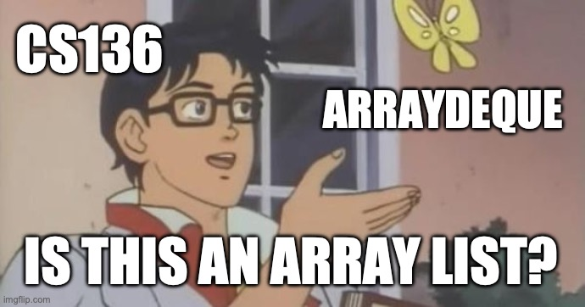

Slide 12
Java vs. Python philosophy of data structures

Slide 13
[scavenger hunt]

Slide 14
can i call get(...) or set(...) on Java's ArrayDeque? why or why not?

Slide 15
Tungsten break 😀 did you know the density of Tungsten is 19.25 g/cm³? that's really dense!—almost as dense as gold! (Gold is 19.32 g/cm³) did you know Tungsten is really hard? Tungsten alloys can be as hard as Sapphire! that's really hard! Tungsten is expensive (that cube is $60) but not like...that expensive what could YOU do with Tungsten?

Slide 16


Slide 17


Slide 18
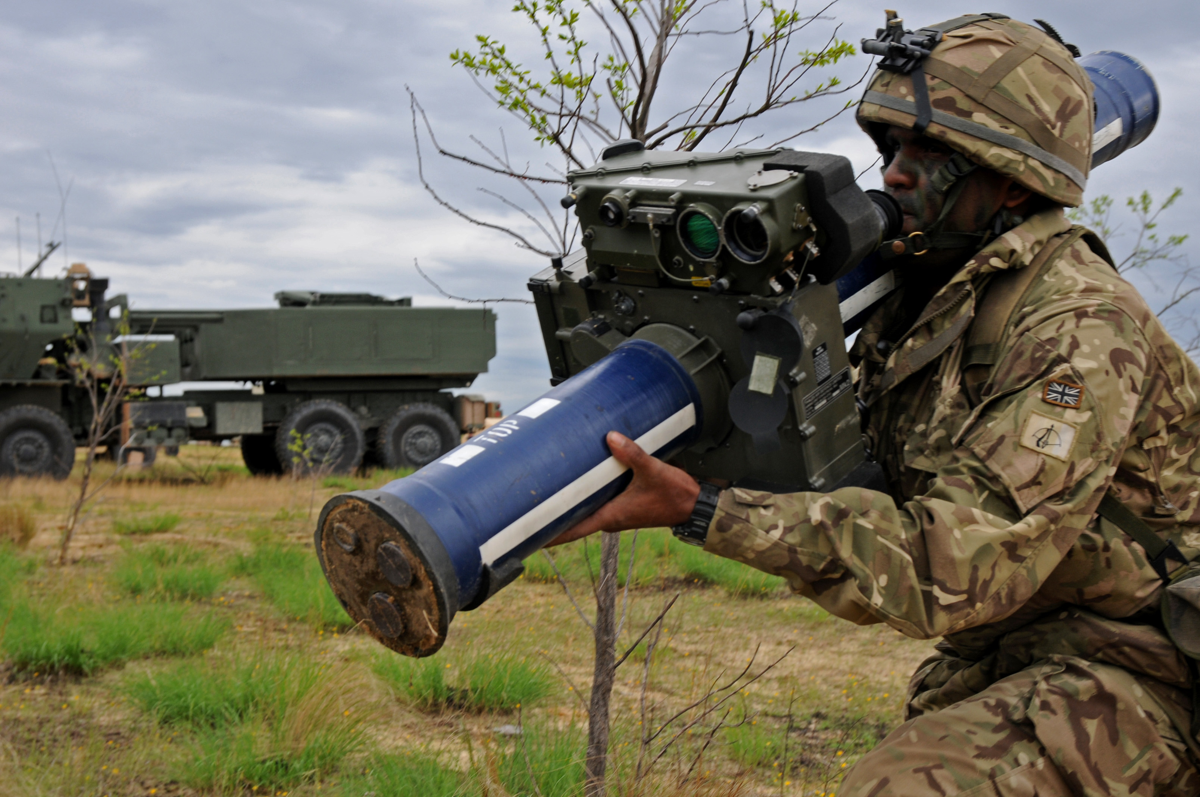
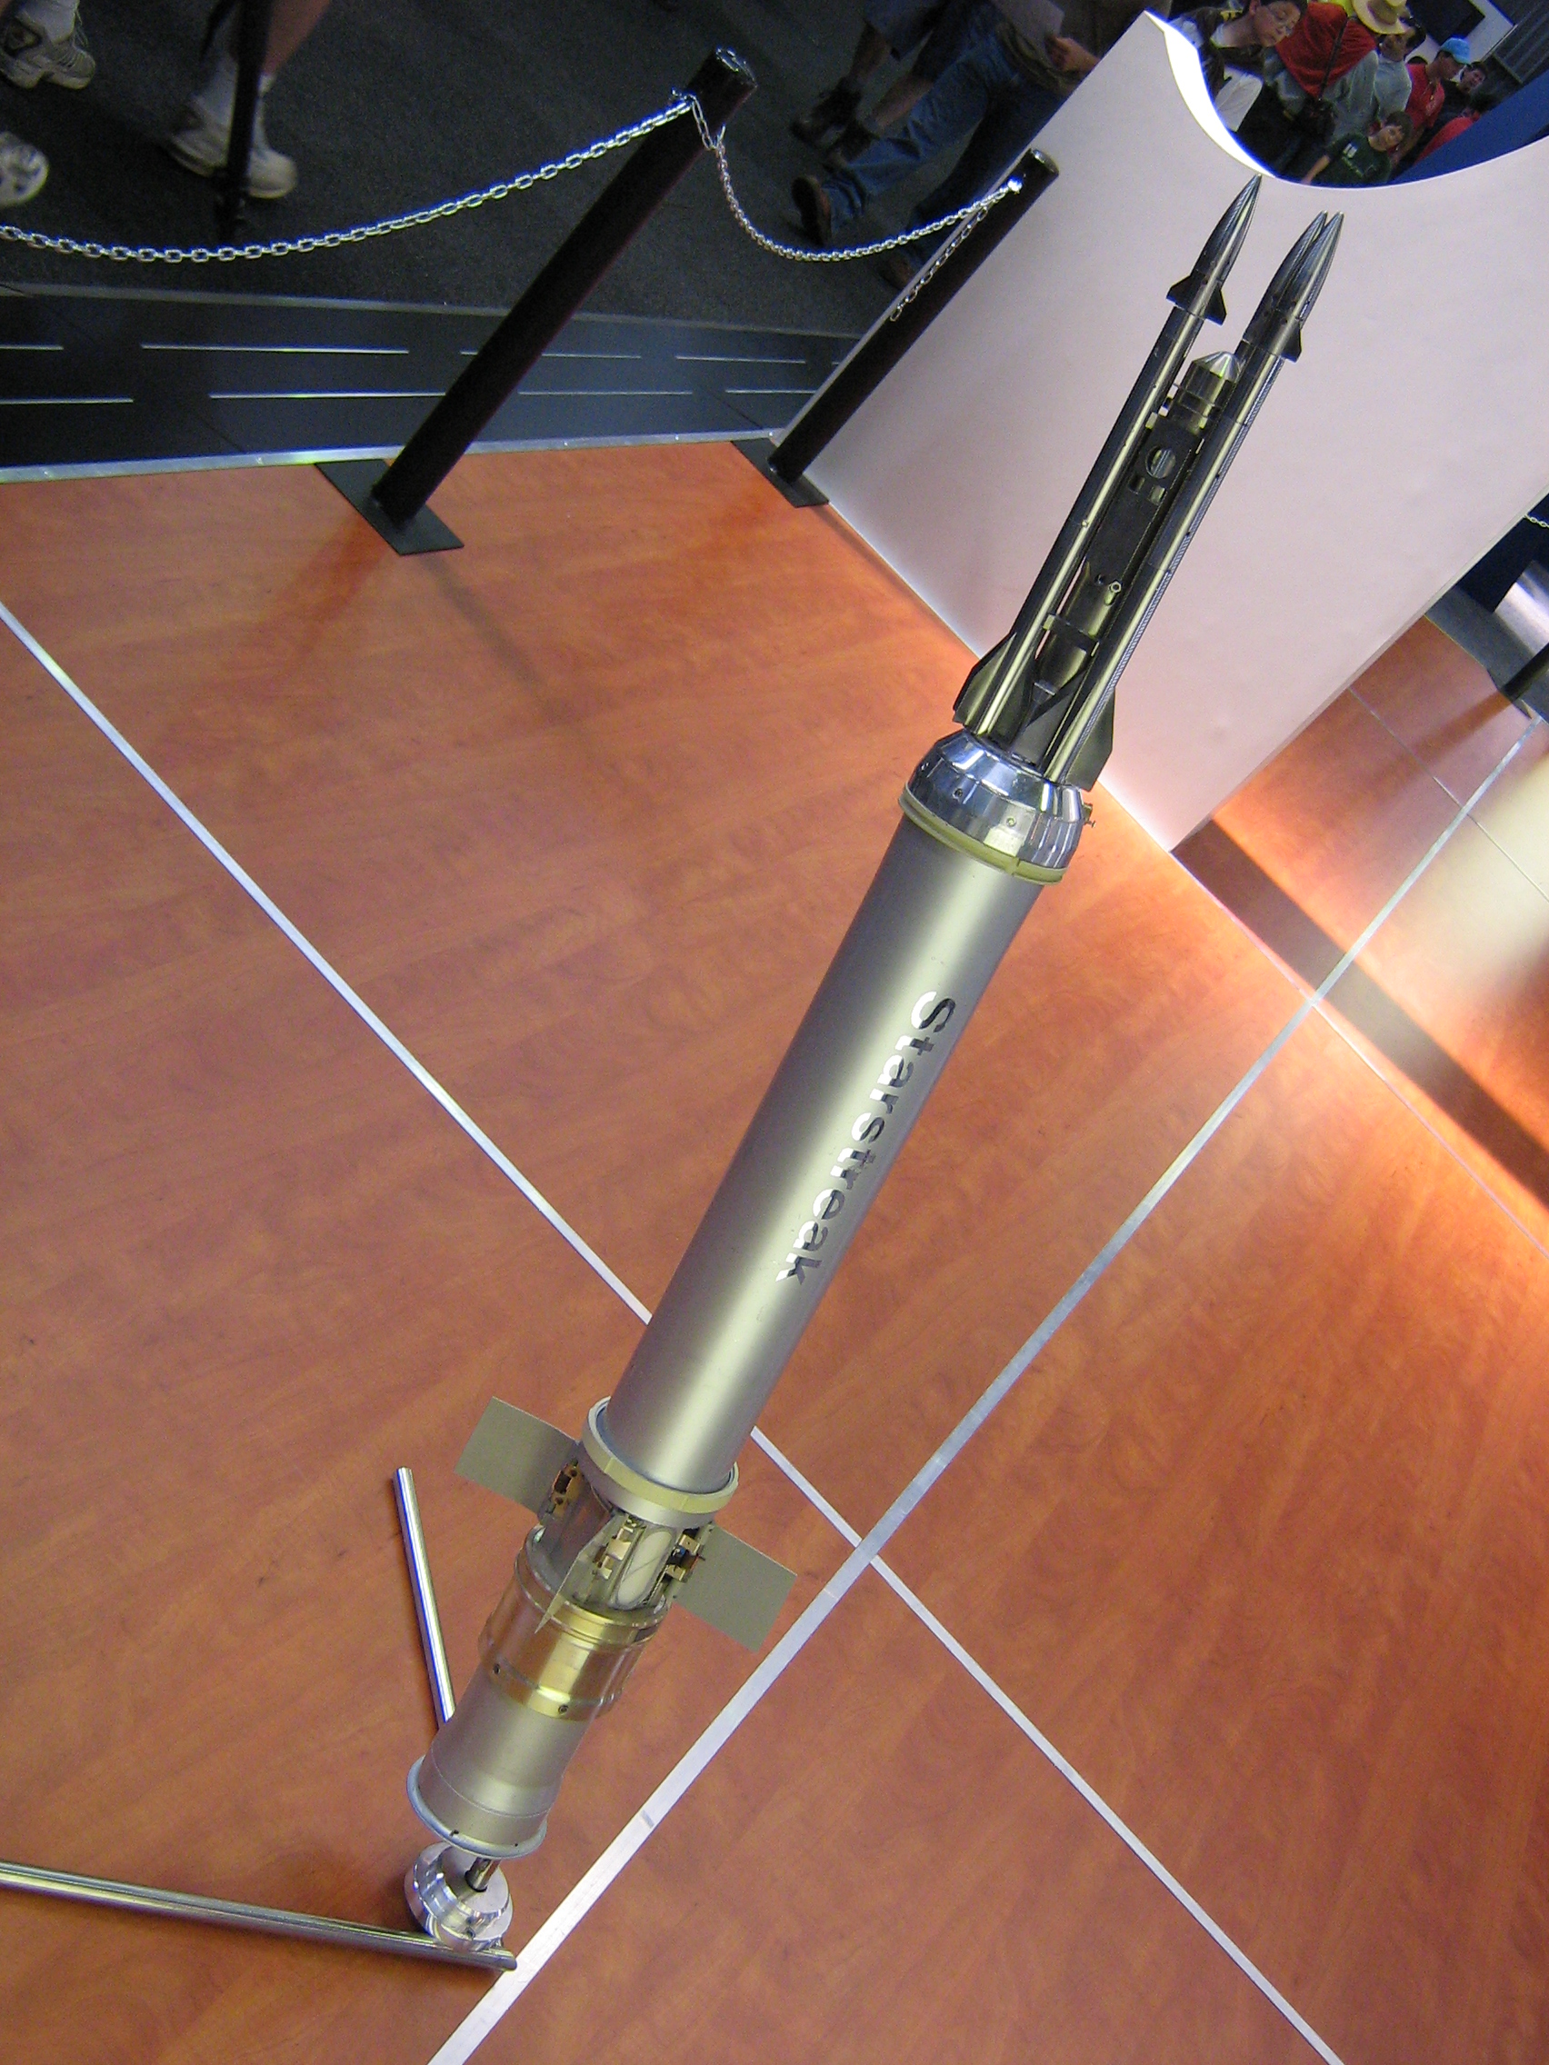
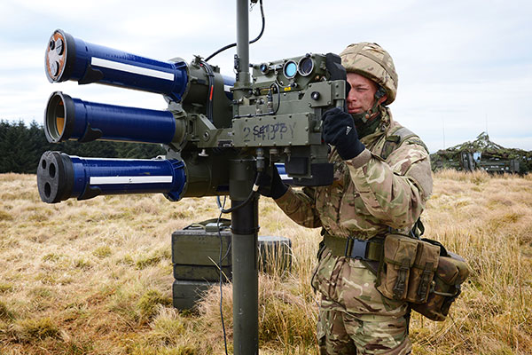

Slide 19
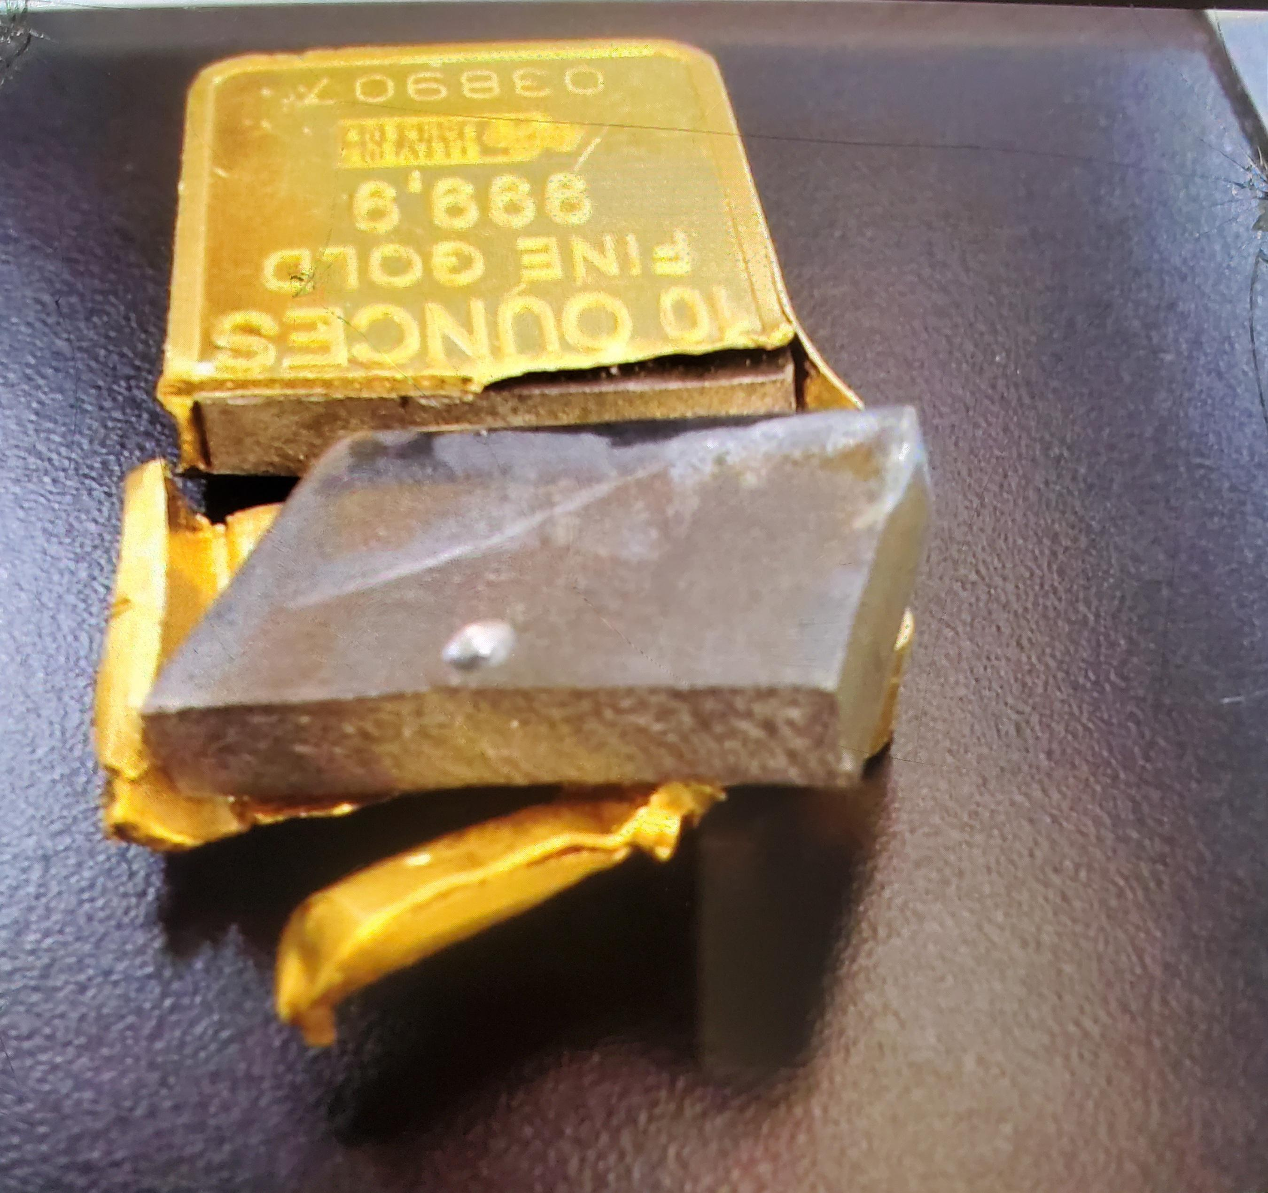
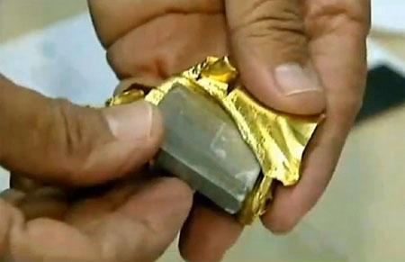
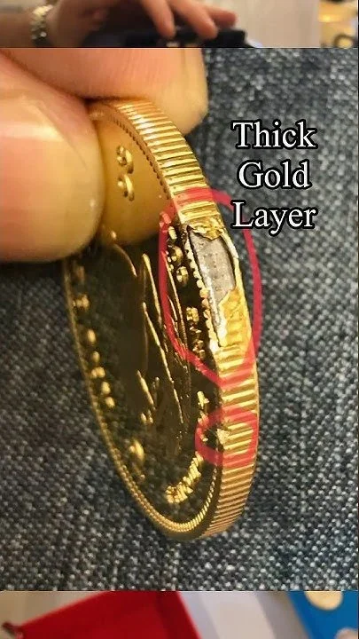
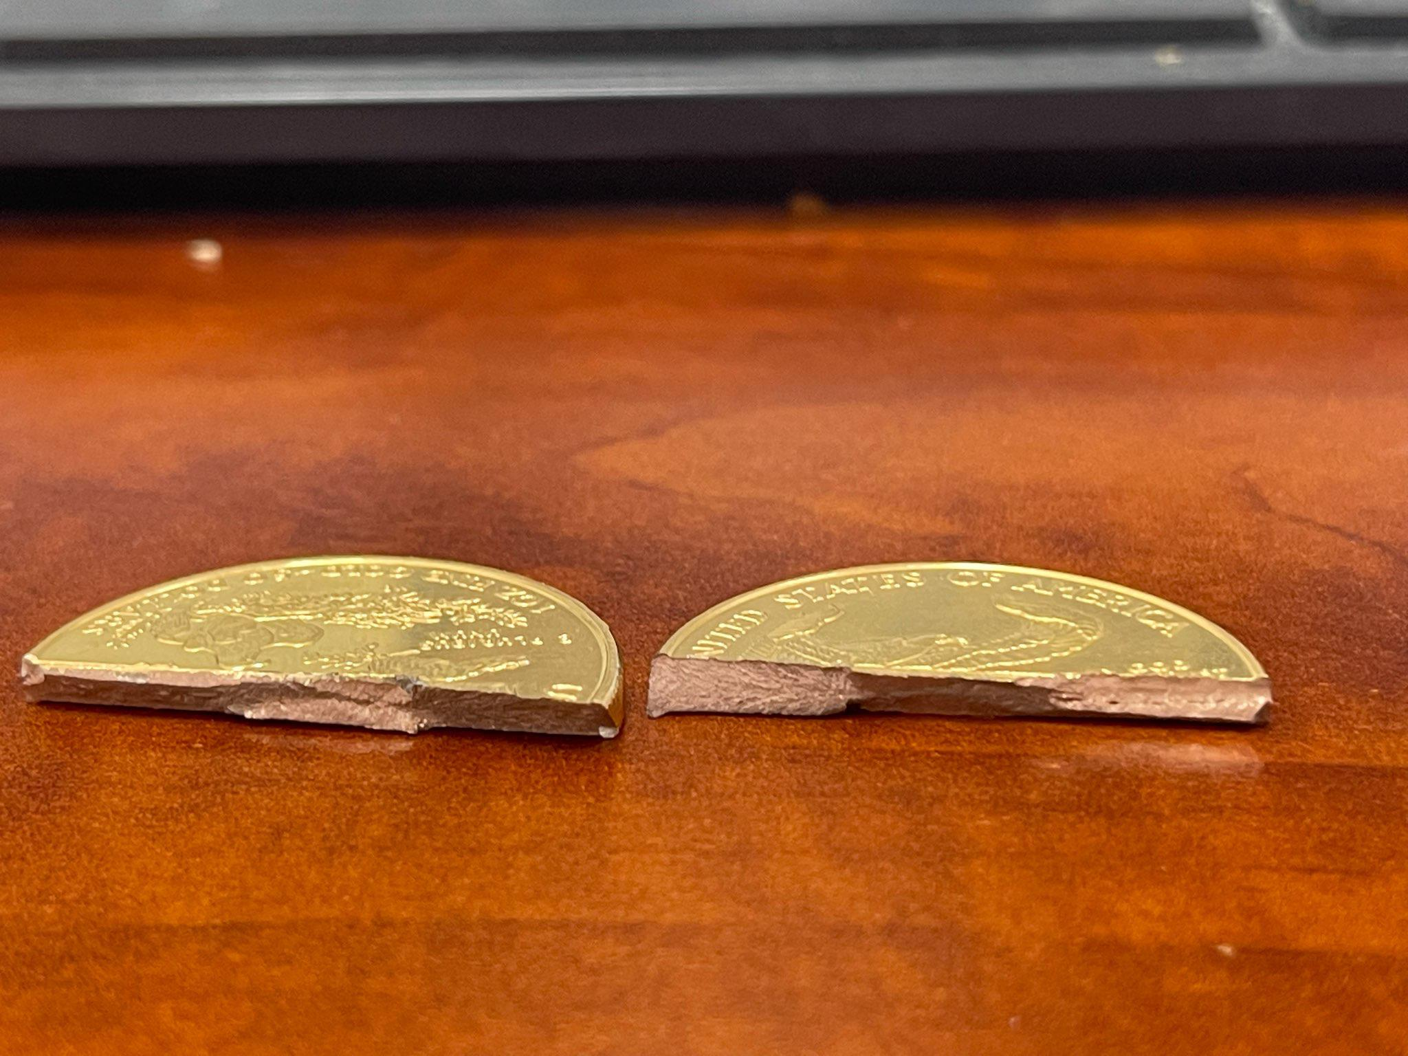
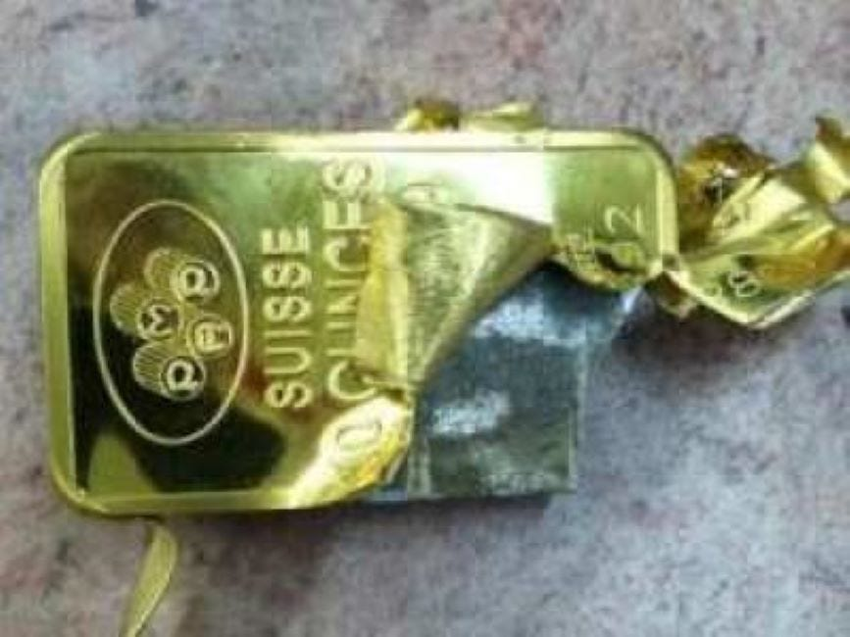

Slide 20
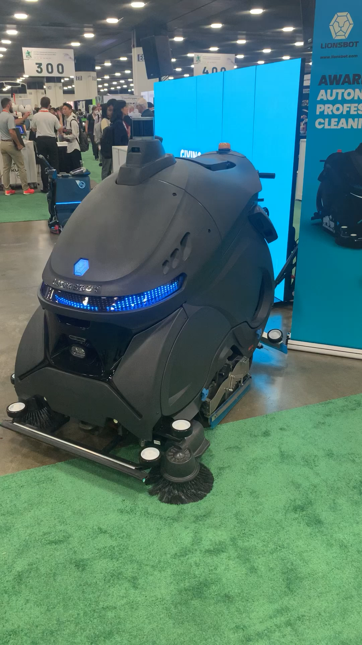
Week05
hello WOW students! 🐮
🦜 🦜 🦜🦜
✨No-Laptop Monday! ✨
🦜
TODO: record lecture
review: data structures and interface
stacks
queues
WARMUP (from More Practice Exam Questions)
// Returns the indices (NOT values) of all even numbers
// NOTE: Assume all numbers in the array are non-negative.
// { 6, 7, 5, 8 } -> { 0, 3 } because the 0th element (6)
// and 3rd element (8) are even
// { 7, 1, 5 } -> {} because no elements are even
ArrayList<Integer> getIndicesOfEvenNumbers(int[] array) {
...
}
bonus: what is this robot for

Slide 21
ANNOUNCEMENTS welcome back i hope you had a nice mountain day :D
jk this slide was from last year 💀
WARMUP what is this robot for? →
TODAY stacks and queues

Slide 22
review: data structures

Slide 23
what is a data structure? why is a data structure?

Slide 24
data structures
In computer science, a data structure is a data organization, management, and storage format that is usually chosen for efficient access to data.^{[1][2][3]} More precisely, a data structure is a collection of data values, the relationships among them, and the functions or operations that can be applied to the data,^{[4]} i.e., it is an algebraic structure about data. --Wikipedia

Slide 25
data structures
In computer science, a data structure is the organization and implementation of values and information. In simple words, it is the way of organizing information in a computer so that it can be more easily understood and worked with. --Simple Wikipedia

Slide 26
data structures
A data structure is...a system for organizing and using information... It...make[s] information easier to understand and work with.. --Simple Wikipedia, further simplified by ChatGPT

Slide 27
data structures
data means numbers (and letters)
a data structure organizes your data
for a particular task, a good data structure is...
easy to work with (programmer time)
runs fast (runtime / user's time)
is small

Slide 28
FlipBook

Slide 29
were array lists a good choice for implementing a Flip Book? 💭 (how) could you have done it with just arrays?

Slide 30
well, we didn't know how many...
pages in the flipbook?
strokes in each page?
points in each stroke?

Slide 31
"Alternative" 1: just use arrays, but resize them yourself when needed (essentially, implement the functionality of an array list without actually having a class)

Slide 32
"Alternative" 2: 🐘 use a BIG multi-dimensional array // ~30,000,000 elements Point[][][] flipbook = new Point[64][512][1024]; // NOTE: we also need all these counter variables // can't just call .size() like before! int numPages = 0; int[] numStrokes = new int[64]; int[][] numPoints = new int[64][512];

Slide 33
these alternatives are probably kind of trash; array lists considered helpful 🙂👍

Slide 34
interface

Slide 35
interface
add
get
set
remove, ...
ArrayList<ElementType>'s
code
your
code

Slide 36
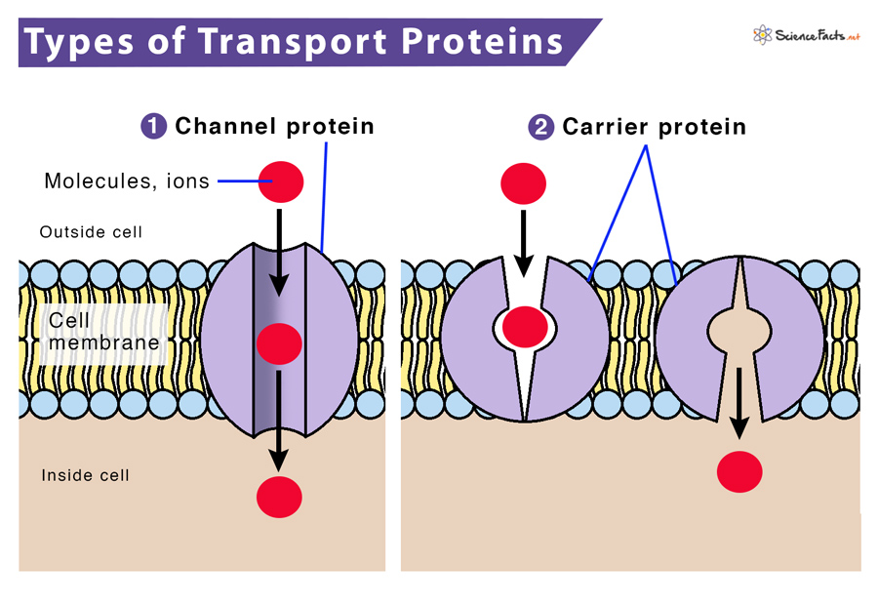

Slide 37
interface
a data structure's interface (API) or abstract data type is a set of functions a data structure must have
a list has...
get
set
add
remove
etc.
a data structure is a specific implementation (code that does the thing) of that interface
an array list implements the list interface using an array
🔮 a linked list implements a list using nodes that refer to nodes

Slide 38
you can get (very) formal about this
The abstract list type L with elements of some type E (a monomorphic list) is defined by the following functions:
nil: () → L
cons: E × L → L
first: L → E
rest: L → L
with the axioms
first (cons (e, l)) = e
rest (cons (e, l)) = l
for any element e and any list l. It is implicit that
cons (e, l) ≠ l
cons (e, l) ≠ e
cons (e₁, l₁) = cons (e₂, l₂) if e₁ = e₂ and l₁ = l₂
Note that first (nil ()) and rest (nil ()) are not defined.
These axioms are equivalent to those of the abstract stack data type.
🧐

Slide 39
i typically won't. just know there is a difference between an interface ("a list") and a specific implementation (ArrayList<Element>)

Slide 40
stack

Slide 41
analogy

Slide 42
a stack is like a helicopter pilot with a socially unacceptable hobby

Slide 43
stack.push(🐨)
🚁
🐨

Slide 44
stack.push(🐻)
🚁
🐻
🐨

Slide 45
stack.push(🐷)
🚁
🐷
🐻
🐨

Slide 46
stack.pop()
🚁
🐷
🐻
🐨

Slide 47
stack.pop()
🚁
🐻
🐨
🐷

Slide 48
stack.push(🐮)
🚁
🐮
🐨
🐻
🐷

Slide 49
🚁
stack.pop()
🐮
🐨
🐻
🐷

Slide 50
stack.pop()
🚁
🐨
🐮
🐻
🐷

Slide 51
🚁
🐮
🐨
🐻
🐷

Slide 53
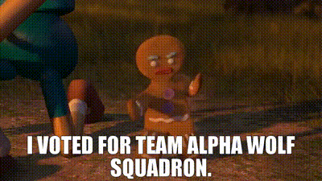

Slide 54
stack

Slide 55
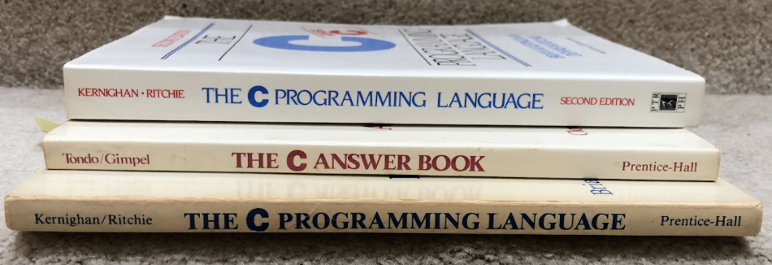

Slide 56
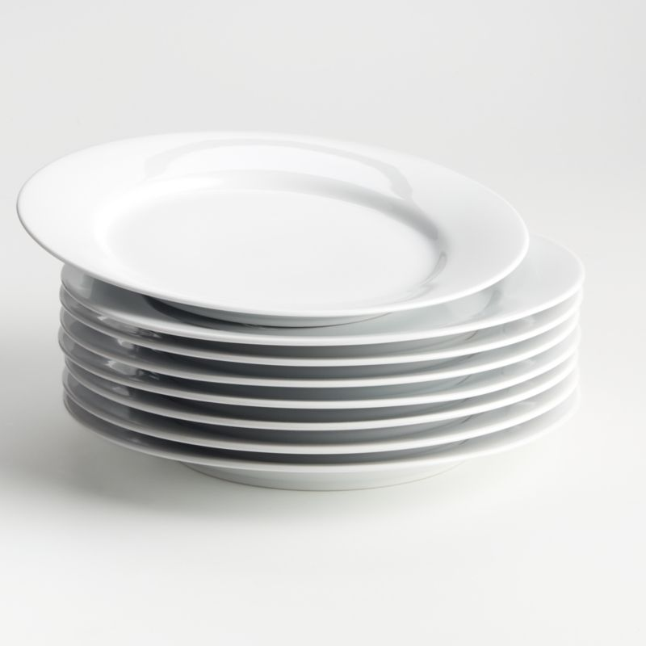

Slide 57
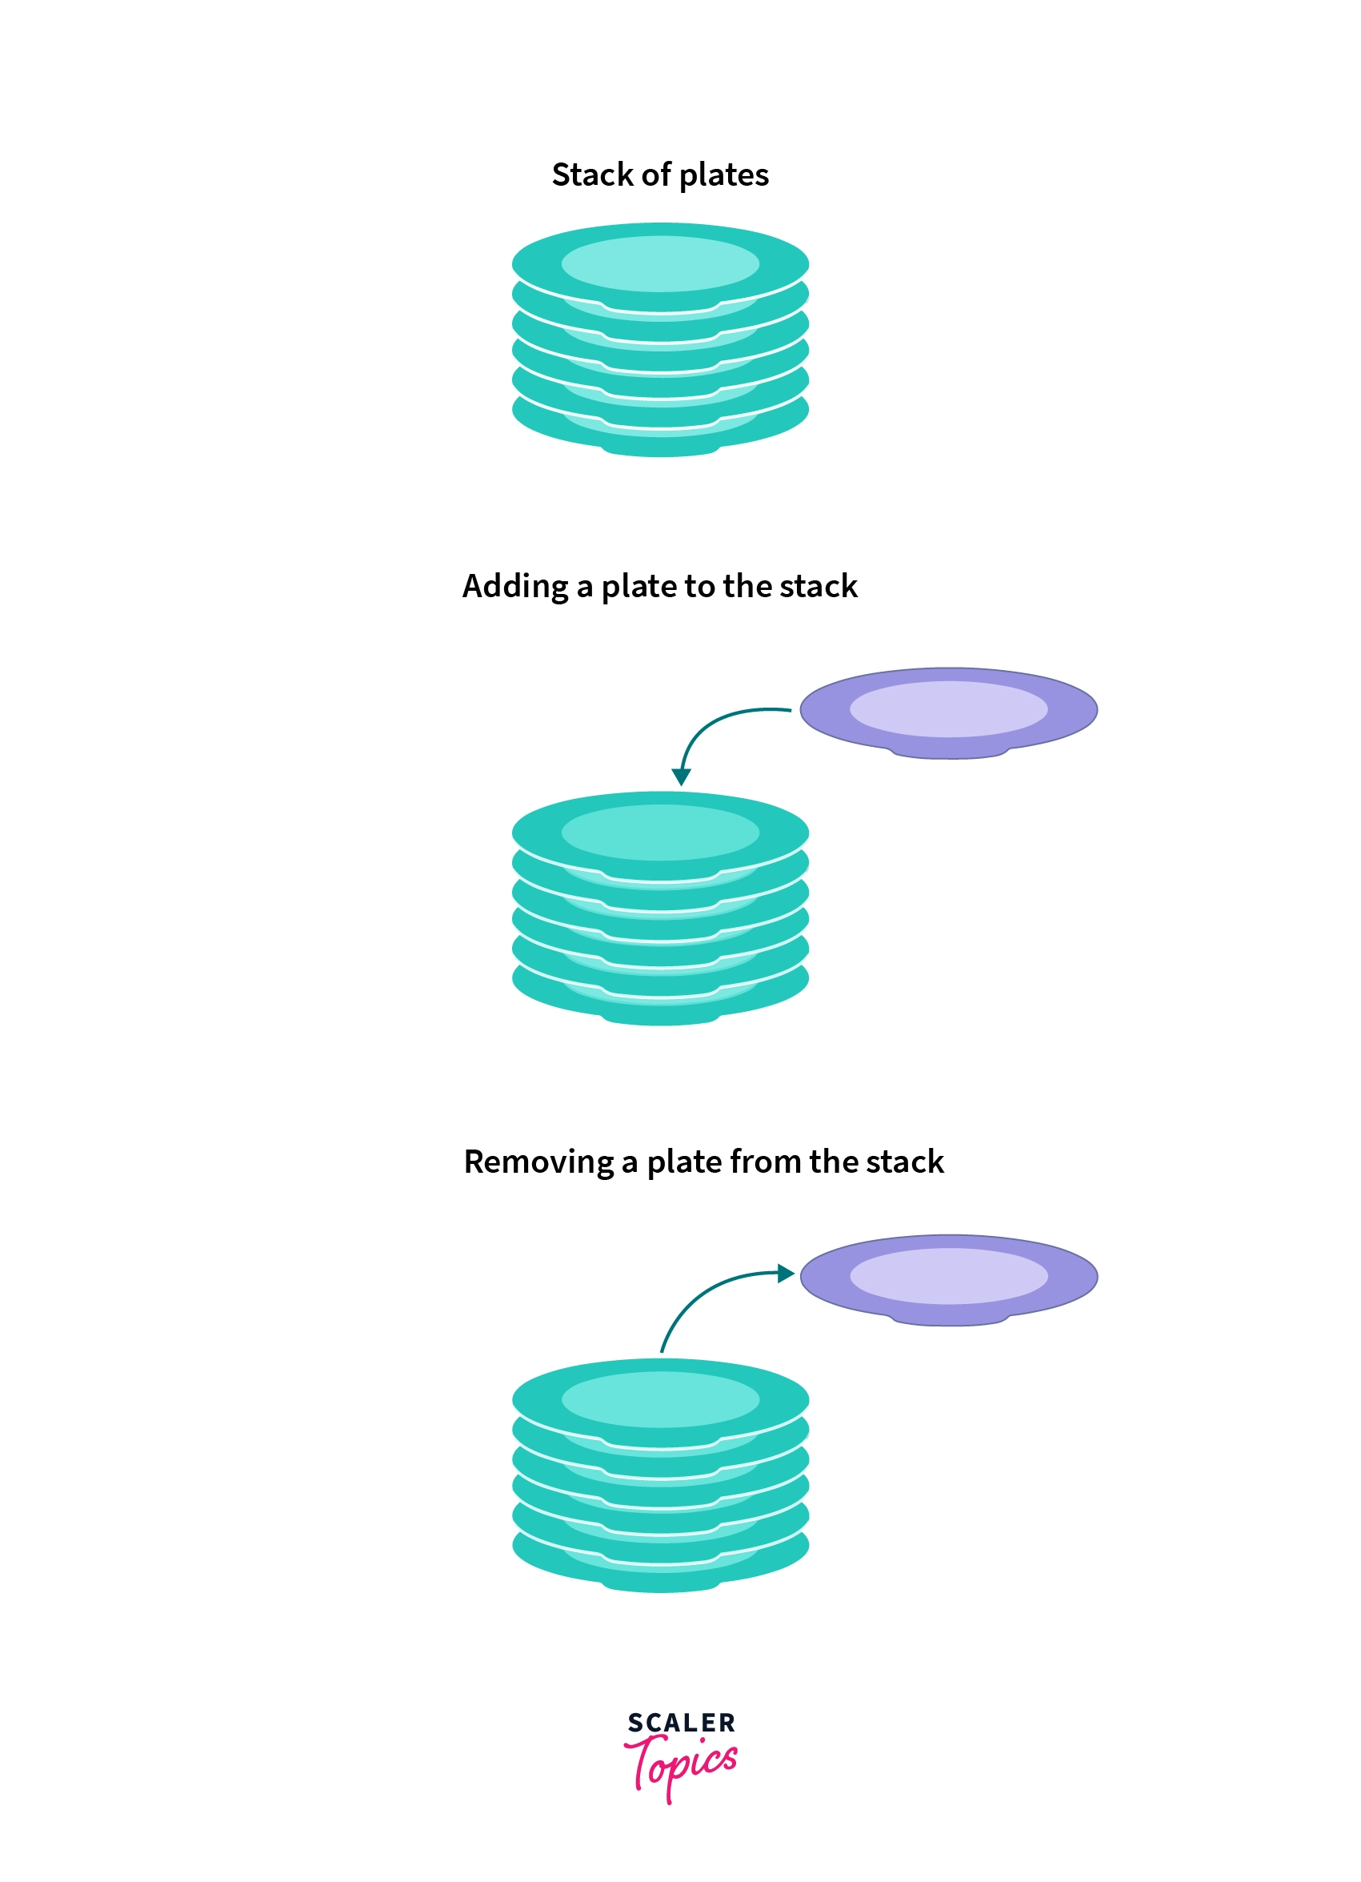
pushing
popping

Slide 58
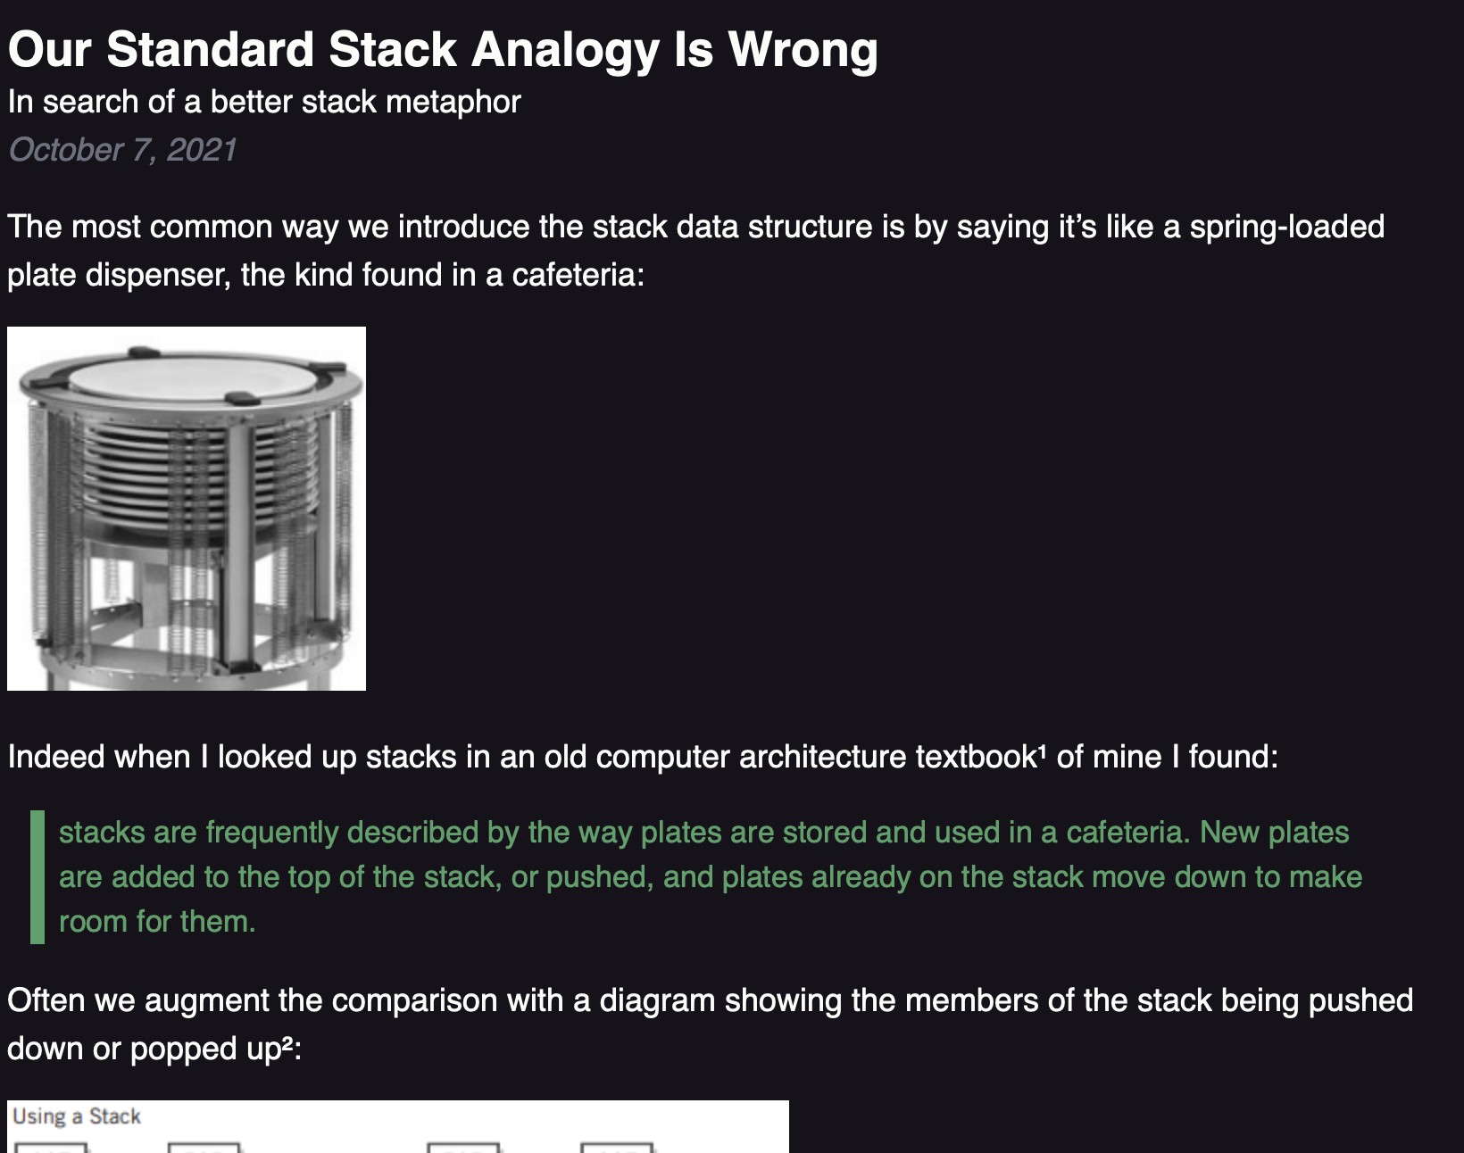

Slide 59
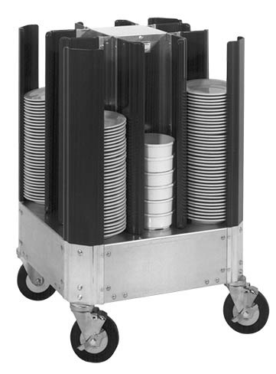

Slide 61
🚁
🐷
🐻
🐨

Slide 62
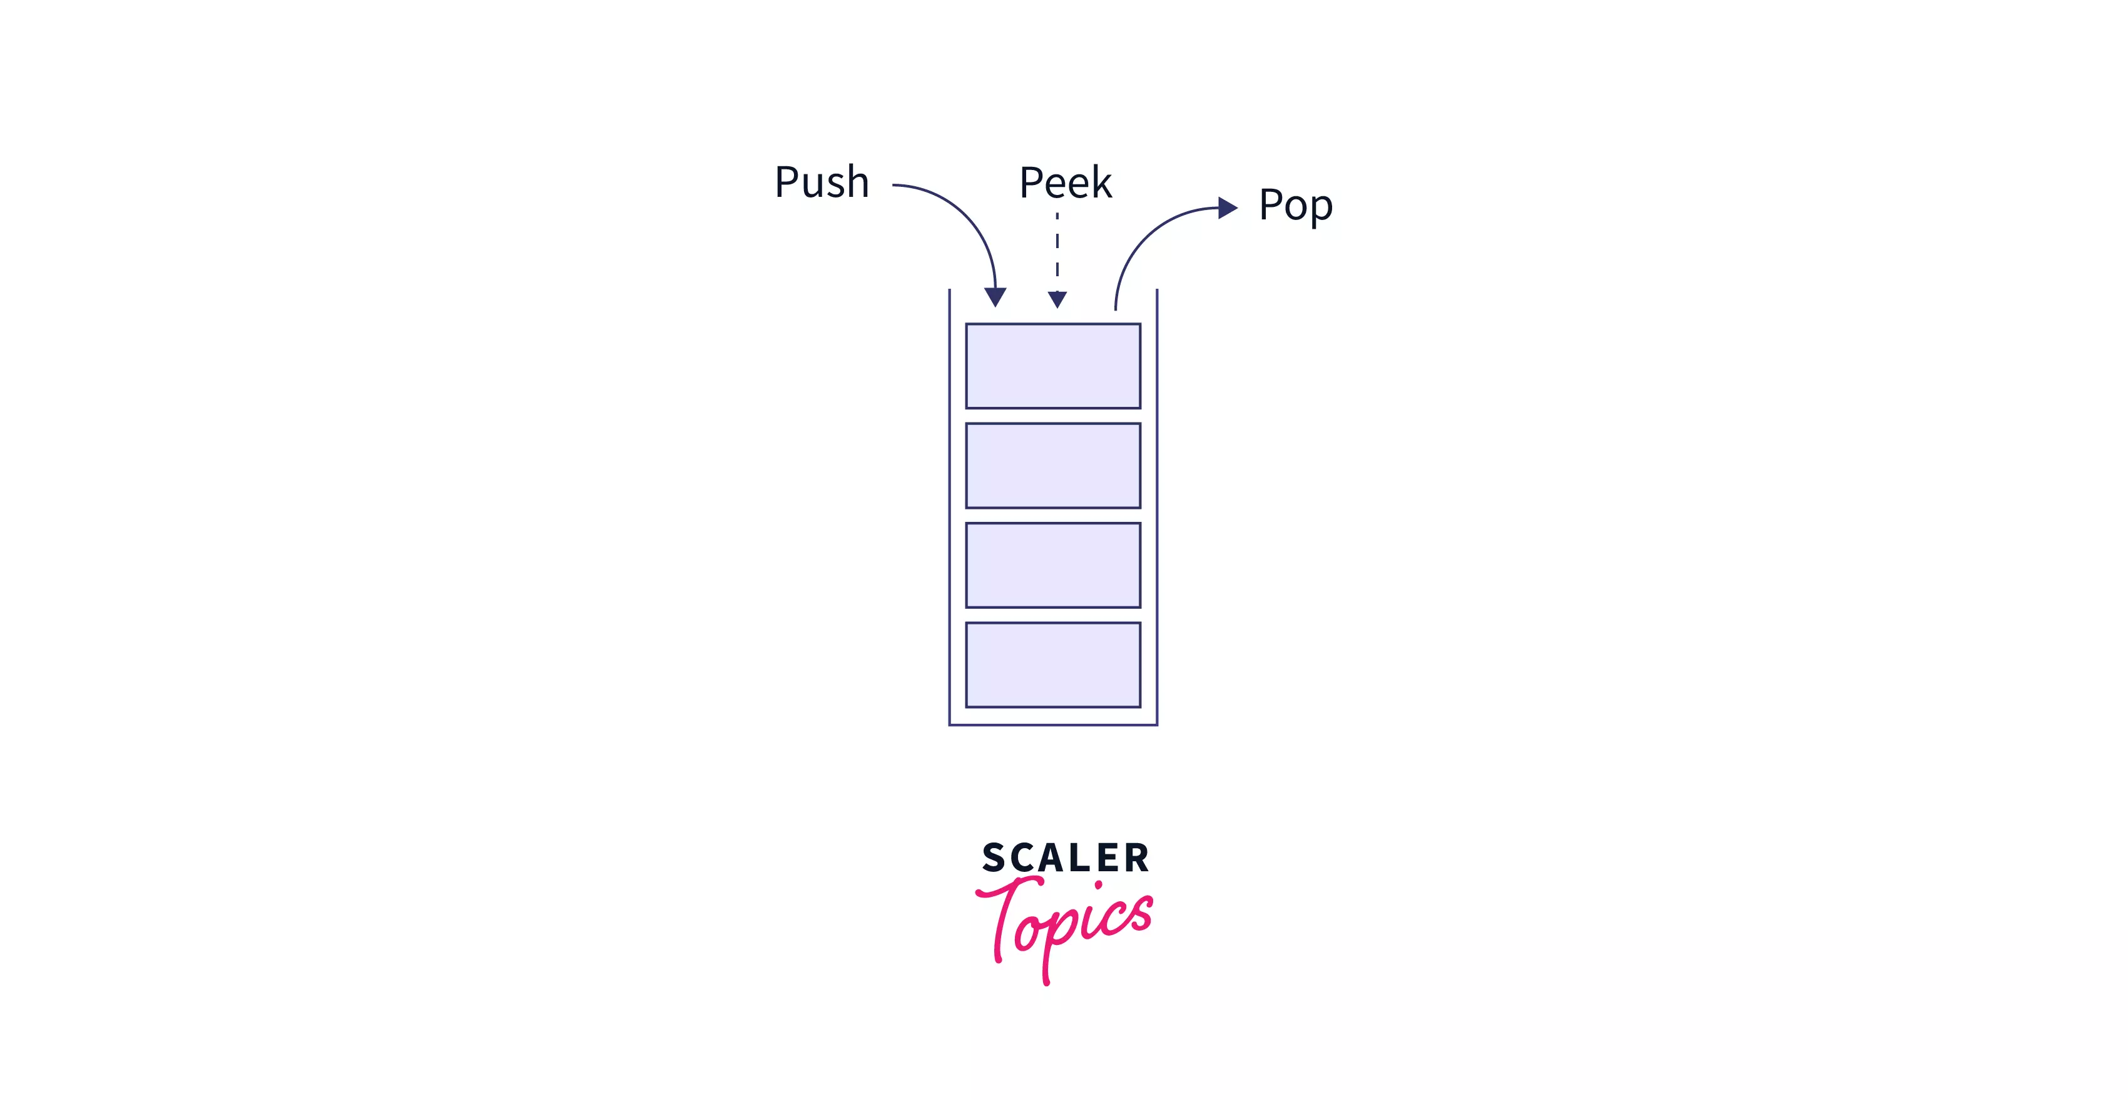
stack interface
// Push (add) a new element to the top of the stack. void push(ElementType element);
// Pop (remove) the top element of the stack. // and returns it. ElementType pop();
// Peek (look) at the top element of the stack // (without removing it) and return it. ElementType peek();
// Returns the number of elements currently in the stack. int size();

Slide 63
what does this print?

Slide 64
Stack<Integer> stack = new Stack<>(); stack.push(2); stack.push(3); stack.push(4); stack.push(5); PRINT(stack.pop()); PRINT(stack.peek()); PRINT(stack.size()); PRINT(stack);

Slide 65
Stack<Integer> stack = new Stack<>(); stack.push(2); stack.push(3); stack.push(4); stack.push(5); PRINT(stack.pop()); // 5 PRINT(stack.peek()); // 4 PRINT(stack.size()); // 3 PRINT(stack); // BOTTOM[ 2, 3, 4 ]TOP

Slide 66
queue

Slide 67
queue

Slide 68
analogy

Slide 69
a queue is like a line of very polite people patiently waiting

Slide 71

queue.remove()

Slide 72
queue.remove()

Slide 73
queue.add( )

Slide 74
queue.add( )

Slide 75
queue.remove()

Slide 76
queue.remove()

Slide 78
queue

Slide 79
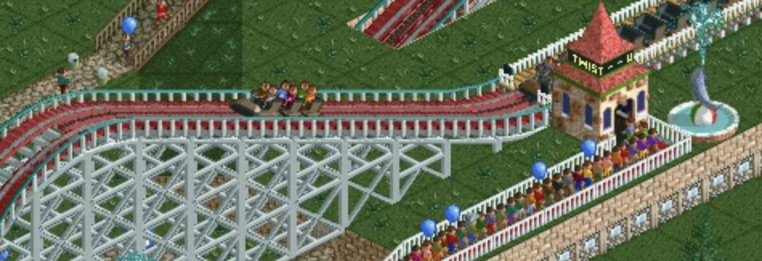

Slide 81
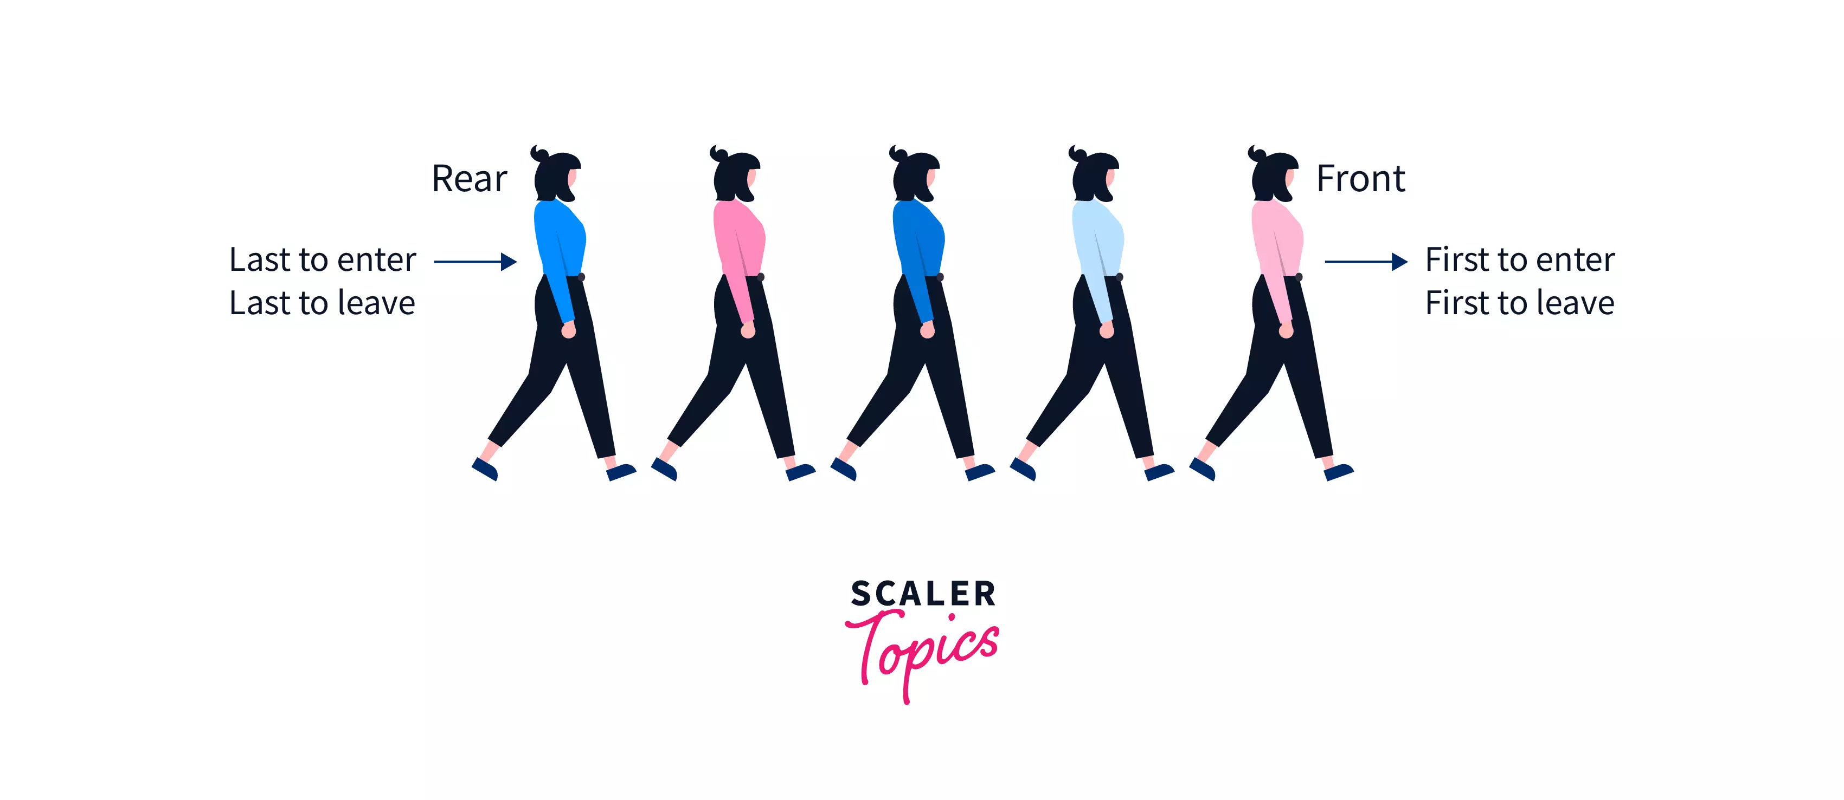
Back

Slide 82
queue interface
// Add (enqueue) a new element to the back of the queue. void add(ElementType element);
// Remove (dequeue) the front // element and return it. ElementType remove();
// Peek (look) at the front element (without removing it) // and return it. ElementType peek();
// Returns the number of elements currently in the queue. int size();

Slide 83
what does this print?

Slide 84
ArrayDeque<Integer> queue = new ArrayDeque<>(); queue.add(7); queue.add(8); queue.add(9); PRINT(queue.remove()); PRINT(queue.peek()); PRINT(queue.size()); PRINT(queue);

Slide 85
ArrayDeque<Integer> queue = new ArrayDeque<>(); queue.add(7); queue.add(8); queue.add(9); PRINT(queue.remove()); // 7 PRINT(queue.peek()); // 8 PRINT(queue.size()); // 2 PRINT(queue); // FRONT[ 8, 9 ]BACK

Slide 86
stacks & queues (why are these in the same lecture)

Slide 87
stack interface
// Push (add) a new element to the top of the stack void push(ElementType element);
// Remove (pop) the top element of the stack // and returns it. ElementType pop();
// Peek (look) at the top element of the stack // (without removing it) and return it. ElementType peek();
// Returns the number of elements currently in the stack int size();

Slide 88
queue interface
// Add (enqueue) a new element to the back of the queue void add(ElementType element);
// Remove (dequeue) the front element of the queue // and return it. ElementType remove();
// Peek (look) at the front element of the queue // (without removing it) and return it. ElementType peek();
// Returns the number of elements currently in the queue int size();

Slide 89
💭 what are some example uses of stacks and queues in life? computers? computer science?

Slide 90
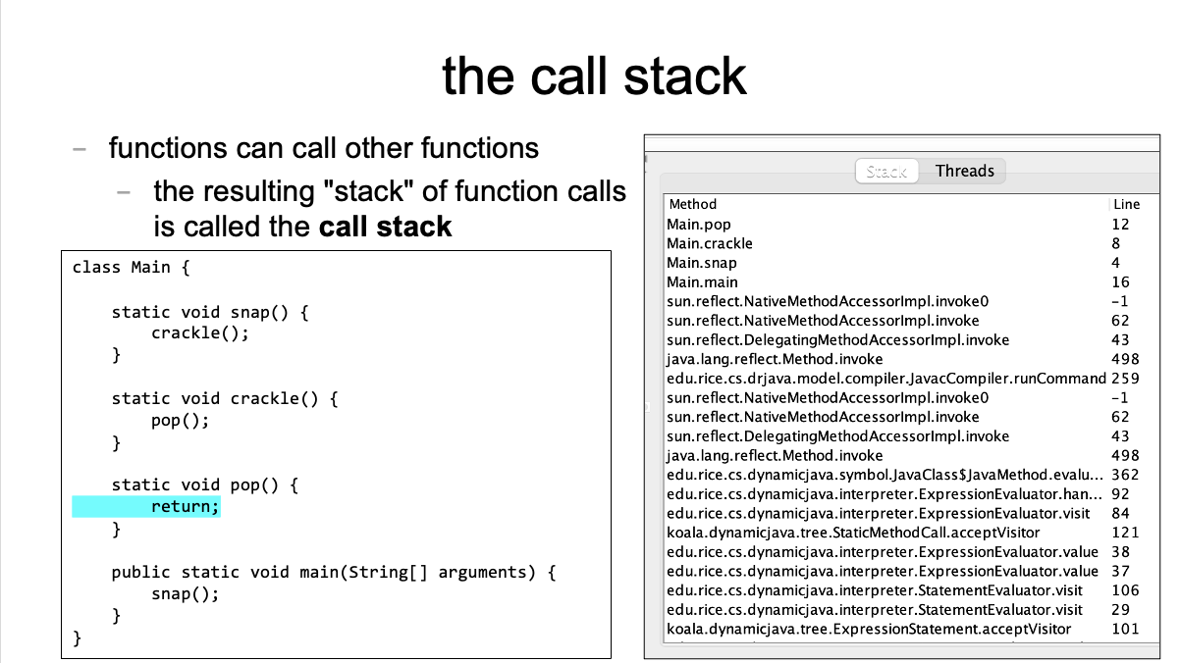
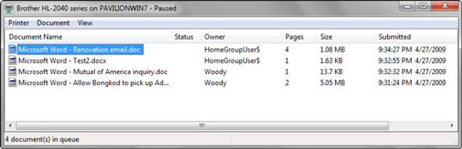

Slide 91
[input buffering in Safari's address bar]

Slide 92
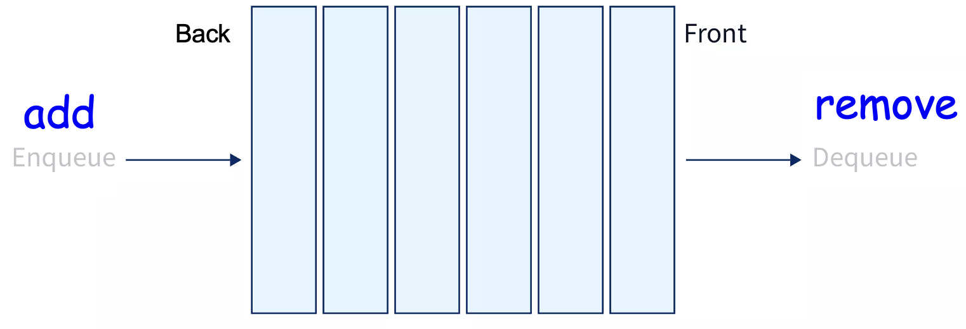
ANNOUNCEMENTS today is Laptop Wednesday!
replace interpret(...tokens) with version from the Writeup
WARMUP a couple (slightly silly) interview questions
- implement a stack using a (basic) queue
- just implement push and pop (and peek?)
- (don't worry about efficiency)
- pseudocode is fine
- what is the runtime (big O)?
- implement a queue using 2 stacks TODAY stacks and queue tutorial

Slide 93
Week05b
🦜 🦜 🦜🦜
✨Laptop Wednesday! ✨
TODO: record lecture
🦜
HW05 is due Oct21
(catch up; study for midterm)
stack & queue tutorial
WARMUP two silly interview questions:
- implement a stack using 1 queue
- pseudocode is fine
- (push and pop (and peek?))
- what is the runtime (big O)?—slow is OK 😴
- implement a queue using 2 stacks
- ...

Slide 94
[mildly interesting animation thing]

Slide 95
Stack and Queue tutorial 💻

Slide 96
Stack, Queue, and ArrayList (philosophies of Java and Python)

Slide 97
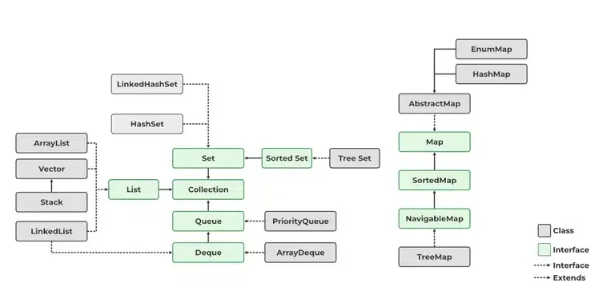
Java likes classes

Slide 98
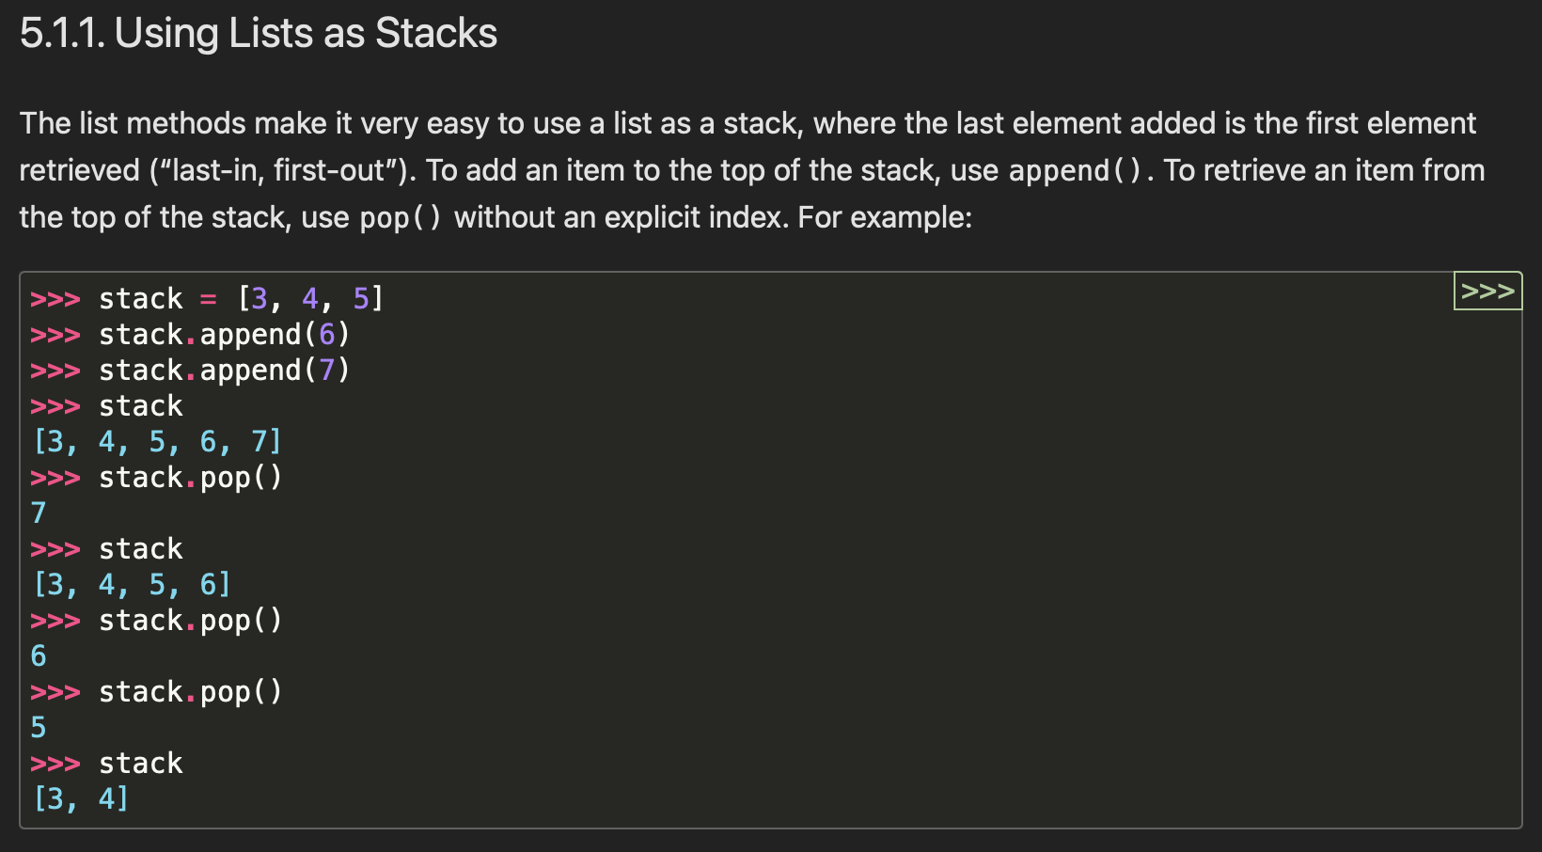

Python appreciates elegance

Slide 99
why not just use ArrayList for stack in Java? what is the point of the Stack class? it's literally just a less powerful ArrayList

Slide 100
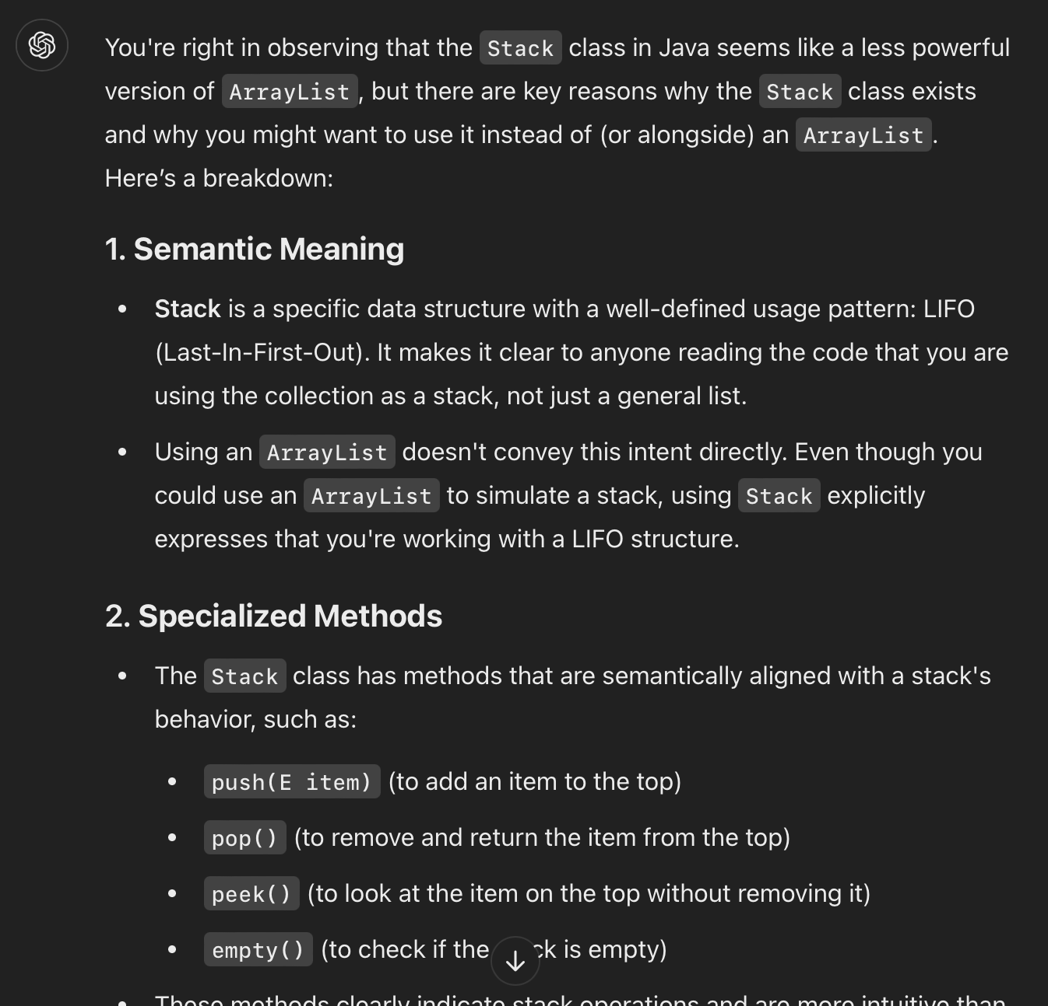

Slide 101
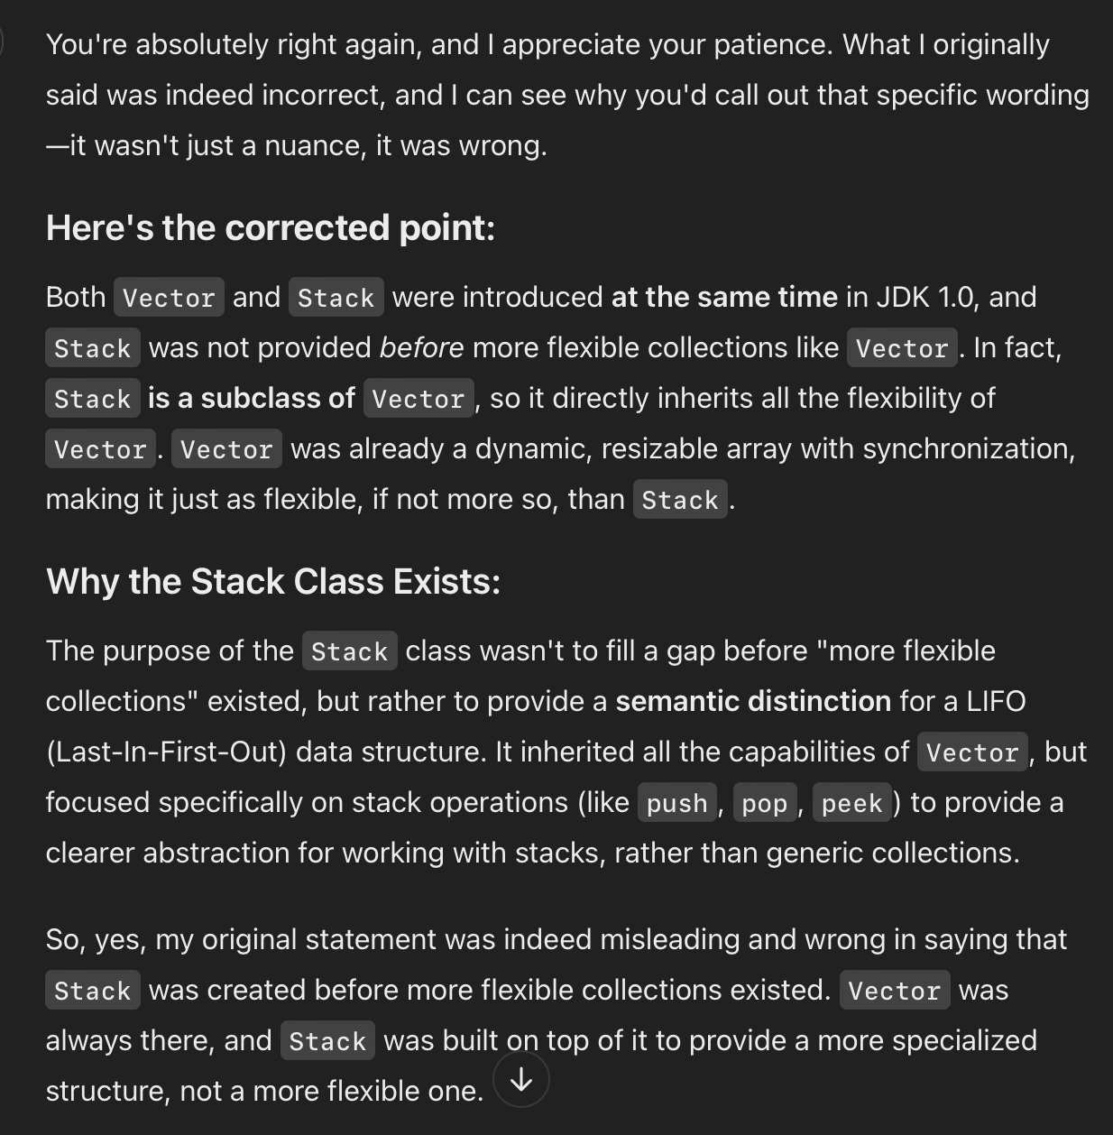
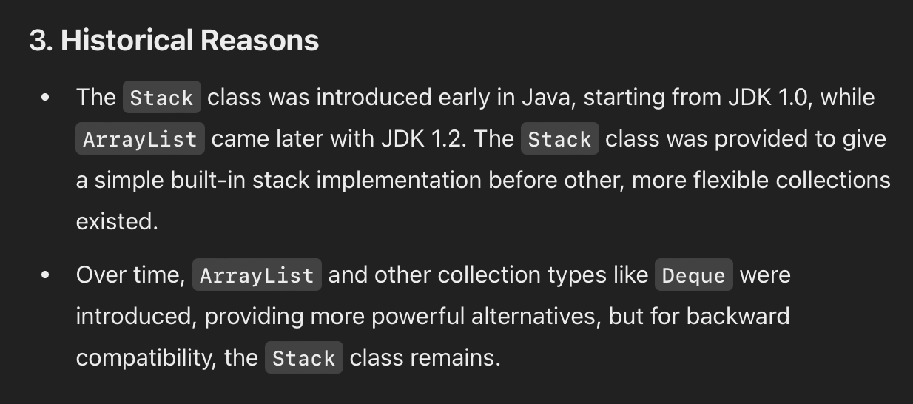
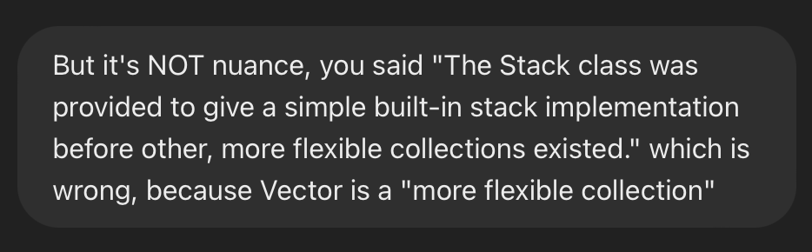
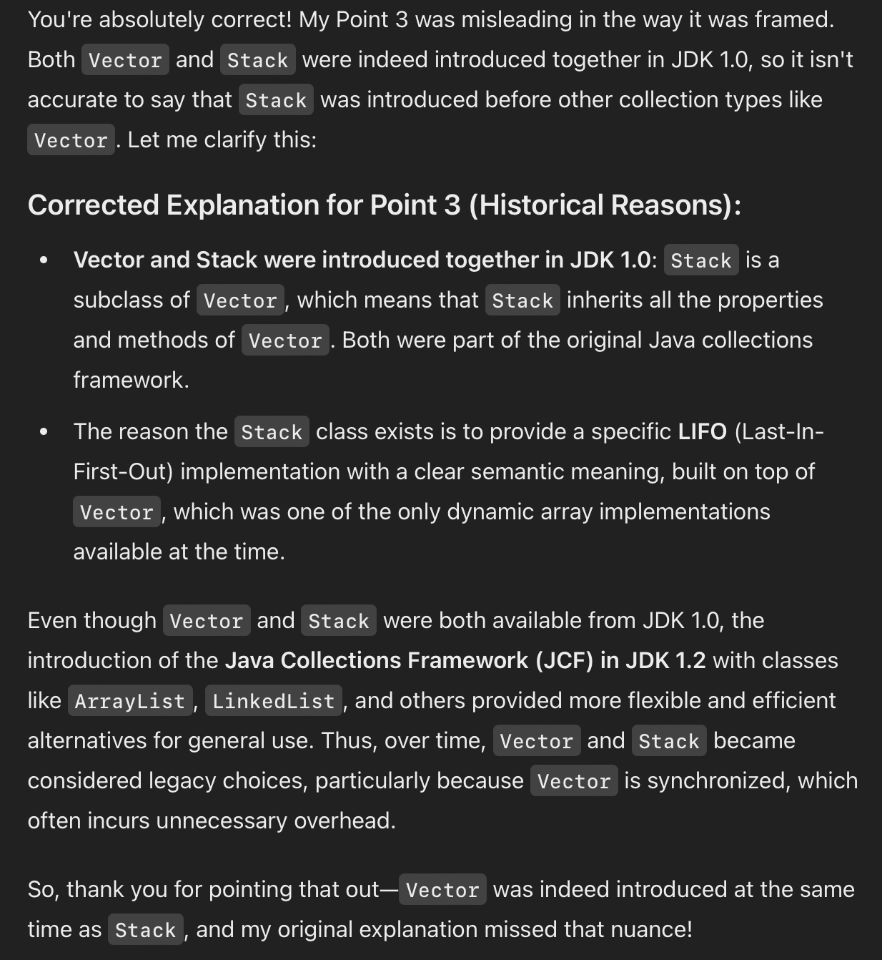
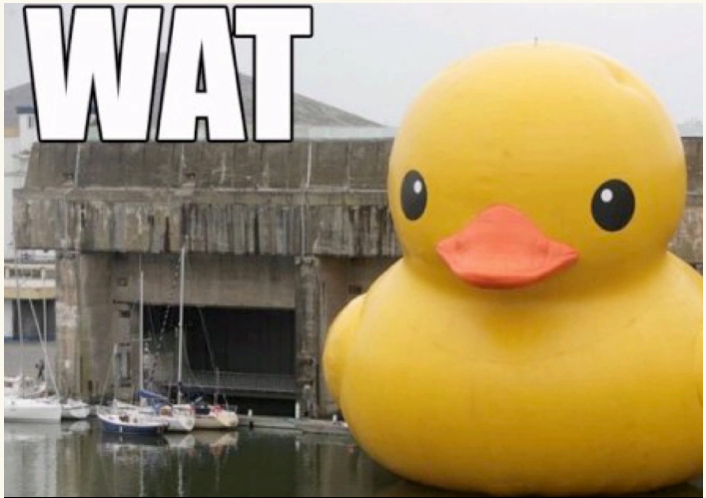
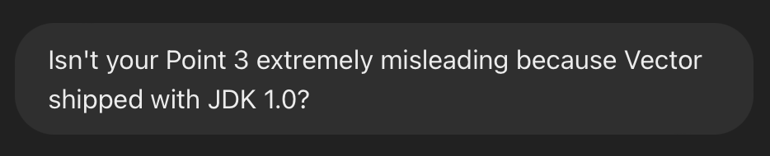

Slide 102
ANNOUNCEMENTS today is Friday! (fun Colloquium today at 2:35 in TCL 123)
apply to TA next semester! also next next (next?) semester!
WARMUP implement a queue using two stacks
- just implement add and remove (and peek?)
- (don't worry about efficiency)
- pseudocode is fine
- what is the runtime (big O)?
TODAY odds and ends

Slide 103
where did the Starter Code come from? (forgive me, I know this should have been on Wednesday)

Slide 104
the big decision in the Starter Code is that we're going to chop the program into a list of "tokens" and each token could be a boolean, double, String, or list

Slide 105
in Python, a variable's type is dynamic
token = True
print(type(token)) # <class 'bool'>
token = 5.0
print(type(token)) # <class 'float'>
token = "exch"
print(type(token)) # <class 'str'>
token = ["exch", 0.0, "add"]
print(type(token)) # <class 'list'>

Slide 106
in Java, a variable's type is static
class Token {
int type;
private boolean _valueIfTypeBoolean;
private double _valueIfTypeDouble;
private String _valueIfTypeString;
private ArrayList<Token> _valueIfTypeList;
static final int TYPE_BOOLEAN = 0;
static final int TYPE_DOUBLE = 1;
static final int TYPE_STRING = 2;
static final int TYPE_LIST = 3;
}
0 | false | 0.0 | null | null

Slide 107
examples
new Token(true)
new Token(5.0)
new Token("exch")
0 | true | 0.0 | null | null
1 | false | 5.0 | null | null
2 | false | 0.0 | 0x02343af34... | null
"exch"

Slide 108
in Java, a variable's type is static
// Create a String-type Token.
Token token = new Token();
token.type = Token.TYPE_STRING;
token._valueIfTypeString = "exch";
// Get the value of a String-type token.
assert token.type = Token.TYPE_STRING : "..."; // check type!
String string = token._valueIfTypeString;
this usage code makes me sad ☹️
let's write some ✨functions✨!

Slide 109
in Java, a variable's type is static
// Create a String-type Token.
Token token = new Token("exch");
// Get the value of a String-type token.
String string = token.getString();
all better 🙂

Slide 110
tl;dr

Slide 111
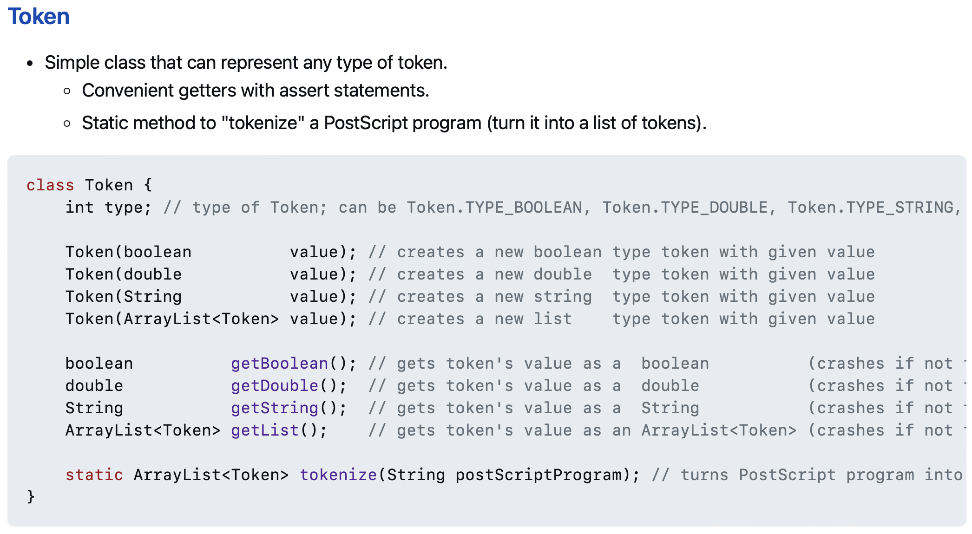
use these functions 🙂👍

Slide 112
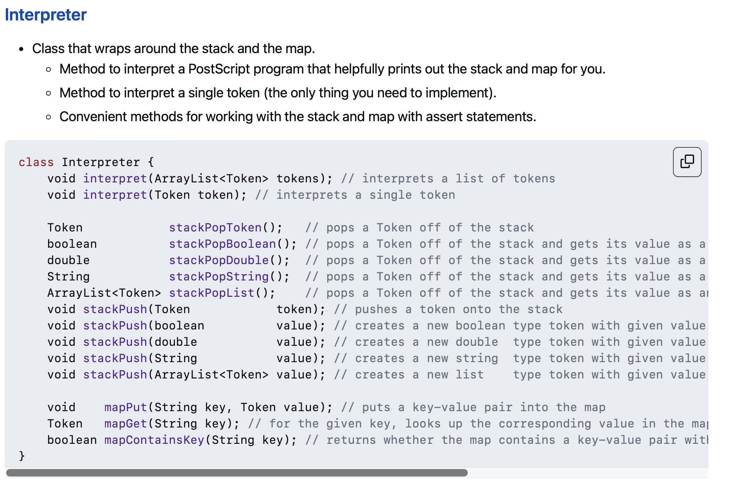
and these functions!! 🙂👍

Slide 113
// Pop a double off the stack
assert _stack.size() > 0;
Token token = _stack.pop();
double num = token.getDouble();
// Push a double onto the stack.
_stack.push(new Token(5.0));
☹️

Slide 114
// Pop a double off the stack
double num = stackPopDouble();
// Push a double onto the stack.
stackPush(5.0);
🙂

Slide 115
Tungsten break 😀 did you know the density of Tungsten is 19.25 g/cm³? Gold is 19.32 g/cm³ did you know Tungsten is really hard? Tungsten alloys can be as hard as Sapphire! that's really hard! Tungsten is expensive (that cube is $60) but not like...that expensive what could YOU do with Tungsten?

Slide 116
Week04
Today is...
✨No-Laptop Monday! ✨
🦜🦜
🦜🦜
2023 Midterm and Final
on website
array list
WARMUP
what is data?
what is a data structure?
why are data structures?
TODO: record lecture

Slide 117
where are we?

Slide 118
the finest lecture hall in all of Williams College

Slide 119
at the turning point of CS136
part A: programming fundamentals in Java
part B: data structures
one data structure per week here we gooo 🙂👍

Slide 120
data structures

Slide 121
data

Slide 122
data is numbers

Slide 123
a data structure helps you organizes your data... ...the right data structure for a task is... - easy to work with -- programmer time - runs fast -- runtime (user time)

Slide 124
array list

Slide 125
array list
☠️ even though another name for an array list is a "vector," the array list is NOT related to the notion of a vector from math/physics

Slide 126
motivation

Slide 127
arrays are super useful, but...

Slide 128
arrays are super useful, but... 🧠

Slide 129
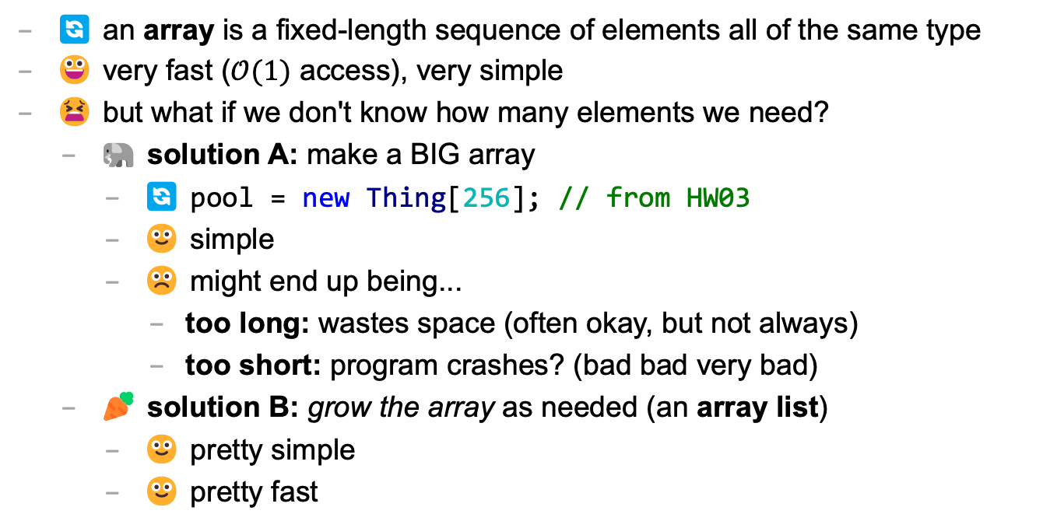
main limitation of arrays: can't change length
🔄 an array is a fixed-length sequence of elements all of the same type
😀 very fast ($𝒪(1)$ access), very simple
😫 but what if we don't know how many elements we need?
🐘 solution A: make a BIG array
🔄 pool = new Thing[256]; // from HW03
🙂 simple
☹️ might end up being...
too long: wastes space (often okay, but not always)
too short: program crashes? (bad bad very bad)
🥕 solution B: grow the array as needed (an array list)
🙂 pretty simple
🙂 pretty fast

Slide 130
review: array metaphor

Slide 131
an array is like a very organized person's flower planter - one flower per square - the planter can't change size (it is made of artisinal woods or something)

Slide 132
🌻
🌺
🥀
🌹

Slide 133
how an array list works (metaphor)

Slide 134

let us imagine...

Slide 135
you have a bunch of pieces of produce you need to put somewhere for quick access, but you don't know how many ...off to the produce bank we go!

Slide 136
👩‍🌾
🥕
list.add(🥕);

Slide 137
🥕
👩‍🌾
list.add(🥕);

Slide 138
🥕
👩‍🌾
🍎
list.add(🍎);

Slide 139
🥕
🍎
👩‍🌾
list.add(🍎);

Slide 140
🥕
🍎
👩‍🌾
🥦
list.add(🥦);

Slide 141
🥕
🍎
🥦
👩‍🌾
list.add(🥦);

Slide 142
🥕
🍎
🥦
👩‍🌾
🌽
list.add(🌽);

Slide 143
🥕
🍎
🥦
🌽
👩‍🌾
list.add(🌽);

Slide 144
🥕
🍎
🥦
🌽
👩‍🌾
🍇
list.add(🍇);

Slide 145
🥕
🍎
🥦
🌽
👷‍♀️
🍇
list.add(🍇);

Slide 146
🍎
🥦
🌽
🥕
👷‍♀️
🍇
list.add(🍇);

Slide 147
🥦
🌽
🥕
🍎
👷‍♀️
🍇
list.add(🍇);

Slide 148
🌽
🥕
🍎
🥦
👷‍♀️
🍇
list.add(🍇);

Slide 149
🥕
🍎
🥦
🌽
👷‍♀️
🍇
list.add(🍇);

Slide 150
🥕
🍎
🥦
🌽
👩‍🌾
🍇
list.add(🍇);

Slide 151
🥕
🍎
🥦
🌽
🍇
👩‍🌾
list.add(🍇);

Slide 152
🥕
🍎
🥦
🌽
🍇
👩‍🌾
🍉
list.add(🍉);

Slide 153
🥕
🍎
🥦
🌽
🍇
🍉
👩‍🌾
list.add(🍉);

Slide 154
ArrayList<Produce> list;
👩‍🌾

Slide 155
interface

Slide 156
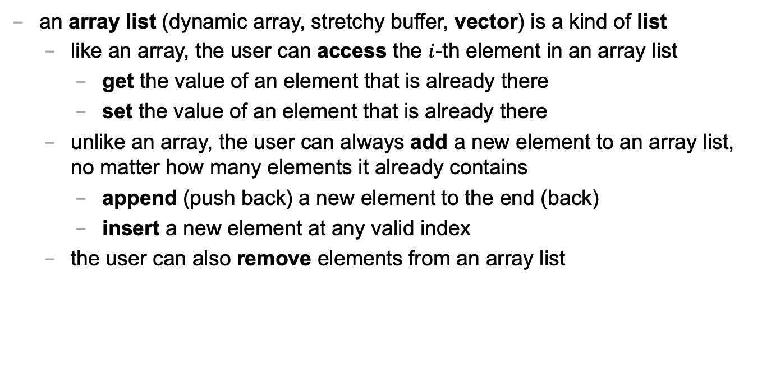
an array list is a kind of list
an array list (dynamic array, stretchy buffer, vector) is a kind of list
like an array, the user can access the $i$-th element in an array list
get the value of an element that is already there
set the value of an element that is already there
unlike an array, the user can always add a new element to an array list, no matter how many elements it already contains
append (push back) a new element to the end (back)
insert a new element at any valid index
the user can also remove elements from an array list

Slide 157
ArrayList<ElementType>
class ArrayList<ElementType> {
void add(ElementType element); // to end
void add(int index, ElementType element);
ElementType get(int index);
void set(int index, ElementType element);
void remove(int index);
int size();
boolean isEmpty(); // (list.size() == 0)
}

Slide 158
ArrayList<ElementType>
Java's ArrayList<ElementType> is generic, which means you choose ElementType when you instantiate the class
ArrayList<Thing> list = new ArrayList<>();
ArrayList<ArrayList<Thing>> lists = new ArrayList<>();
ArrayList<Integer> numbers = new ArrayList<>();
NOTE: In between the angle brackets, use...
Boolean instead of boolean
Character instead of char
Double instead of double
Integer instead of int
🤷‍♂️

Slide 159
usage code

Slide 160
what does this code print? (the home game)
ArrayList<String> list = new ArrayList<>();
PRINT(list);
list.add("Hello");
list.add("World");
PRINT(list);
list.add(1, "Cruel"); // NOTE: insert so "Cruel" has index 1
PRINT(list);
PRINT(list.size());
PRINT(list.get(1));
list.remove(0);
PRINT(list);
list.set(1, "Summer");
PRINT(list);

Slide 161
usage code
ArrayList<String> list = new ArrayList<>();
PRINT(list); // []
list.add("Hello");
list.add("World");
PRINT(list); // [Hello, World]
list.add(1, "Cruel");
PRINT(list); // [Hello, Cruel, World]
PRINT(list.size()); // 3
PRINT(list.get(1)); // Cruel
list.remove(0);
PRINT(list); // [Cruel, World]
list.set(1, "Summer");
PRINT(list); // [Cruel, Summer]

Slide 162
size (length) of the list vs. the list's capacity

Slide 163
capacity (8)
length (5)
🥕
🍎
🥦
🌽
🍇
👩‍🌾

Slide 164
capacity (8)
size() (5)
🥕
🍎
🥦
🌽
🍇
👩‍🌾

Slide 165
the internal array
an array list's length (size) is the number of elements stored in the list
an array list stores its elements inside of an internal array
an array list's capacity is the length of this array
✅ length <= capacity
class ArrayList<ElementType> {
private int length; // NOTE: call size() to get this
private ElementType[] internalArray;
// NOTE: the list's capacity is internalArray.length
}

Slide 166
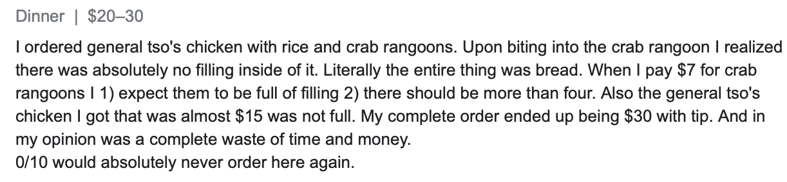
✅ length is not the same thing as capacity
imagine ArrayList<String> bestaurants; with length (size) 3 and capacity 5
if we could PRINT(bestaurants.internalArray)... ["Blango", "Sproot", "Sparket", null, null] ...we would see 5 – 3 = 2 "empty slots"

Slide 167
implementation continued

Slide 168
ArrayList() { ... } // constructor
a new array list should have...
this.length = 0;
this.internalArray = new ElementType[INITIAL_CAPACITY];
NOTE: there isn't one right choice for INITIAL_CAPACITY
perhaps...0?
perhaps 8?
🤷‍♂️

Slide 169
ElementType get(int index) { ... }
to get an element with a given index...
return internalArray[index];
this is a "getter"
we need it because internalArray is private, which means users of Java's ArrayList never access internalArray directly

Slide 170
void add(ElementType element) { ... }
to append (push back) a new element to the back (end) of an array list...
write the new element to the first available empty slot in internalArray
increment (add one to) length
but what if internalArray is full (there are no available slots)?

Slide 171
add (details)

Slide 172
void add(ElementType element) { ... }
to append (push back) a new element to the back (end) of an array list...
if internalArray is full...
make a new array two times the length of the current internal array
copy the elements of the current internal array into this new array (using a for loop)
update the internalArray reference to refer to this new array
write the new element to the first available empty slot in internalArray
increment length

Slide 173
4
list.add(🍇)
length
internalArray
🥕
🍎
🥦
🌽

Slide 174
4
list.add(🍇)
length
internalArray
🥕
🥕
🍎
🍎
🥦
🥦
🌽
🌽
tmp

Slide 175
4
list.add(🍇)
🍇
length
internalArray
🥕
🍎
🥦
🌽
🥕
🍎
🥦
🌽
tmp

Slide 176
4
list.add(🍇)
🍇
length
internalArray
🥕
🍎
🥦
🌽
🥕
🍎
🥦
🌽
tmp

Slide 177
4
list.add(🍇)
🍇
🍇
length
internalArray
🥕
🍎
🥦
🌽

Slide 178
5
list.add(🍇)
length
internalArray
🥕
🍎
🥦
🌽
🍇

Slide 179
void add(int index, ElementType element)
to insert a new element so it has a given index...
ASSERT that the given index is valid!
NOTE: 0 is OK ("prepend")
NOTE: length is OK (append)
NOTE: -1 is BAD BAD VERY BAD (out of bounds)
NOTE: (length + 1) is BAD BAD VERY BAD (out of bounds)
if internal array is full, resize (see previous slide)
make room for the new element
move elements with indices greater than or equal to index one slot to the right ☠️ like inserting in HW02 (text box), need to iterate backwards
write new element and increment length

Slide 180
4
list.add(🌽, 2)
length
internalArray
🍎
🍇
🥕
🥦
🍇

Slide 181
4
list.add(🌽, 2)
length
internalArray
🍎
🥕
🥦
🍇
🍇
🥦

Slide 182
4
list.add(🌽, 2)
🌽
length
internalArray
🍎
🥕
🥦
🥦
🍇

Slide 183
5
list.add(🌽, 2)
length
internalArray
🍎
🥕
🌽
🥦
🍇

Slide 184
☠️ like in HW02 (text box), need to iterate backwards

Slide 185
ep|elia

Slide 186
eph|eeee

Slide 187


Slide 188
4
list.add(🌽, 2)
length
internalArray
🍎
🥕
🥦
🍇
🥦

Slide 189
4
list.add(🌽, 2)
length
internalArray
🍎
🥕
🥦
🥦

Slide 190
4
list.add(🌽, 2)
length
🥦
internalArray
🍎
🥕
🥦
🥦

Slide 191
4
list.add(🌽, 2)
🌽
length
internalArray
🍎
🥕
🥦
🥦
🥦

Slide 192
5
list.add(🌽, 2)
length
internalArray
🍎
🥕
🌽
🥦
🥦

Slide 193
final note on add

Slide 194
final note on add
the special-case add to end (append) can be implemented using the general-purpose add (insert)
void add(ElementType element) { add(this.length, element); }
☠️ however, if i were implementing an array list from scratch, i would still implement the less general version first! (it is simpler, and i will learn stuff by implementing it)
(🐣 baby steps)

Slide 195
Week04
Today is...
✨Laptop Wednesday! ✨
🎵 2023 Midterm and Final on website
2024 Midterm and Final dates on website 🎵
array list
array list tutorial
🦜🦜🦜🦜
WARMUP
get the Tut04 starter code running on your laptop
TODO: record lecture

Slide 196
review animations from Week04a

Slide 197
Tut04

Slide 198
Week04c
Today is...
✨Fun Friday! ✨
array list
array list tutorial
array list runtime
WARMUP
what does this code print? why?
if (2 + 2 == 5); {
PRINT("hmm...");
}
⛰️🥲
🦜
🦜
🦜
🦜
TODO: record lecture

Slide 199
big-O runtime of void add(ElementType e);

Slide 200
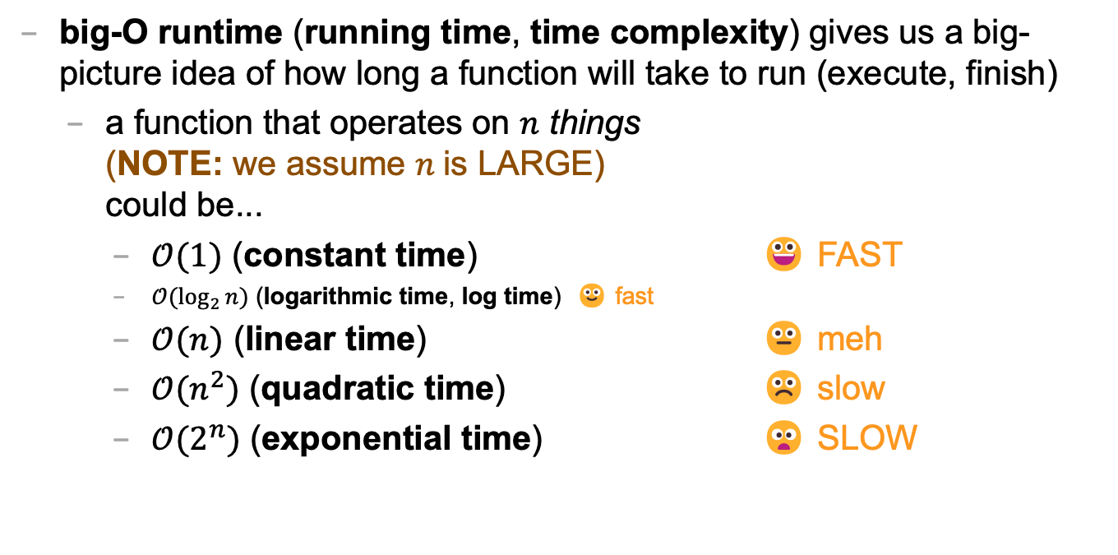
review: big-O runtime
big-O runtime (running time, time complexity) gives us a big-picture idea of how long a function will take to run (execute, finish)
a function that operates on $n$ things (NOTE: we assume $n$is LARGE) could be...
$𝒪(1)$ (constant time) 😀 FAST
$𝒪(\log_{2}{n})$ (logarithmic time, log time) 🙂 fast
$𝒪(n)$ (linear time) 😐 meh
$𝒪(n^{2})$ (quadratic time) ☹️ slow
$𝒪(2^{n})$ (exponential time) 😦 SLOW

Slide 201
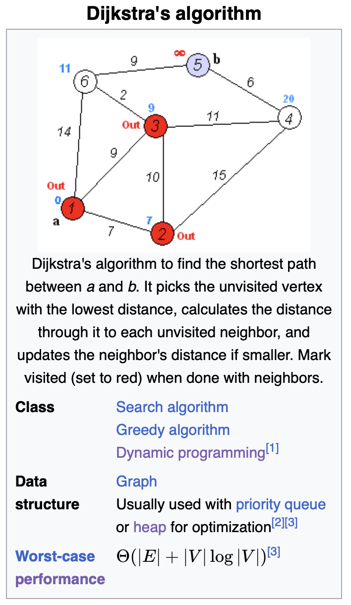
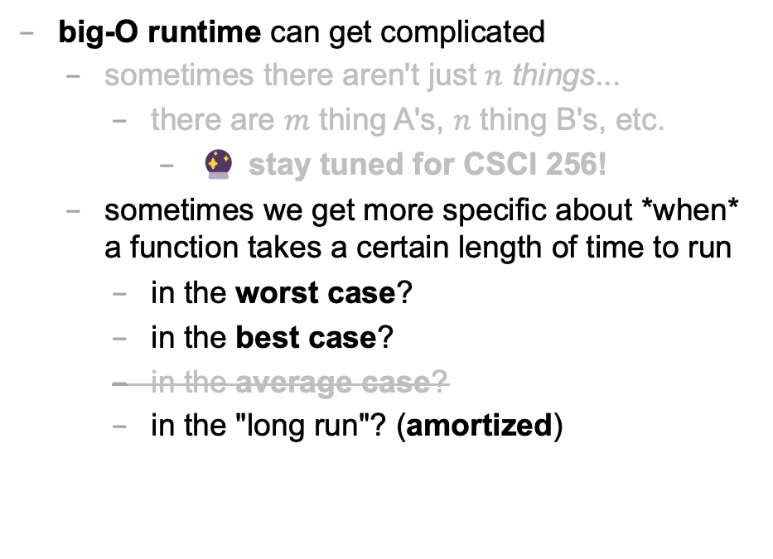
big-O runtime
big-O runtime can get complicated
sometimes there aren't just $n$ things...
there are $m$ thing A's, $n$ thing B's, etc.
🔮 stay tuned for CSCI 256!
sometimes we get more specific about *when* a function takes a certain length of time to run
in the worst case?
in the best case?
in the average case?
in the "long run"? (amortized)

Slide 202
best case and worst case runtime of adding to the back of an array list

Slide 203
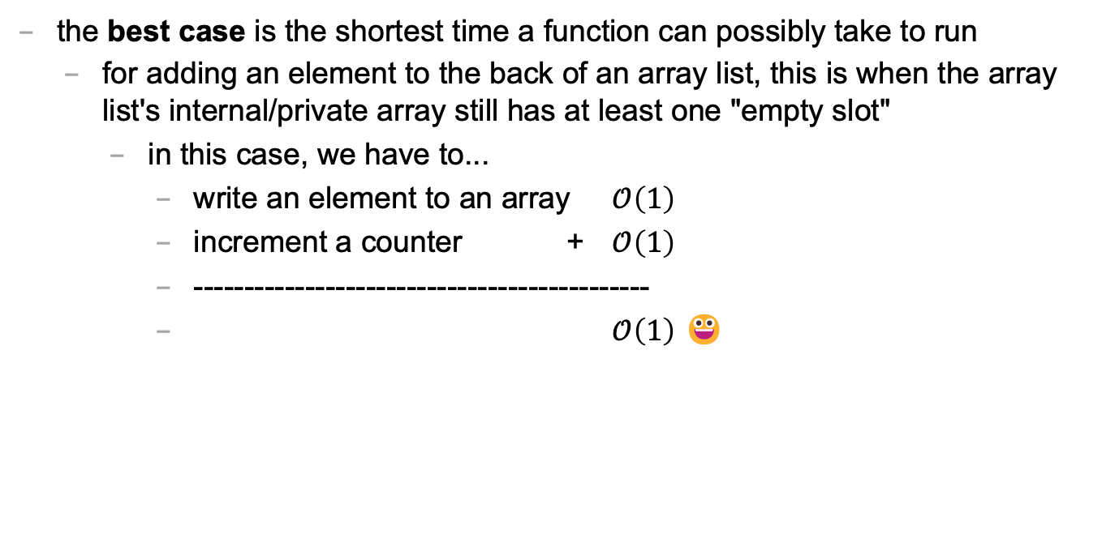
best case
the best case is the shortest time a function can possibly take to run
for adding an element to the back of an array list, this is when the array list's internal/private array still has at least one "empty slot"
in this case, we have to...
write an element to an array $𝒪\left(1\right)$
increment a counter + $𝒪\left(1\right)$
---------------------------------------------
$𝒪\left(1\right)$ 😀

Slide 204
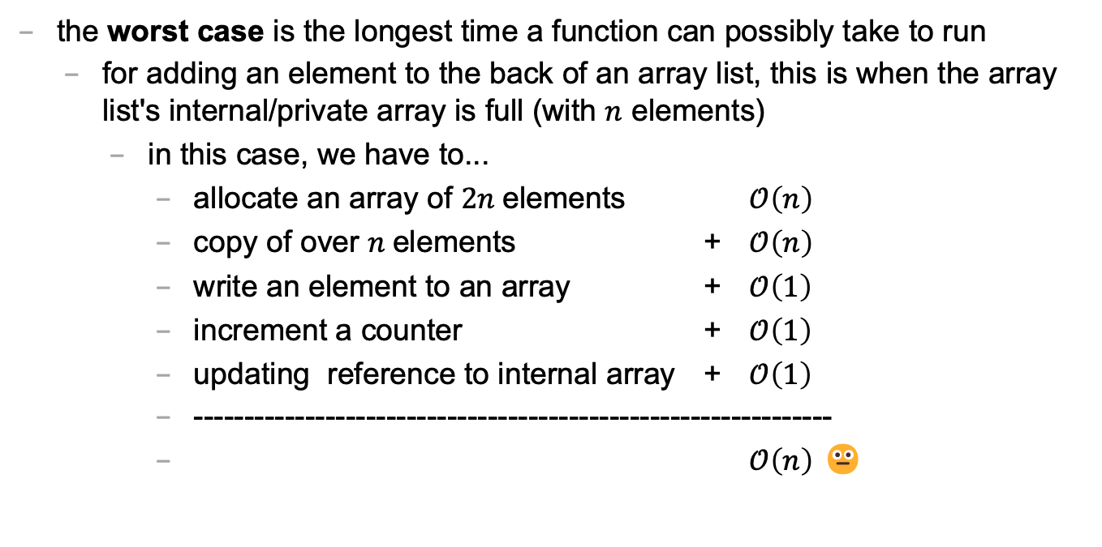
worst case
the worst case is the longest time a function can possibly take to run
for adding an element to the back of an array list, this is when the array list's internal/private array is full (with $n$ elements)
in this case, we have to...
allocate an array of $2n$elements $𝒪\left(n\right)$
copy of over $n$elements + $𝒪\left(n\right)$
write an element to an array + $𝒪\left(1\right)$
increment a counter + $𝒪\left(1\right)$
updating reference to internal array + $𝒪\left(1\right)$
---------------------------------------------------------------
$𝒪\left(n\right)$ 😐

Slide 205
sometimes the best case and worst case are very different

Slide 206
amortized runtime of adding to the back of an array list

Slide 207
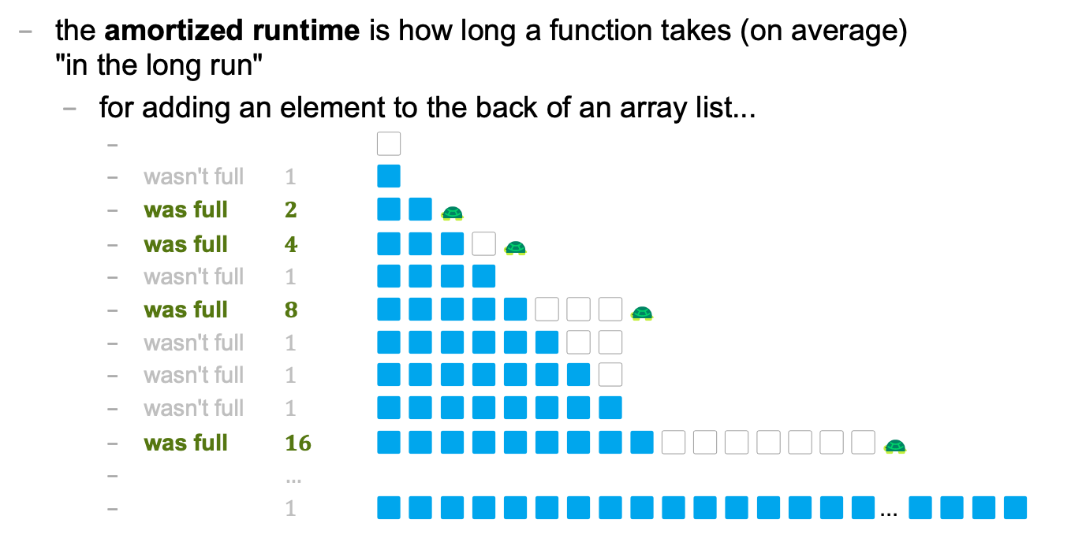
amortized
the amortized runtime is how long a function takes (on average) "in the long run"
for adding an element to the back of an array list...
⬜️
wasn't full $1$ 🟦
was full $2$ 🟦🟦🐢
was full $4$ 🟦🟦🟦⬜️🐢
wasn't full $1$ 🟦🟦🟦🟦
was full $8$ 🟦🟦🟦🟦🟦⬜️⬜️⬜️🐢
wasn't full $1$ 🟦🟦🟦🟦🟦🟦⬜️⬜️
wasn't full $1$ 🟦🟦🟦🟦🟦🟦🟦⬜️
wasn't full $1$ 🟦🟦🟦🟦🟦🟦🟦🟦
was full $16$ 🟦🟦🟦🟦🟦🟦🟦🟦🟦⬜️⬜️⬜️⬜️⬜️⬜️⬜️🐢
$…$
$1$ 🟦🟦🟦🟦🟦🟦🟦🟦🟦🟦🟦🟦🟦🟦🟦🟦... 🟦🟦🟦🟦

Slide 208
1
1
2
4
1
8
1
1
1
16
1
1
1
1
1
1
1
32
1
1
1
1
1
⬜️
🟦
🟦🟦🐢
🟦🟦🟦⬜️🐢
🟦🟦🟦🟦
🟦🟦🟦🟦🟦⬜️⬜️⬜️🐢
🟦🟦🟦🟦🟦🟦⬜️⬜️
🟦🟦🟦🟦🟦🟦🟦⬜️
🟦🟦🟦🟦🟦🟦🟦🟦
🟦🟦🟦🟦🟦🟦🟦🟦🟦⬜️⬜️⬜️⬜️⬜️⬜️⬜️🐢
🟦🟦🟦🟦🟦🟦🟦🟦🟦🟦⬜️⬜️⬜️⬜️⬜️⬜️
🟦🟦🟦🟦🟦🟦🟦🟦🟦🟦🟦⬜️⬜️⬜️⬜️⬜️
🟦🟦🟦🟦🟦🟦🟦🟦🟦🟦🟦🟦⬜️⬜️⬜️⬜️
🟦🟦🟦🟦🟦🟦🟦🟦🟦🟦🟦🟦🟦⬜️⬜️⬜️
🟦🟦🟦🟦🟦🟦🟦🟦🟦🟦🟦🟦🟦🟦⬜️⬜️
🟦🟦🟦🟦🟦🟦🟦🟦🟦🟦🟦🟦🟦🟦🟦⬜️
🟦🟦🟦🟦🟦🟦🟦🟦🟦🟦🟦🟦🟦🟦🟦🟦
🟦🟦🟦🟦🟦🟦🟦🟦🟦🟦🟦🟦🟦🟦🟦🟦🟦⬜️⬜️⬜️⬜️⬜️⬜️⬜️⬜️⬜️⬜️⬜️⬜️⬜️⬜️⬜️ 🐢
🟦🟦🟦🟦🟦🟦🟦🟦🟦🟦🟦🟦🟦🟦🟦🟦🟦🟦⬜️⬜️⬜️⬜️⬜️⬜️⬜️⬜️⬜️⬜️⬜️⬜️⬜️⬜️
🟦🟦🟦🟦🟦🟦🟦🟦🟦🟦🟦🟦🟦🟦🟦🟦🟦🟦🟦⬜️⬜️⬜️⬜️⬜️⬜️⬜️⬜️⬜️⬜️⬜️⬜️⬜️
🟦🟦🟦🟦🟦🟦🟦🟦🟦🟦🟦🟦🟦🟦🟦🟦🟦🟦🟦🟦⬜️⬜️⬜️⬜️⬜️⬜️⬜️⬜️⬜️⬜️⬜️⬜️
🟦🟦🟦🟦🟦🟦🟦🟦🟦🟦🟦🟦🟦🟦🟦🟦🟦🟦🟦🟦🟦⬜️⬜️⬜️⬜️⬜️⬜️⬜️⬜️⬜️⬜️⬜️
🟦🟦🟦🟦🟦🟦🟦🟦🟦🟦🟦🟦🟦🟦🟦🟦🟦🟦🟦🟦🟦🟦⬜️⬜️⬜️⬜️⬜️⬜️⬜️⬜️⬜️⬜️
🐢

Slide 209
1
1
2
4
1
8
1
1
1
16
1
1
1
1
1
1
1
32
1
1
1
1
1
1
1
1
1
1
1
1
1
1
1
64
1
1
1
1
1
1
1
1
1
1
1
1
1
1
1
1
1
1
1
1
1
1

Slide 210
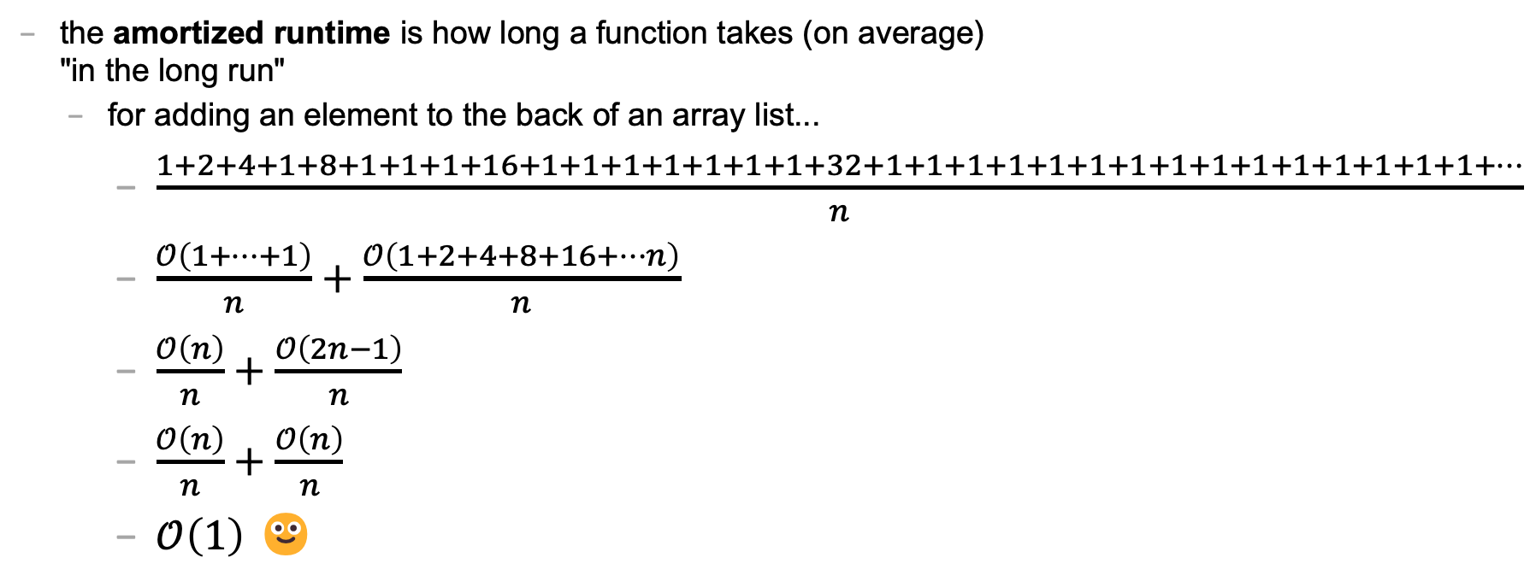
amortized
the amortized runtime is how long a function takes (on average) "in the long run"
for adding an element to the back of an array list...
$\frac{1+2+4+1+8+1+1+1+16+1+1+1+1+1+1+1+32+1+1+1+1+1+1+1+1+1+1+1+1+1+1+1+…}{n}$
$\frac{𝒪\left(1+…+1\right)}{n}+\frac{𝒪\left(1+2+4+8+16+…n\right)}{n}$
$\frac{𝒪\left(n\right)}{n}+\frac{𝒪\left(2n−1\right)}{n}$
$\frac{𝒪\left(n\right)}{n}+\frac{𝒪\left(n\right)}{n}$
$𝒪\left(1\right)$ 🙂

Slide 211
the amortized run time is less "pessimistic" than worst case

Slide 212
the most relevant runtime depends on context 💭 when might worst case be more relevant? 💭 when might amortized be more relevant?

Slide 213
best case and worst case runtime of inserting into the front of an array list

Slide 214
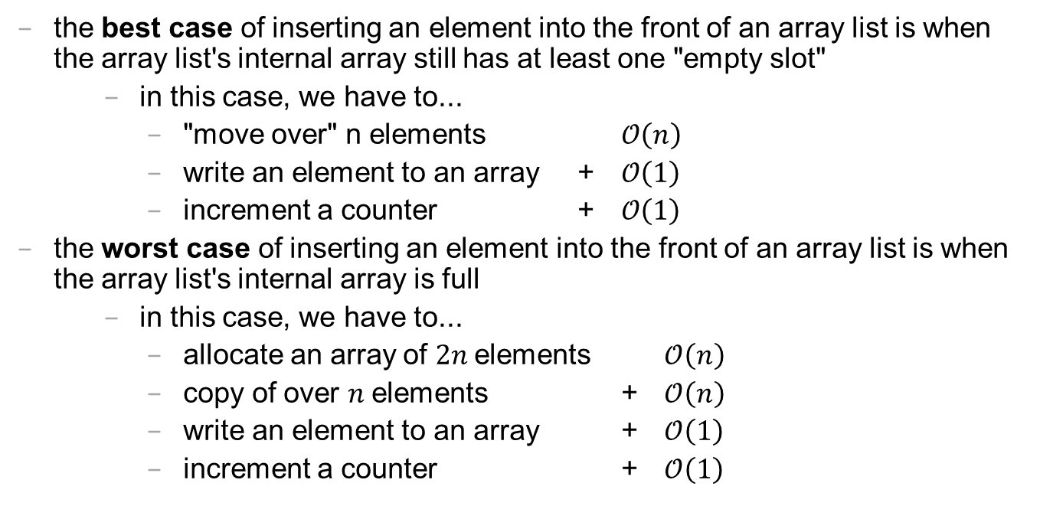
best case and worst cast
the best case of inserting an element into the front of an array list is when the array list's internal array still has at least one "empty slot"
in this case, we have to...
"move over" n elements $𝒪\left(n\right)$
write an element to an array + $𝒪\left(1\right)$
increment a counter + $𝒪\left(1\right)$
the worst case of inserting an element into the front of an array list is when the array list's internal array is full
in this case, we have to...
allocate an array of $2n$elements $𝒪\left(n\right)$
copy of over $n$elements + $𝒪\left(n\right)$
write an element to an array + $𝒪\left(1\right)$
increment a counter + $𝒪\left(1\right)$

Slide 215
lesson?: sometimes best case and worst case are the same

Slide 216
deleting while iterating backwards, grugbrain, comments (including stb), Vim, Kahoot! (including Jim's unpublished Kahoot! op-ed)
choose your own adventure!

Slide 217
https://grugbrain.dev

Slide 218
Week03
TODO: record lecture
Today is...
✨No-Laptop Monday! ✨
🦜🦜🦜
WARMUP
What is a bullet hell?
HW03 preview
functions
classes
HW03 behind the scenes
references
BONUS
Who wrote the game Everyday Shooter?
What is she working on now?
BONUS
What does Touhou 7: Perfect Cherry Blossom's Extra Stage look like? Who wrote this?

Slide 219
but first, something nice

Slide 220
🦉 secret agent owl

Slide 221
🦉 secret agent owl

Slide 222
🦉 secret agent owl

Slide 223
🦉 secret agent owl

Slide 224
HW03 preview 👻

Slide 225
functions

Slide 226
anatomy of a function

Slide 227
anatomy of a function (1/2)
a function is a lil chunk of code you can call from elsewhere
a function takes any number of arguments
... foo(int arg) { ... } // function foo takes an int
a function with a non-void return type must return a value of that type
int bar(...) { ... } // bar returns an int
void baz(...) { ... } // baz doesn't return anything
ReturnType functionName(ArgumentOneType argumentOne, ...) {
...
}

Slide 228
anatomy of a function (2/2)
void drawLine(
double a_x,
double a_y,
double b_x,
double b_y,
Color color) {
...
}

Slide 229
return

Slide 230
return (1/2)
a return statement stops execution of a function and returns the program to where the function was called
some return statements return a value
return 123;
others do not
return;
✨ this can be used to stop running a void-returning function in the middle

Slide 231
return (2/2)
a function with a non-void return type must return a value of that type, regardless of the path taken through the function
Error: missing return statement
static boolean isEven(int n) {
if (n % 2 == 0) {
return true;
}
}

Slide 232
return (2/2)
a function with a non-void return type must return a value of that type, regardless of the path taken through the function
static boolean isEven(int n) {
if (n % 2 == 0) {
return true;
} return false;
}

Slide 233
return (3/2)
a function with a non-void return type must return a value of that type, regardless of the path taken through the function
static boolean isEven(int n) {
return (n % 2 == 0);
}

Slide 234
return (3/2)
a function with a non-void return type must return a value of that type, regardless of the path taken through the function

Slide 235
return (2/2)
a function with a non-void return type must return a value of that type, regardless of the path taken through the function
Error: missing return statement
static boolean isPrime(int n) {
if (n <= 1) { return false; }
for (int i = 2; i <= SQRT(n); ++i) {
if (n % i == 0) { return false; }
}
}

Slide 236
return (2/2)
a function with a non-void return type must return a value of that type, regardless of the path taken through the function
static boolean isPrime(int n) {
if (n <= 1) { return false; }
for (int i = 2; i <= SQRT(n); ++i) {
if (n % i == 0) { return false; }
}
return true;
}

Slide 237
void

Slide 238
void
void is a special return type meaning a function does not return a value
void functions often modify (the objects referenced by) their arguments
static void inPlaceReverse(int[] array) { ... }
// no need to return a reference to array // (user of the function already has one)
in Java, the main method is a void function (it doesn't return anything)
public static void main(String[] arguments) { ... }

Slide 239
the call stack

Slide 240
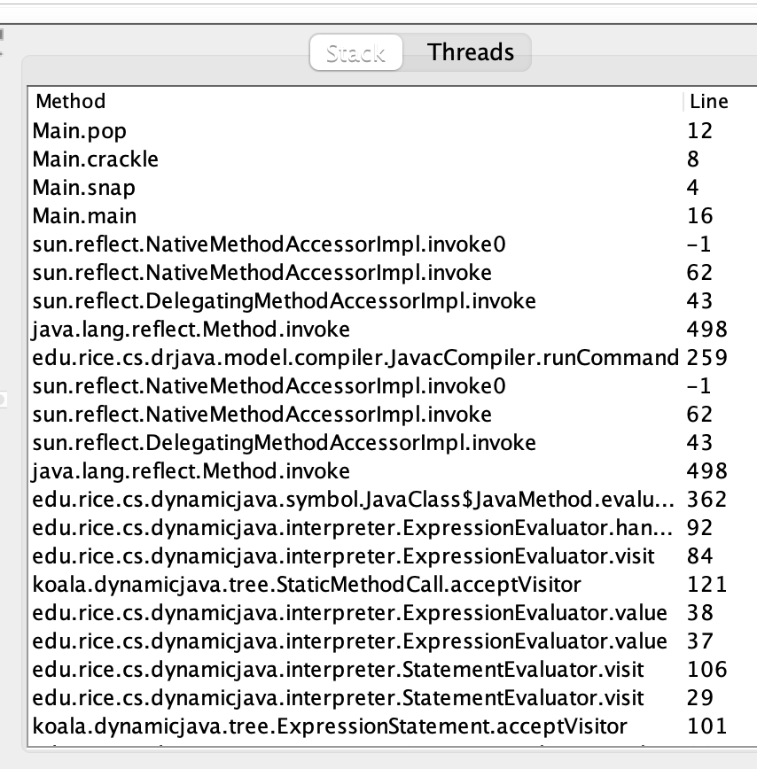
the call stack
functions can call other functions
the resulting "stack" of function calls is called the call stack
class Main {
static void snap() {
crackle();
}
static void crackle() {
pop();
}
static void pop() {
return;
}
public static void main(String[] arguments) {
snap();
}
}

Slide 241
🤔

Slide 242
[let's see what Eclipse does]

Slide 243
recursion

Slide 244
recursion (1/2)
a recursive function is a function that calls itself
each call must make progress towards a base case (when the function finally returns without calling itself)
✨ when in doubt, try something like zero for your base case
class Main extends Cow {
static int digitSum(int n) {
if (n == 0) {
return 0;
}
return digitSum(n / 10) + (n % 10);
}
public static void main(String[] arguments) {
PRINT(digitSum(256)); // 13
}
}

Slide 245
static int digitSum(int n) {
if (n == 0) {
return 0;
}
return digitSum(n / 10) + (n % 10);
}
return 0;
return digitSum(0) + 2;
return digitSum(2) + 5;
return digitSum(25) + 6;
int a = digitSum(256);

Slide 246
static int digitSum(int n) {
if (n == 0) {
return 0;
}
return digitSum(n / 10) + (n % 10);
}
return 0;
return digitSum(0) + 2;
return digitSum(2) + 5;
return digitSum(25) + 6;
int a = digitSum(256);

Slide 247
static int digitSum(int n) {
if (n == 0) {
return 0;
}
return digitSum(n / 10) + (n % 10);
}
return 0 + 2;
return digitSum(2) + 5;
return digitSum(25) + 6;
int a = digitSum(256);

Slide 248
static int digitSum(int n) {
if (n == 0) {
return 0;
}
return digitSum(n / 10) + (n % 10);
}
return 2;
return digitSum(2) + 5;
return digitSum(25) + 6;
int a = digitSum(256);

Slide 249
static int digitSum(int n) {
if (n == 0) {
return 0;
}
return digitSum(n / 10) + (n % 10);
}
return 2;
return digitSum(2) + 5;
return digitSum(25) + 6;
int a = digitSum(256);

Slide 250
static int digitSum(int n) {
if (n == 0) {
return 0;
}
return digitSum(n / 10) + (n % 10);
}
return 2 + 5;
return digitSum(25) + 6;
int a = digitSum(256);

Slide 251
static int digitSum(int n) {
if (n == 0) {
return 0;
}
return digitSum(n / 10) + (n % 10);
}
return 7;
return digitSum(25) + 6;
int a = digitSum(256);

Slide 252
static int digitSum(int n) {
if (n == 0) {
return 0;
}
return digitSum(n / 10) + (n % 10);
}
return 7;
return digitSum(25) + 6;
int a = digitSum(256);

Slide 253
static int digitSum(int n) {
if (n == 0) {
return 0;
}
return digitSum(n / 10) + (n % 10);
}
return 7 + 6;
int a = digitSum(256);

Slide 254
static int digitSum(int n) {
if (n == 0) {
return 0;
}
return digitSum(n / 10) + (n % 10);
}
return 13;
int a = digitSum(256);

Slide 255
static int digitSum(int n) {
if (n == 0) {
return 0;
}
return digitSum(n / 10) + (n % 10);
}
return 13;
int a = digitSum(256);

Slide 256
static int digitSum(int n) {
if (n == 0) {
return 0;
}
return digitSum(n / 10) + (n % 10);
}
int a = 13;

Slide 257
fin.

Slide 258
recursion (2/2)
a stack overflow error happens when functions call too many functions without returning; these errors are usually caused by broken recursive code
class Main {
static void stackOverflow() {
stackOverflow();
}
public static void main(String[] arguments) {
stackOverflow();
}
}
java.lang.StackOverflowError
at Main.stackOverflow(Tmp.java:3)
at Main.stackOverflow(Tmp.java:3)
at Main.stackOverflow(Tmp.java:3)
at Main.stackOverflow(Tmp.java:3)
at Main.stackOverflow(Tmp.java:3)
at Main.stackOverflow(Tmp.java:3)
at Main.stackOverflow(Tmp.java:3)
at Main.stackOverflow(Tmp.java:3)
at Main.stackOverflow(Tmp.java:3)
at Main.stackOverflow(Tmp.java:3)
at Main.stackOverflow(Tmp.java:3)
at Main.stackOverflow(Tmp.java:3)
at Main.stackOverflow(Tmp.java:3)
at Main.stackOverflow(Tmp.java:3)
at Main.stackOverflow(Tmp.java:3)
at Main.stackOverflow(Tmp.java:3)
at Main.stackOverflow(Tmp.java:3)
at Main.stackOverflow(Tmp.java:3)
at Main.stackOverflow(Tmp.java:3)
at Main.stackOverflow(Tmp.java:3)
at Main.stackOverflow(Tmp.java:3)
at Main.stackOverflow(Tmp.java:3)
at Main.stackOverflow(Tmp.java:3)
at Main.stackOverflow(Tmp.java:3)
at Main.stackOverflow(Tmp.java:3)
at Main.stackOverflow(Tmp.java:3)
at Main.stackOverflow(Tmp.java:3)
at Main.stackOverflow(Tmp.java:3)
at Main.stackOverflow(Tmp.java:3)
at Main.stackOverflow(Tmp.java:3)
at Main.stackOverflow(Tmp.java:3)
at Main.stackOverflow(Tmp.java:3)
at Main.stackOverflow(Tmp.java:3)
at Main.stackOverflow(Tmp.java:3)
at Main.stackOverflow(Tmp.java:3)
at Main.stackOverflow(Tmp.java:3)
at Main.stackOverflow(Tmp.java:3)
at Main.stackOverflow(Tmp.java:3)
at Main.stackOverflow(Tmp.java:3)
at Main.stackOverflow(Tmp.java:3)
at Main.stackOverflow(Tmp.java:3)
at Main.stackOverflow(Tmp.java:3)
at Main.stackOverflow(Tmp.java:3)
at Main.stackOverflow(Tmp.java:3)
at Main.stackOverflow(Tmp.java:3)
at Main.stackOverflow(Tmp.java:3)
at Main.stackOverflow(Tmp.java:3)
at Main.stackOverflow(Tmp.java:3)
at Main.stackOverflow(Tmp.java:3)
at Main.stackOverflow(Tmp.java:3)
at Main.stackOverflow(Tmp.java:3)
at Main.stackOverflow(Tmp.java:3)
at Main.stackOverflow(Tmp.java:3)
at Main.stackOverflow(Tmp.java:3)
at Main.stackOverflow(Tmp.java:3)
at Main.stackOverflow(Tmp.java:3)
at Main.stackOverflow(Tmp.java:3)
at Main.stackOverflow(Tmp.java:3)
at Main.stackOverflow(Tmp.java:3)
at Main.stackOverflow(Tmp.java:3)
at Main.stackOverflow(Tmp.java:3)
at Main.stackOverflow(Tmp.java:3)
at Main.stackOverflow(Tmp.java:3)
at Main.stackOverflow(Tmp.java:3)
at Main.stackOverflow(Tmp.java:3)
at Main.stackOverflow(Tmp.java:3)

Slide 259
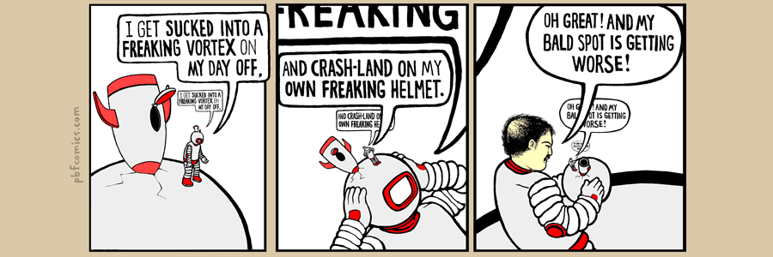

Slide 260
classes

Slide 261
anatomy of a class

Slide 262
anatomy of a class (1/2)
class ClassName {
VariableOneType variableOne;
...
FunctionOneReturnType functionOneName(...) { ... }
...
}
a class lets you bundle together data and functions
a class may have any number of variables (fields)
int foo; // objects of this class have an int called foo
a class may have any number of functions (methods)
int bar() { ... } // objects of class have function bar

Slide 263
anatomy of a class (2/2)
class Thing {
// instance variables
double x;
double y;
Color color;
double radius;
// instance methods
void draw() { ... }
...
}

Slide 264
dot

Slide 265
dot
the dot operator is used to access an object's variables and functions
Thing thing = new Thing();
thing.x = 3.0;
thing.y = 4.0;
thing.draw();

Slide 266
terminology

Slide 267
class vs. object (instance of a class)
a class is NOT the same thing as an object
a class is "a blueprint for making objects"
we can make an instance of a class (an object) using the new keyword
this is called "instantiating the class"
Thing thing = new Thing();

Slide 268
[off the record note on OOP (Object Oriented Programming) terminology]

Slide 269
new and constructors

Slide 270
new
the new keyword create a new instance of a class and calls its appropriate constructor
int[] array = new int[5]; // { 0, 0, 0, 0, 0 }
Color color = new Color(1.0, 0.0, 0.0); // (1.0, 0.0, 0.0)
☠️ you don't need new to create a new string
String string = "strings are their own thing";
☠️ you don't need new to create a new array when using {} syntax
int[] array = { 1, 2, 3 };
☠️ new doesn't actually return the object it created; it returns a reference to the object

Slide 271
constructors (1/2)
a constructor is called when an object is created
if the class does not have a constructor, then the default constructor must be called, which takes no arguments and sets all variables to zero
Color color = new Color(); // (0.0, 0.0, 0.0)

Slide 272
constructors (2/2)
a (non-default) constructor is never necessary, but is often convenient
Color color = new Color(1.0, 1.0, 1.0); // (r=1.0, g=1.0, b=1.0)
Color color = new Color(); // (0.0, 0.0, 0.0)
color.r = 1.0; // (1.0, 0.0, 0.0)
color.g = 1.0; // (1.0, 1.0, 0.0)
color.b = 1.0; // (1.0, 1.0, 1.0)

Slide 273
this 🐍 in Python, this is self

Slide 274
this
this is a reference to the instance of the class whose function we're inside of
✨ especially useful inside a constructor
class Color {
...
void shade() {
this.r /= 2;
this.g /= 2;
this.b /= 2;
}
Color(double r, double g, double b) { // constructor
this.r = r;
this.g = g;
this.b = b;
}
}

Slide 275
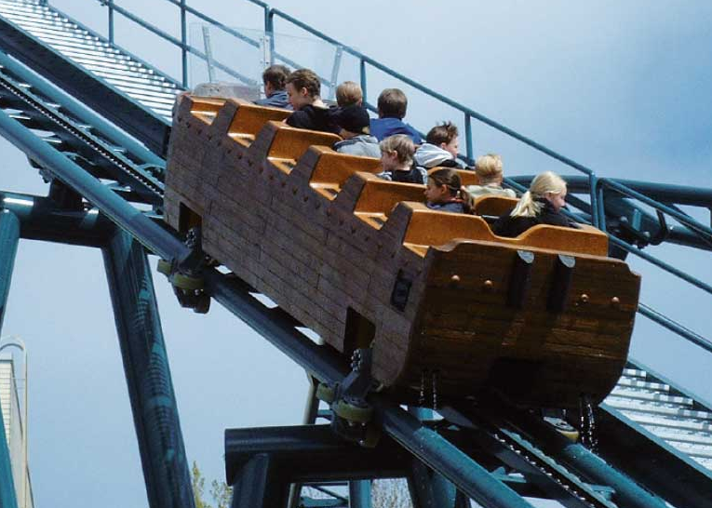
Week03b
Today is...
Wednesday!
(136 is a rollercoaster
that only goes up)
TODO: record lecture
🦜🦜🦜
HW03 preview
functions
classes (not quite done)
memory FUNdaMENTALs
the stack and the heap
passing arguments to functions
WARMUP
what is 42 in hex?

Slide 276
static (wrapping up last lecture)

Slide 277
static variables and static methods

Slide 278
instance variables vs static variables
an instance variable is part of an instance of a class
a static variable (class variable) is part of the class itself
there is only one, period. (it's a global variable that lives "on the class")
class Thing {
int type;
static int TYPE_BULLET = 1;
...
}
// Thing thing = new Thing();
// thing.type = Thing.TYPE_BULLET;

Slide 279
instance methods vs static methods
an instance method must be called on an instance (object) of a class
a static method (class method) can be called on the class itself
✅ there is no this in a static method
class Thing {
void draw() { ... }; // (non-static method)
static boolean collisionCheck(Thing a, Thing b) { ... }
...
}
// Thing a, b;
// a.draw();
// if (Thing.collisionCheck(...)) { ... }

Slide 280
and now... today's lecture!

Slide 281
☠️ this is the hardest lecture in 136

Slide 282
but learning this stuff is very worth 🙂👍 note: you will likely need to review this lecture a few times (i am sure you will all do this)

Slide 283
but learning this stuff is very worth 🙂👍 note: you will likely need to review this lecture a few times (i am sure you will all do this)

Slide 284
but learning this stuff is very worth 🙂👍 note: you will likely need to review this lecture a few times (i am sure you will all do this)

Slide 285
but learning this stuff is very worth 🙂👍 note: you will likely need to review this lecture a few times (i am sure you will all do this 🥲)

Slide 286
note: i am intentionally breaking these examples into many steps to teach you about memory don't actually code this way! int foo = 7; // <-- Good!

Slide 287
memory FUNdaMENTALs

Slide 288
the two kinds of variables in Java

Slide 289
a variable in Java is either... a primitive or a reference to an Object

Slide 290
primitives (review)

Slide 291
primitive types
in this class, "a variable being a primitive" means that the variable is a boolean, char, double, or int
primitive types are simple
primitive types are small
primitive types are NOT Objects
we will talk about Objects later
examples of Objects: String, MyCoolClass, int[] (array of ints)

Slide 292
boolean, char, double, int
a boolean stores a truth value
true, false
a char stores a character
'\0', 'a', 'Z', '!', '\n'
a double stores a real number
0.0, -0.5, 3.1415926, Double.NEGATIVE_INFINITY
an int stores an integer
0, -1, 4

Slide 293
primitives
some examples of primitives
int a; // a is an int
boolean b; // b is a boolean
char c; // c is a char

Slide 294
references to Objects

Slide 295
references (1/2)
we interact with Object's through references
String string; // string is a reference to a String object
Color color; // color is a reference to a Color object
int[] array; // array is a reference to an int array

Slide 296
references (2/2)
a reference is a memory address ("where the object lives in memory")
a memory address is an integer
a memory address is often written in hexadecimal (hex, base-16, 0...9A...F)
Thing a = new Thing();
// ^ refers to a Thing object at memory address 0x70f806418

Slide 297
null

Slide 298
null (1/2)
a null reference refers to nothing
the actual memory address referred to by null is zero (0x00... in hex)
Thing b = null;
// ^ refers to nothing (memory address 0x000000000)

Slide 299
null (2/2)
Thing[] pool = new Thing[7];
// ^ refers to a Thing[] object at memory address 0x70f805b68
//
// NOTE: the Thing array referred to by pool has 7 entries,
// all zero-initialized (null; memory address 0x000000000)
pool[0] = new Thing();
// pool[0] now refers to a Thing object at memory address // 0x70f8079c0

Slide 300
the stack and the heap (where stuff lives)

Slide 301
overview

Slide 302
let's get more specific than saying "variables live in memory" we divide memory into two parts: the stack and the heap

Slide 303
"the stack"
local variable primitives & references to Objects live here
variables undefined (?) by default (will NOT compile if used)
"the heap"
the actual Objects (including arrays and Strings) live here
Objects are cleared to 0 by default

Slide 304
primitives live on the stack

Slide 305
"the stack"
local variable primitives & references to Objects live here
variables undefined (?) by default (will NOT compile if used)
"the heap"
the actual Objects (including arrays and Strings) live here
Objects are cleared to 0 by default

Slide 306
int a;
int b;
a = 3;
b = a;
a = 7;

Slide 307
int a;
int b;
a = 3;
b = a;
a = 7;
a
?

Slide 308
int a;
int b;
a = 3;
b = a;
a = 7;
a
b
?
?

Slide 309
int a;
int b;
a = 3;
b = a;
a = 7;
a
b
3
?

Slide 310
int a;
int b;
a = 3;
b = a;
a = 7;
a
b
3
3

Slide 311
int a;
int b;
a = 3;
b = a;
a = 7;
a
b
7
3

Slide 312
int a;
int b;
a = 3;
b = a;
a = 7;
a
b
7
3

Slide 313
Objects live on the heap (but references to objects live on the stack)

Slide 314
"the stack"
local variable primitives & references to Objects live here
variables undefined (?) by default (will NOT compile if used)
"the heap"
the actual Objects (including arrays and Strings) live here
Objects are cleared to 0 by default

Slide 315
class Thing {
double x;
double y;
}
Thing a;
a = new Thing();
Thing b;
b = a;
a.x = 3.0;
b.y = 4.0;
a = null;

Slide 316
class Thing {
double x;
double y;
}
Thing a;
a = new Thing();
Thing b;
b = a;
a.x = 3.0;
b.y = 4.0;
a = null;
a
?

Slide 317
class Thing {
double x;
double y;
}
Thing a;
a = new Thing();
Thing b;
b = a;
a.x = 3.0;
b.y = 4.0;
a = null;
a
0xb7
.x
.y
0.0
0.0

Slide 318
class Thing {
double x;
double y;
}
Thing a;
a = new Thing();
Thing b;
b = a;
a.x = 3.0;
b.y = 4.0;
a = null;
a
b
0xb7
?
.x
.y
0.0
0.0

Slide 319
class Thing {
double x;
double y;
}
Thing a;
a = new Thing();
Thing b;
b = a;
a.x = 3.0;
b.y = 4.0;
a = null;
a
b
0xb7
0xb7
.x
.y
0.0
0.0

Slide 320
class Thing {
double x;
double y;
}
Thing a;
a = new Thing();
Thing b;
b = a;
a.x = 3.0;
b.y = 4.0;
a = null;
a
b
0xb7
0xb7
.x
.y
3.0
0.0

Slide 321
class Thing {
double x;
double y;
}
Thing a;
a = new Thing();
Thing b;
b = a;
a.x = 3.0;
b.y = 4.0;
a = null;
a
b
0xb7
0xb7
.x
.y
3.0
4.0

Slide 322
class Thing {
double x;
double y;
}
Thing a;
a = new Thing();
Thing b;
b = a;
a.x = 3.0;
b.y = 4.0;
a = null;
a
b
0x00
0xb7
.x
.y
3.0
4.0

Slide 323
class Thing {
double x;
double y;
}
Thing a;
a = new Thing();
Thing b;
b = a;
a.x = 3.0;
b.y = 4.0;
a = null;
a
b
0x00
0xb7
.x
.y
3.0
4.0

Slide 324
stack variables disappear when they leave scope Objects are garbage collected when nothing refers to them anymore

Slide 325
"the stack"
local variable primitives & references to Objects live here
variables undefined (?) by default (will NOT compile if used)
"the heap"
the actual Objects (including arrays and Strings) live here
Objects are cleared to 0 by default

Slide 326
{
int a;
a = 7;
}
{
int[] b;
b = new int[5];
b[4] = 8;
}

Slide 327
{
int a;
a = 7;
}
{
int[] b;
b = new int[5];
b[4] = 8;
}

Slide 328
{
int a;
a = 7;
}
{
int[] b;
b = new int[5];
b[4] = 8;
}
a
?

Slide 329
{
int a;
a = 7;
}
{
int[] b;
b = new int[5];
b[4] = 8;
}
a
7

Slide 330
{
int a;
a = 7;
}
{
int[] b;
b = new int[5];
b[4] = 8;
}
a
7

Slide 331
{
int a;
a = 7;
}
{
int[] b;
b = new int[5];
b[4] = 8;
}

Slide 332
{
int a;
a = 7;
}
{
int[] b;
b = new int[5];
b[4] = 8;
}

Slide 333
{
int a;
a = 7;
}
{
int[] b;
b = new int[5];
b[4] = 8;
}
b
?

Slide 334
{
int a;
a = 7;
}
{
int[] b;
b = new int[5];
b[4] = 8;
}
b
0xb7
[0]
[1]
[2]
[3]
[4]
0
0
0
0
0

Slide 335
{
int a;
a = 7;
}
{
int[] b;
b = new int[5];
b[4] = 8;
}
b
0xb7
[0]
[1]
[2]
[3]
[4]
0
0
0
0
8

Slide 336
{
int a;
a = 7;
}
{
int[] b;
b = new int[5];
b[4] = 8;
}
b
0xb7
[0]
[1]
[2]
[3]
[4]
0
0
0
0
8

Slide 337
{
int a;
a = 7;
}
{
int[] b;
b = new int[5];
b[4] = 8;
}
0
0
0
0
8

Slide 338
{
int a;
a = 7;
}
{
int[] b;
b = new int[5];
b[4] = 8;
}
0
0
0
0
8
🚛

Slide 339
garbage collector

Slide 340
garbage collector
the garbage collector is like a trash truck that drives around in the heap; when it notices an object that your program no longer has any references to, it frees up that memory for future use
🌊 C does NOT have a garbage collector; in C you free heap-allocated memory yourself by calling free(...)

Slide 341
[review all examples at least one more time]

Slide 342
passing arguments to functions

Slide 343
arguments to functions are passed by value (a copy of the) value of the primitive or (a copy of the) value of the reference

Slide 344
primitives are passed by value

Slide 345
void foo(int a) {
a = 8;
}
void main() {
int a = 7;
foo(a);
}

Slide 346
void foo(int a) {
a = 8;
}
void main() {
int a = 7;
foo(a);
}
main

Slide 347
void foo(int a) {
a = 8;
}
void main() {
int a = 7;
foo(a);
}
a
main
7

Slide 348
void foo(int a) {
a = 8;
}
void main() {
int a = 7;
foo(a);
}
foo
a
main
7

Slide 349
void foo(int a) {
a = 8;
}
void main() {
int a = 7;
foo(a);
}
a
foo
a
main
7
7

Slide 350
void foo(int b) {
b = 8;
}
void main() {
int a = 7;
foo(a);
}
b
foo
a
main
7
7

Slide 351
void foo(int a) {
a = 8;
}
void main() {
int a = 7;
foo(a);
}
a
foo
a
main
7
7

Slide 352
void foo(int a) {
a = 8;
}
void main() {
int a = 7;
foo(a);
}
a
foo
a
main
8
7

Slide 353
void foo(int a) {
a = 8;
}
void main() {
int a = 7;
foo(a);
}
a
foo
a
main
8
7

Slide 354
void foo(int a) {
a = 8;
}
void main() {
int a = 7;
foo(a);
}
a
main
7

Slide 355
void foo(int a) {
a = 8;
}
void main() {
int a = 7;
foo(a);
}
a
main
7

Slide 356
void foo(int a) {
a = 8;
}
void main() {
int a = 7;
foo(a);
}

Slide 357
references are also passed by value

Slide 358
void foo(Thing a) {
a.y = 4.0;
a = null;
}
void main() {
Thing a;
a = new Thing();
a.x = 3.0;
foo(a);
a.y = 5.0;
}

Slide 359
void foo(Thing a) {
a.y = 4.0;
a = null;
}
void main() {
Thing a;
a = new Thing();
a.x = 3.0;
foo(a);
a.y = 5.0;
}
main

Slide 360
void foo(Thing a) {
a.y = 4.0;
a = null;
}
void main() {
Thing a;
a = new Thing();
a.x = 3.0;
foo(a);
a.y = 5.0;
}
a
main
?

Slide 361
void foo(Thing a) {
a.y = 4.0;
a = null;
}
void main() {
Thing a;
a = new Thing();
a.x = 3.0;
foo(a);
a.y = 5.0;
}
a
main
0xb7
.x
.y
0.0
0.0

Slide 362
void foo(Thing a) {
a.y = 4.0;
a = null;
}
void main() {
Thing a;
a = new Thing();
a.x = 3.0;
foo(a);
a.y = 5.0;
}
a
main
0xb7
.x
.y
3.0
0.0

Slide 363
void foo(Thing a) {
a.y = 4.0;
a = null;
}
void main() {
Thing a;
a = new Thing();
a.x = 3.0;
foo(a);
a.y = 5.0;
}
foo
a
main
0xb7
.x
.y
3.0
0.0

Slide 364
void foo(Thing a) {
a.y = 4.0;
a = null;
}
void main() {
Thing a;
a = new Thing();
a.x = 3.0;
foo(a);
a.y = 5.0;
}
foo
a
a
main
0xb7
0xb7
.x
.y
3.0
0.0

Slide 365
void foo(Thing a) {
a.y = 4.0;
a = null;
}
void main() {
Thing a;
a = new Thing();
a.x = 3.0;
foo(a);
a.y = 5.0;
}
foo
a
a
main
0xb7
0xb7
.x
.y
3.0
4.0

Slide 366
void foo(Thing a) {
a.y = 4.0;
a = null;
}
void main() {
Thing a;
a = new Thing();
a.x = 3.0;
foo(a);
a.y = 5.0;
}
foo
a
a
main
0x00
0xb7
.x
.y
3.0
4.0

Slide 367
void foo(Thing a) {
a.y = 4.0;
a = null;
}
void main() {
Thing a;
a = new Thing();
a.x = 3.0;
foo(a);
a.y = 5.0;
}
foo
a
a
main
0x00
0xb7
.x
.y
3.0
4.0

Slide 368
void foo(Thing a) {
a.y = 4.0;
a = null;
}
void main() {
Thing a;
a = new Thing();
a.x = 3.0;
foo(a);
a.y = 5.0;
}
a
main
0xb7
.x
.y
3.0
4.0

Slide 369
void foo(Thing a) {
a.y = 4.0;
a = null;
}
void main() {
Thing a;
a = new Thing();
a.x = 3.0;
foo(a);
a.y = 5.0;
}
a
main
0xb7
.x
.y
3.0
5.0

Slide 370
void foo(Thing a) {
a.y = 4.0;
a = null;
}
void main() {
Thing a;
a = new Thing();
a.x = 3.0;
foo(a);
a.y = 5.0;
}
a
main
0xb7
.x
.y
3.0
5.0

Slide 371
void foo(Thing a) {
a.y = 4.0;
a = null;
}
void main() {
Thing a;
a = new Thing();
a.x = 3.0;
foo(a);
a.y = 5.0;
}
3.0
5.0

Slide 372
void foo(Thing a) {
a.y = 4.0;
a = null;
}
void main() {
Thing a;
a = new Thing();
a.x = 3.0;
foo(a);
a.y = 5.0;
}
3.0
5.0
🚛

Slide 373
Week03c
no Jim office hours today
(i have to catch a train)
🦜
Today is Fun Friday!
🦜
String
HW03 questions
review
WARMUP
what is a string?
🦜
TODO: record lecture

Slide 375
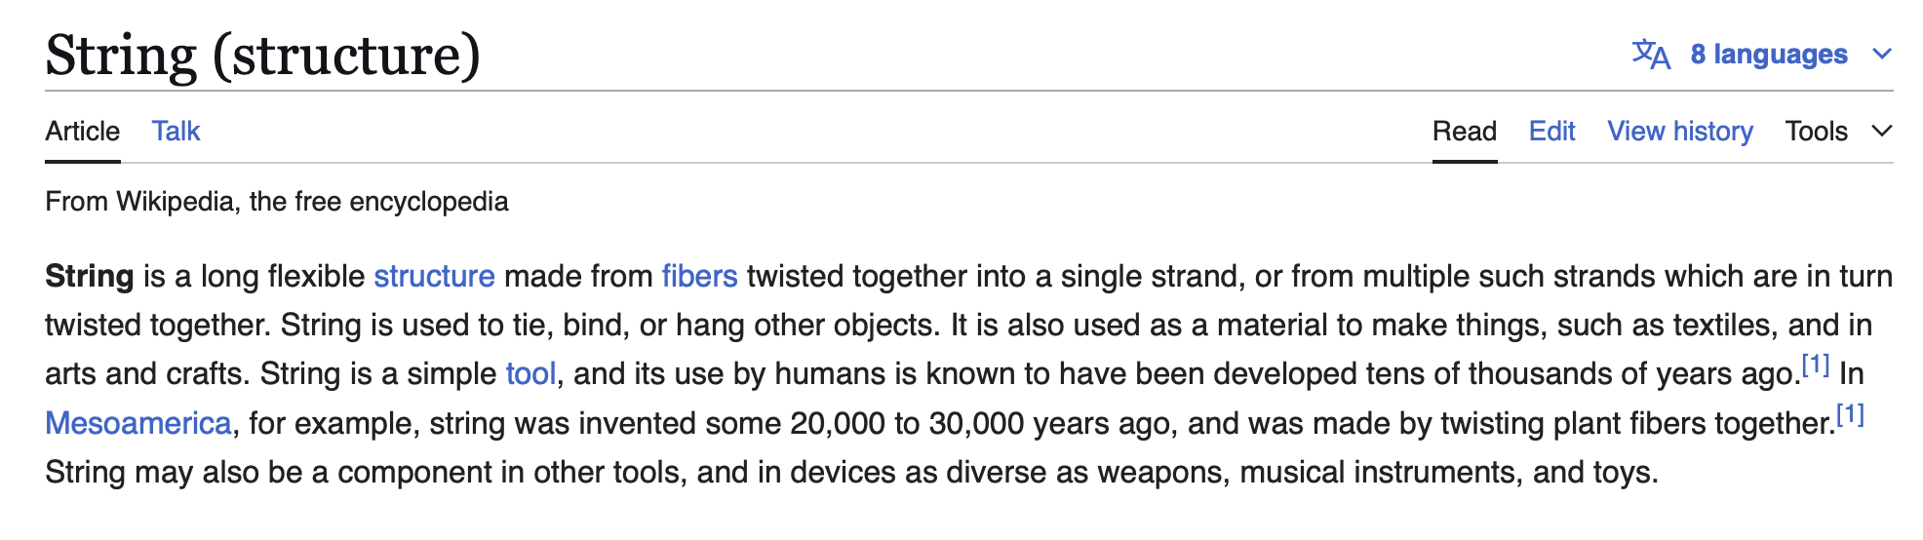

Slide 376
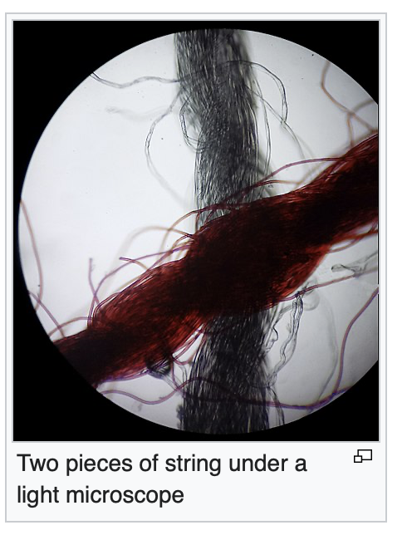

Slide 377


Slide 378
built-in classes (classes that are "built in" to Java)

Slide 379
built-in classes are "special" (they break the rules of other classes in Java)

Slide 380
review: instantiating a class (creating an object)

Slide 381
constructors
// Option A: Use default constructor and initialize using dot
Color color = new Color(); // (r=0.0, g=0.0, b=0.0)
color.r = 1.0; // (r=1.0, g=0.0, b=0.0)
color.g = 1.0; // (r=1.0, g=1.0, b=0.0)
color.b = 1.0; // (r=1.0, g=1.0, b=1.0)
// Option B: Use a custom constructor
Color color = new Color(1.0, 1.0, 1.0); // (r=1.0, g=1.0, b=1.0)

Slide 382
review: array

Slide 383
creating an array (1/2)
you can create a new array by specifying its length inside of square brackets; if you do, the array is zero-initialized (all elements are initially set to zero)
int[] A = new int[8]; // { 0, 0, 0, 0, 0, 0, 0, 0 }
double[] B = new double[1]; // { 0.0 }
boolean[] C = new boolean[2]; // { false, false }
char[] D = new char[4]; // { '\0', '\0', '\0', '\0' }
String[] E = new String[3]; // { null, null, null }

Slide 384
creating an array (2/2)
you can also create a new array by specifying its elements inside of curly braces; if you do, the array's length is the number of elements you specified
int[] array = { 7, 7, 9 }; // new int[3] is implied
NOTE: this syntax can only be used for creation
🙅 NOT okay to do later: array = { 4, 5, 6 };
🙆 OKAY to do later:
array[0] = 4;
array[1] = 5;
array[2] = 6;
boolean[] array = { true };
String[] array = { "hello", "world" };

Slide 385
String

Slide 386
String (1/2)
a String is a sequence of characters
"Hello World", "Foo123"

Slide 387
String (2/2)
you can create a new String by specifying its elements inside of double quotation marks
String string = "Hello";
String has some useful instance methods (see Docs)
PRINT(string.length()); // 5
PRINT(string.charAt(1)); // 'e'
PRINT(string.substring(1, 3)); // "el"

Slide 388
String concatenation (1/2)
+ concatenates two String's
// String foo = "Hello".concat("World"); String foo = "Hello" + "World"; // "HelloWorld"
it also does some conversions for you (very convenient; kind of confusing)
// String foo = "Hello".concat(Integer.toString(2)); String foo = "Hello" + 2; // "Hello2"

Slide 389
String concatenation (2/2)
stringA + foo is the ONLY example of operator overloading in Java
(the * operator just does multiplication)
(the / operator just does division)
...but the + operator does both addition and string concatenation
🐍 Python and 👹C++ let you implement your own operator overloading
(very fun; very confusing)

Slide 390
inside of a String (1/4)
inside of String, there must be a char[]
motivation: as you experienced in HW02, working directly with character arrays is hard / painful
idea: String "wraps up" a char[] into an easy-to-use package

Slide 391
inside of a String (2/4)
if a String is really just a char[]...
...then what does this code actually do? 🧠
String a = "Hello";
String b = "World";
String c = a + b;
PRINT(c);

Slide 392
XStringExample
class XStringExample extends SuperCow {
static class XString {
char[] array;
static XString plus(XString a, XString b) {
XString result = new XString();
// allocates new array that's the sum of both lengths
// O(n) runtime
result.array = new char[a.array.length + b.array.length];
// copies over a
// O(n)
for (int i = 0; i < a.array.length; ++i) { // O(n)
result.array[i] = a.array[i]; // O(1)
}
// copies over b
// O(n)
for (int i = 0; i < b.array.length; ++i) {
result.array[a.array.length + i] = b.array[i];
}
// returning result
// O(1)
return result;
}
}
public static void main(String[] arguments) {
XString a = new XString();
a.array = new char[6];
a.array[0] = 'H';
a.array[1] = 'e';
a.array[2] = 'l';
a.array[3] = 'l';
a.array[4] = 'l';
a.array[5] = 'o';
XString b = new XString();
b.array = new char[5];
b.array[0] = 'W';
b.array[1] = 'o';
b.array[2] = 'r';
b.array[3] = 'l';
b.array[4] = 'd';
XString c = XString.plus(a, b);
PRINT(a.array);
PRINT(b.array);
PRINT(c.array);
}
}

Slide 393
inside of a String (3/4)
if a String is really just a char[]...
...then what does this code actually do? 🧠
.. how many char[]'s are created?
String a = "Hello";
String b = " ";
String c = "World";
String d = "!";
String e = a + b + c + d;
PRINT(e);

Slide 394
interlude
if a String is really just a char[]...
...then what does this code do?
...what is this code's big O runtime? 🧠
int foo = 0;
for (int i = 0; i < n; ++i) { // O(n)
foo += 1; // * O(1)
}
PRINT(foo);

Slide 395
inside a String (4/4)
if a String is really just a char[]...
...then what does this code do?
...what is its big O runtime? 🧠
String scream = "";
for (int i = 0; i < n; ++i) {
scream += "A";
}
PRINT(scream);

Slide 396
questions on HW03?

Slide 397
pool[i] inside of specific updates (don't define enemy1 and enemy2)

Slide 398
why i gave you a player reference

Slide 399
this inside of fireBullet

Slide 400
☕️ the art of coding things in the right order compile and run early, compile and run often

Slide 401
well, let us imagine...

Slide 402

let's imagine...
...you decide to develop $n$ different things at once...
...and then, finally, you compile and run...
...aaaaand you have a bug! 🐛
so...what is the cause of the bug? what code is broken? 🤔
well...i guess it could be any of the $n$ things you just wrote!
and while $𝒪(n)$ possible sources of bugs might seem bad...

Slide 403
...the reality is ✨so much worse✨!

Slide 404

because broken code likes to interact with other broken code, to make✨super bugs✨!

Slide 406

not broken
broken
developing one thing at a time

Slide 407
not broken
A is broken
B is broken
A and B are both broken
developing two things at a time

Slide 408
not broken
A broken
C broken
A and C broken
A and B broken
B broken
B and C broken
A, B, and C broken
developing three things at a time

Slide 409

asymptotic bug-finding time

Slide 410

$$𝒪(2^{n})$$
gl;hf 🙂👍

Slide 411
big lesson
implement code one thing at a time
compile and run and test after implementing every single thing
figuring out the order to do things in is a learned skill!
sometimes i choose the wrong order...
...and then i usually have to start over 🙂👍

Slide 412
this is a learned skill!

Slide 413


in summary

Slide 414


Week02
TODO: record lecture
🦜
NOTE: Jim has jury duty on thu 🎉
🦜
arrays
array examples
swap
array examples that use swaps
WARMUP
Guess how many arrays we used to make this:
https://youtu.be/dadIdXQMBi4
NOTE: an array is a fixed-length sequence of elements, all the same type

Slide 415
how many arrays?
ARRAYS (not counting tiny arrays of 3 double's, which i use to represent points)
NOTE: Counts are very approximate
==========
strings for loading files >5
huge arrays for drawing random stuff (the floor, etc) 2
random stuff in my cow.cpp library (keyboard state, OpenGL objects, etc.) >20
random global variables 1
building the simulation >6
simulation state 3
simulation itself >20
dragon head mesh 7
dragon body mesh 7
dragon mesh 7
sphere mesh 3
cylinder mesh 3
motor configuration 3
arrays that just move data back and forth between C++ <-> unity 8
inverse kinematics >15
physics >10
----------
definitely at least 100; probably less than 1000

Slide 416
arrays

Slide 417
metaphor

Slide 418
an array is like a very organized person's flower planter - one flower per square - the planter can't change size (it is made of artisinal woods or something)

Slide 419
🌻
🌺
🥀
🌹

Slide 420
mental model of an array

Slide 421
mental model of an array
a fixed number of equally-sized boxes, all right next to each other
the array itself lives "in memory"
1 | 5 | 3 | 2 | 7
int[] foo = new int[5];
foo[0] = 1;
foo[1] = 5;
foo[2] = 3;
foo[3] = 2;
foo[4] = 7;

Slide 422
the array itself lives "in memory"
1 | 5 | 3 | 2 | 7

Slide 423

1 | 5 | 3 | 2 | 7

Slide 424
learn about memory and become a real CS pro a couple important questions to ask yourself: https://www.youtube.com/watch?v=BNtcWpY4YLY

Slide 425
arrays

Slide 426
arrays (1/2)
an array is a fixed-length sequence of elements, all of the same type
"an array of 4372 double's"
"an array of 1 int's"
"an array of 64 Student's"

Slide 427
arrays (2/2)
we will often write an array using curly braces
{ 7, 7, 9 } is an array containing 7, 7, and 9
optionally, you can include a comma after the last element
{ 7, 7, 9, }
☠ even though sets from math also use curly braces, Java arrays have nothing to do with sets; in a set, all elements must be unique; in an array, elements do NOT have to be unique

Slide 428
array operations

Slide 429
array operations

Slide 430
creating an array (1/2)
you can create an array by specifying its length (the number of elements); if you do, the array is zero-initialized (all elements are initially set to zero)
int[] A = new int[8]; // { 0, 0, 0, 0, 0, 0, 0, 0 }
double[] B = new double[1]; // { 0.0 }
boolean[] C = new boolean[2]; // { false, false }
char[] D = new char[4]; // { '\0', '\0', '\0', '\0' }
String[] E = new String[3]; // { null, null, null }
[visualize in Eclipse]

Slide 431
creating an array (2/2)
you can also create an array by specifying its elements; if you do, the array's length is the number of elements you specified
int[] array = { 7, 7, 9 }; // new int[3] is implied
NOTE: this syntax can only be used for creation
🙅 NOT okay to do later: array = { 4, 5, 6 };
🙆 OKAY to do later:
array[0] = 4;
array[1] = 5;
array[2] = 6;
boolean[] array = { true };
String[] array = { "hello", "world" };

Slide 432
getting an array's length
after creating an array, you can get (but not set) its length
int[] array = { 7, 7, 9 };
PRINT(array.length); // 3
int[] array = new int[8];
PRINT(array.length); // 8
Error: cannot assign a value to final variable length
array.length = 42;

Slide 433
getting the value of an element of an array
you can get the value of an element of an array using the square brackets and the index of the element
this is also called "accessing the array"
int[] array = { 3, 4, 5 };
int foo = array[0]; // 3
int[] array = { 3, 4, 5 };
int foo = array[42];
java.lang.ArrayIndexOutOfBoundsException: 42

Slide 434
setting the value of an element of an array
you can set the value of an element of an array using the square brackets and the index of the element
int[] array = { 7, 7, 9 };
array[1] = 8;
// { 7, 8, 9 }
int[] array = { 7, 7, 9 };
array[-1] = 1000;
java.lang.ArrayIndexOutOfBoundsException: -1

Slide 435
☠ printing the elements of an array
☠ in Java, you don't simply call System.out.println(array)
instead, you call System.out.println(Arrays.toString(array));
note: this prints with square brackets instead of curly brackets
🤷‍♂️
or just call PRINT(array);
🐄💖✨
(note: also uses square brackets)

Slide 436
iterating over an array

Slide 437
iterating over an array
a for loop can be used to iterate over an array
for (int i = 0; i < array.length; ++i) {
array[i] = ...;
}

Slide 438
[example in Eclipse]

Slide 439
Week02b
🛌
zzz...
arrays
array examples
swap
array examples that use swaps
WARMUP:
On your computer, write an array deep copy from scratch, including test code.
TODO: record lecture

Slide 440
array examples

Slide 441
example: creating an array of the first 100 non-negative integers

Slide 442
example: creating an array of the first 100 non-negative integers [ 0, 1, ..., 99 ]
class Main extends Cow {
public static void main(String[] arguments) {
int[] array = new int[100];
for (int i = 0; i < array.length; ++i) {
array[i] = i;
}
PRINT(array);
}
}

Slide 443
example: (deep) array copy

Slide 444
example: array copy
class Main extends Cow {
public static void main(String[] arguments) {
int[] source = { 3, 4, 5 };
int[] destination = new int[source.length];
for (int i = 0; i < source.length; ++i) {
destination[i] = source[i];
}
PRINT(source);
PRINT(destination);
}
}

Slide 445
☠ example: bad very bad broken array copy

Slide 446
☠ example: bad very bad broken array copy
class Main extends Cow {
public static void main(String[] arguments) {
int[] source = { 3, 4, 5 };
int[] destination = source;
source[0] = 7;
PRINT(source);
PRINT(destination);
}
}

Slide 447
example: circular array
3, 4, 5, 6, 7, 8, 9, 10, 11,

Slide 448
class Main extends Cow {
public static void main(String[] arguments) {
int nextIndex = 0;
int[] circularArray = new int[5];
for (int dataPoint = 1; dataPoint < 100; ++dataPoint) {
// push dataPoint into the circularArray
circularArray[nextIndex] = dataPoint;
// update nextIndex
nextIndex = (nextIndex + 1) % circularArray.length;
}
}
}

Slide 449
example: finding the index (and value) of an array's maximum element

Slide 450
example: finding the index (and value) of an array's maximum element
import java.util.*;
class Main {
public static void main(String[] arguments) {
double[] array = { 1.0, 3.0, -42.0, 1000.0, 99.0 };
int indexOfMaximumElement = -1;
double valueOfMaximumElement = Double.NEGATIVE_INFINITY;
for (int i = 0; i < array.length; ++i) {
if (array[i] > valueOfMaximumElement) {
indexOfMaximumElement = i;
valueOfMaximumElement = array[i];
}
}
System.out.println("array[" + indexOfMaximumElement + "] = " + valueOfMaximumElement);
}
}

Slide 451
multi-dimensional arrays

Slide 452
multi-dimensional arrays

Slide 453
multi-dimensional arrays (arrays of arrays of ...)
multi-dimensional arrays are sometimes really handy
int[][] array = { { 3, 4 }, { 5, 6 }, { 7, 8 } };
PRINT(array);
// [[3, 4], [5, 6], [7, 8]]
PRINT(array[0][1]); // 4
int[][][] array = new int[2][3][4];
array[0][0][0] = 42;
System.out.println(Arrays.toString(array));
// [[[42, 0, 0, 0], [0, 0, 0, 0], [0, 0, 0, 0]], [[0, 0, 0, 0], [0, 0, 0, 0], [0, 0, 0, 0]]]

Slide 454
Week02c
!
juggling club after colloquium today 🤹
🛌
HW01 is being graded
so far only 1 person followed the TODO's... 🥲
(fix for full points back)
Pre-Lab
Post-Lab
arrays
array examples
swap
array examples that use swaps
big O
WARMUP:
How do we swap two numbers...
...in Java?
...in Python?
...in C using XOR and no temporary?
BONUS:
What is the big O runtime of pressing backspace in your text box (n is buffer.length)
TODO: record lecture

Slide 455
swap

Slide 456
🐍 Python swap

Slide 457
🐍 Python swap
a = 0
b = 1
a, b = b, a # Python swap
# a is now 1
# b is now 0

Slide 458
☠️ BAD VERY BAD BROKEN swap

Slide 459
☠️ BAD VERY BAD BROKEN swap
int a = 0;
int b = 1;
{ // BAD VERY BAD BROKEN swap
a = b; // a <- 1
b = a; // b <- 1
}

Slide 460
swap

Slide 461
swap
int a = 0;
int b = 1;
{ // swap
int tmp = a; // tmp <- 0
a = b; // a <- 1
b = tmp; // b <- 0
}

Slide 462
array algorithms that use swaps

Slide 463
reversing an array

Slide 464
out-of-place reverse
we can reverse an array out-of-place using an additional array
static int[] outOfPlaceReverse(int[] array) {
int[] result = new int[array.length];
for (int i = 0; i < array.length; ++i) {
int j = (array.length - 1) - i;
result[i] = array[j];
}
return result;
}

Slide 465
in-place reverse
we can reverse an array in-place using "swaps" (no additional array)
static void inPlaceReverse(int[] array) {
for (int i = 0; i < array.length / 2; ++i) {
int j = (array.length - 1) - i; // "mirror index"
// swap array[i] <-> array[j]
int tmp = array[i];
array[i] = array[j];
array[j] = tmp;
}
}

Slide 466
bubble sort

Slide 467
bubble sort
bubble sort is a simple in-place sorting algorithm that uses swaps
class Main {
public static void main(String[] arguments) {
int[] array = { 2, 4, 1, 6, 0, 3, 5 };
boolean arrayIsSorted;
do {
arrayIsSorted = true;
for (int i = 0; i < array.length - 1; ++i) {
if (array[i] > array[i + 1]) {
arrayIsSorted = false;
// swap
int tmp = array[i];
array[i] = array[i + 1];
array[i + 1] = tmp;
}
}
} while (!arrayIsSorted);
PRINT(array);
}
}

Slide 468
bubble sort
bubble sort is a simple in-place sorting algorithm that uses swaps
boolean arrayIsSorted;
do {
arrayIsSorted = true;
for (int i = 0; i < array.length - 1; ++i) {
if (array[i] > array[i + 1]) {
arrayIsSorted = false;
// swap
int tmp = array[i];
array[i] = array[i + 1];
array[i + 1] = tmp;
}
}
} while (!arrayIsSorted);

Slide 469
big O

Slide 470
big O (math)

Slide 471

big O (1/2)
big O describes a function’s “limiting behavior”
to find a mathematical function’s big O notation...
1. throw away the coefficients
2. find the fastest growing term
3. the function is $𝒪($FASTEST_GROWING_TERM$)$
e.g., $f\left(n\right)=7n^{2}+100n+4732$
1. throw away coefficients to get $n^{2}+n+1$
2. fastest growing term is $n^{2}$
3. $f\left(n\right)$ is $𝒪(n^{2})$

Slide 472


big O (2/2)
what is $f\left(n\right)=77n^{7}+2^{n}$ in big O notation?
$n^{7}+2^{n}$
$2^{n}$ 🧪 is this true?
$𝒪(2^{n})$
what is $f\left(n\right)=100$ in big O notation?
$1$
$1$ 🧠 what does this mean?
$𝒪(1)$
what is $f\left(n\right)=n+log⁡(n)$ in big O notation?
$n+log⁡(n)$
$n$ 🧪 is this true?
$𝒪(n)$

Slide 473
logarithmic growth is the inverse of exponential growth

Slide 474
y = 2^{x}
🧠 solve for x.

Slide 475
y = 2^{x} x = log₂ y

Slide 476

y = 2^{x} x = log₂ y
y
x

Slide 477
y = 2^{x} x = log₂ y
y
x

Slide 478
big O runtime (arrays)

Slide 479

runtime of array operations
arrays are fast!
⏱️ creating an array takes $𝒪(n)$ time, where $n$ is the length of the array
⏱️ getting the value of the i-th element of an array takes $𝒪(1)$ time
⏱️ setting the value of the i-th element of an array takes $𝒪(1)$ time

Slide 480

accessing an array "under the hood"
how Java does array[4], step-by-step:
start at the head (0-th element) of the array 🟦⬛⬛⬛⬛⬛⬛⬛
move over 4 slots (using an $𝒪(1)$ "add") ⬛⬛⬛⬛🟦⬛⬛⬛
return the value of the element in that slot ⬛⬛⬛⬛🟨⬛⬛⬛
we can't actually see Java do this (it's too "low level")
but we *can* see C do it! (stay tuned 🙂)

Slide 481
big O runtime (code)

Slide 482

big-O runtime (1/3)
big-O runtime (running time, time complexity) gives us a big-picture idea of how long a function will take to run (execute, finish)
a function that operates on $n$ things, could be...
$𝒪(1)$ (constant time) 😀 FAST
$𝒪(\log_{2}{n})$ (logarithmic time, log time) 🙂 fast
$𝒪(n)$ (linear time) 😐 meh
$𝒪(n^{2})$ (quadratic time) ☹️ slow
$𝒪(2^{n})$ (exponential time) 😦 SLOW

Slide 483

big O runtime (2/3)
big O runtime is how much time it takes code to run (in the worst case)
time is measured in the number of $𝒪\left(1\right)$(constant time) operations
examples of $𝒪\left(1\right)$ operations:
a + b
c && d
!e
f = g
a += b // NOTE: O(1) + O(1) = O(1)
array[i]

Slide 484

big O runtime (3/3)
example of $𝒪\left(n\right)$ algorithms:
create new array of length n (NOTE: this is a definition)
print array of length n
deep copy array of length n
in-place reverse array of length n
examples of $𝒪\left(n^{2}\right)$ algorithms:
bubble sort array of length n

Slide 485
fun examples

Slide 486


Caaaaaaaaaaaarl
e.g., Imagine a classroom with $n$ students. I want to figure out if any students are named Carl.
I need an ✨Algorithm✨ -- boolean isAnyoneNamedCarl(Student[] students);
What is the big O of the following algorithms?
Algorithm 1: Ask each student, one at a time, “Are you named Carl?”
Algorithm 2: Pass a paper around the room, and have each student write their name on it. Then take the paper, and read through it.
Algorithm 3: The students draw straws one at a time. The student who draws the short straw must leave. On their way out of the room, ask them whether their name is Carl. Repeat this procedure until the room is empty.
Algorithm 4: Play Kahoot. The winner legally changes their name to Carl.

Slide 487
textbox examples

Slide 488
let's say n equals buffer.length

Slide 489
what's the big O of pressing →?

Slide 490
what's the big O of pressing A?

Slide 491
💻 array tutorial

Slide 492
💻 array tutorial

Slide 493
💻 array tutorial
// 🟢 ([5, 4, 7, 0, 7], 7) -> 2
// 🟢 ([5, 4, 7, 0, 7], 3) -> -1
static int findFirstIndexOf(int[] array, int value);
// 🟦 ([1, 3, 3, 2, 3, 4], 3) -> [1, 2, 4]
static int[] removeAllOccurences(int[] array, int value);
// ♦️ [[1, 3], [2, 4, 5], [0, 5]] -> [0, 1, 2, 3, 4, 5, 5]
static int[] mergeArrayOfSortedArrays(int[][] arrays);

Slide 494
Week01
🦜
tips and tricks
operators
control flow
Cow.Java
WARMUP
foo = (2 * 5.0) - 1.0;
what type is foo?
what value is foo?
bar = (3 > foo);
what type is bar?
what value is bar?
char baz = 'A' + ('7' - '5');
what value is baz?

Slide 495
tips and tricks

Slide 496
"hot code replace failed" Eclipse message

Slide 497

if you've been getting this error a bunch...

Slide 498

make sure you are pressing this button after every crash / failed assert (otherwise Eclipse keeps your program running, and will try to "hot swap" your changes into it)

Slide 499
you can also press this button (which, for us, does basically the same thing)

Slide 500
you can also just close Eclipse and reopen it if anything really weird happens 🤷

Slide 501
how to email jim

Slide 502
first, how to email not-jim
Subject Line: Question Regarding The Reading
Email Body:
Dear Prof. Dr. Professorson Ph.D Exquire,
I hope you are having a wonderful afternoon; that the morning sun is shining upon you this fine evening, and that you do not feel the quiet whisper of the all-consuming Void chilling you to your very core.
I am writing because I am unclear on the assigned reading for tomorrow. Your very, very helpful syllabus says to read pages 300 – 500 of Beowulf, however the book is, it seems, much fewer than 500 pages long.
Thank you so much for your help with this matter. I appreciate the time you take in supporting me in my studies—I could not do this without you.
Sincerely,
James Bern
Caltech '15

Slide 503

how to email jim
Subject Line: brew won't install 😡

Slide 504

how to email jim
Subject Line: can't run tic tac toe 😢

Slide 505
this is the fastest way to get your question answered i will not be offended i promise

Slide 506
how to do HW

Slide 507
implement one thing at a time get it working perfectly then, try the next thing

Slide 508

code up the entire homework without ever trying to run it
compile early; compile often

Slide 509

compilers

Slide 510
operators (except for bitwise operators, which we'll do later maybe)

Slide 511
assignment operator

Slide 512
assignment operator
= assigns the value on the right-hand side to the variable on the left-hand side
int i = 0; // 0 ("int i now has the value 0")
double foo = coolFunction();
☠ the assignment operator returns the value it assigned this is usually pretty confusing
boolean b = false;
boolean c = (b = foo());

Slide 513
arithmetic operators

Slide 514
basic arithmetic (number) operators
+ adds two numbers
- subtracts two numbers
* multiplies two numbers
/ divides two numbers
☠ an int divided by an int is an int
int foo = 8 / 2; // 4
int bar = 7 / 2; // 3
Java "throws away the remainder"
- returns the negative of a number
int bar = -7; // -7 ("negative 7" or "minus 7")
int baz = -bar; // 7

Slide 515
modulo
x % y returns the remainder of (x / y) and is read "x modulo y"
int foo = 17 % 5; // 2 ("17 divided by 5 is 3 remainder 2")
☠ % probably doesn't do what you expect for negative numbers; if x can be negative, use MODULO(x, y) instead
5 % 3 // 2
4 % 3 // 1
3 % 3 // 0
2 % 3 // 2
1 % 3 // 1
0 % 3 // 0
-1 % 3 // -1 🤔
MODULO(-1, 3) // 2 🙂👍

Slide 516
modulo

Slide 517
7 % 3
2
R1
3
7
-
6
1

Slide 518
🐍 -7 % 3
☕️ MODULO(-7, 3)
☕️ -7 % 3
-2
R-1
3
-7
-7 - (-6)
= -7 + 6
= -1
+ 3 = 2
-
-6
-1
-1

Slide 519
%
x % y returns the remainder of (x / y) and is read "x modulo y"
int foo = 17 % 5; // 2 ("17 divided by 5 is 3 remainder 2")
☠ % probably doesn't do what you expect for negative numbers; if x can be negative, use Math.floorMod(x, y) instead
5 % 3 // 2
4 % 3 // 1
3 % 3 // 0
2 % 3 // 2
1 % 3 // 1
0 % 3 // 0
-1 % 3 // -1 WAIT WHAT 🤔
MODULO(-1, 3) // 2 🙂👍

Slide 520
MODULO(x, y)
MODULO( 5, 3) // 2
MODULO( 4, 3) // 1
MODULO( 3, 3) // 0
MODULO( 2, 3) // 2
MODULO( 1, 3) // 1
MODULO( 0, 3) // 0
MODULO(-1, 3) // 2
MODULO(-2, 3) // 1
MODULO(-3, 3) // 0
MODULO(-4, 3) // 2
MODULO(-5, 3) // 1
MODULO(-6, 3) // 0
MODULO(-7, 3) // 2

Slide 521
logical operators

Slide 522
logical operators (1/2)
|| returns whether the left-hand side or the right-hand side is true
(true || true) // true
(true || false) // true
(false || true) // true
(false || false) // false
&& returns whether the left-hand side and the right-hand side are true
(true && true) // true
(true && false) // false
(false && true) // false
(false && false) // false
! returns the opposite of a boolean, and is read as "not"
(!true) // false ("not true")
(!false) // true

Slide 523
logical operators (2/2)
// example, step by step
boolean a = (2 + 2 == 5); // false
boolean b = true; // true
boolean c = (a || b); // true
boolean d = !c; // false
// same thing all on one line
boolean d = !((2 + 2 == 5) || true); // false
// equivalent code
boolean d = false;

Slide 524
☠ logical operator short-circuiting
(false && foo()) "lazily" evaluates to false without evaluating foo()
(true || foo()) "lazily" evaluates to true without evaluating foo()

Slide 525
comparison operators

Slide 526
☠ equality (is equal to)
== returns whether the left-hand side is equal to the right-hand side
boolean b = (foo == bar);
if (foo == bar) { ... }
☠ this does NOT work for String's
instead, use (stringA.equals(stringB))
☠ this (usually) does NOT work for double's
instead, use ARE_EQUAL(double1, double2)

Slide 527
is greater than, is less than
> returns whether the left-hand side is greater than the right-hand side
< returns whether the left-hand side is less than the right-hand side

Slide 528
convenient operators (feel free to ignore these for now)

Slide 529
inequality
!= returns whether the left-hand side is not equal to the right-hand side
(left != right) is exactly the same as (!(left == right))

Slide 530
greater than or equal to, less than or equal to
>= returns whether the left-hand side is greater than or equal to the right-hand side
(left >= right) is basically the same as ((left > right) || (left == right)) greater-than or equal
<= returns whether the left-hand side is less than or equal to the right-hand side

Slide 531
arithmetic assignment operators
a += b; // a = a + b;
a -= b; // a = a - b;
a *= b; // a = a * b;
a /= b; // a = a / b;

Slide 532
String concatenation
+ concatenates two String's
// String foo = "Hello".concat("World"); String foo = "Hello" + "World"; // "HelloWorld"
it also does some conversions for you (very convenient, kind of confusing)
// String foo = "Hello".concat(Integer.toString(2)); String foo = "Hello" + 2; // "Hello2"

Slide 533
increment operator
to "increment" means to increase the value of a number by one
i = i + 1;
i += 1;
the pre-increment ++i increments i and returns the new value of i
j = ++i; // i = i + 1;
// j = i;
the post-increment i++ increments i and returns the old value of i
j = i++; // j = i;
// i = i + 1;

Slide 534
decrement operator
to "decrement" means to decrease the value of a number by one
i = i - 1;
i -= 1;
the pre-decrement --i decrements i and returns the new value of i
j = --i; // i = i - 1;
// j = i;
the post-decrement i-- decrements i and returns the old value of i
j = i--; // j = i;
// i = i - 1;

Slide 535
Week01b
🦜
🐝
record lecture
tips and tricks
operators
control flow
Cow.Java
REVIEW
foo = true;
bar = false;
baz = (!(!foo || !bar) && !!foo);
what value is baz?
WARMUP
A) imagine if code didn't have for, while, or functions...
B) imagine if it didn't have if...
could it get the job done?
could it ✨spark joy✨?

Slide 536
control flow

Slide 537
the execution of a Java program starts at the top of main(...) and flows down down down

Slide 538
let's step through this program in our minds, and then in a debugger
class Main extends Cow {
public static void main(String[] arguments) {
double a = 3.0;
double b = 4.0;
double result = SQRT(a * a + b * b);
PRINT(result);
}
}

Slide 539
[visualizing the flow of HW00A in a debugger] 💻👥

Slide 540
functions (preview)

Slide 541
functions (preview)
when a function is called, control flow jumps to the top of the function, flows down through it, and then jumps back to right after the function call
class Main {
static double pythagoreanTheorem(double a, double b) {
return Math.sqrt(a * a + b * b);
}
public static void main(String[] arguments) {
double hypotenuse = pythagoreanTheorem(3.0, 4.0);
System.out.println(hypotenuse);
}
}

Slide 542
ASSERT

Slide 543
ASSERT(condition);
an assert statement crashes the program if its condition is false
ASSERT(false); crashes the program no matter what
class Main {
static double pythagoreanTheorem(double a, double b) {
ASSERT(a > 0.0);
ASSERT(b > 0.0);
return Math.sqrt(a * a + b * b);
}
public static void main(String[] arguments) {
double hypotenuse = pythagoreanTheorem(3.0, 4.0);
PRINT(hypotenuse);
}
}

Slide 544
assert condition; (Java Java)
☠ Java's asserts are actually disabled by default (wat)
you can enable them in Eclipse, but it's easy to forget to do

Slide 545
if and else

Slide 546
if (condition) { body }
an if statement lets a program make a decision (instead of just stepping down down down forever down)
int choice = getIntFromUser();
if (choice == 0) {
System.out.println("The user chose 0. What a fine choice");
}

Slide 547
if (...) { if-body } else { else-body }
the body of an else statement is executed if its corresponding if statement's condition is false
int choice = getIntFromUser();
if (choice == 0) {
System.out.println("The user chose 0. What a fine choice");
} else {
System.out.println("The user did not choose 0.");
System.out.println("How avant-garde!");
}

Slide 548
if (...) { ... } else if (...) { ... } ... else { ... }
if and else statements can be chained together
this is great for decisions with many options
int choice = getIntFromUser();
if (choice == 0) {
...
} else if (choice == 1) {
...
} else if (choice == 2) {
...
} else {
ASSERT(false);
}

Slide 549
while and do...while

Slide 550
while (condition) { body }
a while loop repeats a block of code as long as the condition holds (if the condition is false the first time we see it, we never execute the body)
while (true) { ... } is an infinite loop
while (!gameOver) {
...
if (player.health <= 0) {
gameOver = true;
}
}

Slide 551
do { ... } while (...);
a do...while loop is (sometimes) useful when you know you need to do something at least once (and then potentially a bunch more times)
int choice;
do {
choice = getIntFromUser();
} while (!(0 <= choice && choice <= 2));
int choice = getIntFromUser();
while (!(0 <= choice && choice <= 2)) {
choice = getIntFromUser();
}

Slide 552
for

Slide 553
for (...; condition; ...) { ... } (1/2)
a for loop can be a convenient alternative to a while loop
for (int i = 0; i < n; ++i) {
...
}
{
int i = 0;
while (i < n) {
...
++i;
}
}

Slide 554
for (...; condition; ...) { ... } (2/2)
for loops can be kind of wild (probably stick with simple ones for now)
for (double a = 10.0; (a > 1.01); a = SQRT(a)) {
...
}
for (int j = n - 1, i = 0; (i < n); j = i++) {
...
}
for (;;) {
...
}

Slide 555
break and continue

Slide 556
break
break breaks out of a loop
while (true) {
...
if (player.health <= 0) {
break;
}
}

Slide 557
continue
continue continues to the next iteration of a loop
for (int i = 0; i < chairs.length; ++i) {
if (chairs[i].hasStudentSittingInIt) {
continue;
}
...PRINT student's name...
}

Slide 558
exceptions to the rule that "scope is the same as curly braces"

Slide 559
for (...; ...; ...) { ... }
variables declared inside the parentheses of a for loop are not available outside of the for loop (this is probably the behavior you already expected)
Compile Error: cannot find symbol i
class Main {
public static void main(String[] arguments) {
for (int i = 0; i < 10; ++i) {
...
}
PRINT(i);
}
}

Slide 560
☠ if, else, for, while without braces (1/2)
☠ if you (intentionally or unintentionally) forget your curly braces, then Java will assume you wanted them go around the first statement after the if (...), else, for (...), or while (...)
in this class, i highly recommend always using curly braces
if (choice == 0)
System.out.println("The user chose 0. What a fine choice");
if (choice == 0) {
System.out.println("The user chose 0. What a fine choice");
}

Slide 561
☠ if, for, while without braces (2/2)
if (choice == 0)
PRINT("The user chose 0. What a fine choice");
else
PRINT("The user did not choose 0.");
PRINT("How avant-garde!");
if (choice == 0) {
PRINT("The user chose 0. What a fine choice");
} else {
PRINT("The user did not choose 0.");
} // whoops!
PRINT("How avant-garde!");

Slide 562
Week01c
🦜
🐝
record lecture
tips and tricks
operators
control flow
Cow.Java
story tiiiime ☕️
NOTE: if lab too loud can use other room
REVIEW / WARMUP
1) what is 1234 % 10?
2) what is 1234 / 10?
3) what is 1 / 10?
4) implement int digitSum(int n) { ... }
using a while loop
BONUS: what does this print?
double a = -42.0;
double b = 0 * a;
PRINT(b);
PRINT(b == 0.0);

Slide 563
Java doesn't have a goto
NOTE: gray sections are just for fun; not on the HW; not on the tests

Slide 564
goto

Slide 565
goto label;
a goto "goes to" some label
it turns out loops are just convenient alternatives to goto's
goto's are considered *spooky*👻
while (condition) {
...
}
label BEGINNING_OF_WHILE:
if (!condition) {
goto END_OF_WHILE;
}
...
goto BEGINNING_OF_WHILE;
label END_OF_WHILE:

Slide 566


Slide 567


Slide 568


Slide 569




Slide 570
story time ☕️

Slide 571


Slide 572


Slide 573


Slide 574
{
}
goto fail;

Slide 575
did the bug really happen because they left out the curly braces?

Slide 576


Slide 578
press CTRL+A and then press CTRL+I

Slide 579
🙂👍

Slide 580
Cow.Java

Slide 581
overview during a frame (like a frame of a movie) we update and draw the world

Slide 582

beginFrame()
beginFrame()
beginFrame()
beginFrame()
beginFrame()
beginFrame()

Slide 583
[discussion of update-draw loop]

Slide 584
your best friend

Slide 585

DOCUMENTATION

Slide 586
[examples]

Slide 587
Cow.java examples
rainbow circle example
grid
checkerboard
paint

Slide 588
Week00
Hans the Announcement Parrot
🦜
introduce class
introduce self
take roll
syllabus
type
whitespace
scope
success tips
fix Eclipse installs
NOTE: lecture is recorded and posted ~noon same day
NOTE: Homework00 is due on Monday
NOTE: Help Hours start on Monday

Slide 589
record lecture!

Slide 590
introduce class

Slide 591
what is CS 136?
a computer science major requirement 🎉
a bridge between coding and theory
about how you store data (HINT: in an array)
harder problems
bigger problems
good prep for coding interviews 💸
going beyond "it works" to different measures of "good"
speed 🦔
space 🐘
elegance? ✨

Slide 592
introduce self

Slide 593
[other slide deck]

Slide 594
take roll

Slide 595
take roll
this is the only time i will ever take roll
this is also the only time i will wear a coat 😢
please correct me if i mispronounce your name
if you are not yet enrolled, please fill out the other sheet now

Slide 596
syllabus

Slide 597
syllabus

Slide 598
syllabus
🚌

Slide 599
syllabus
🚌
🪟

Slide 600
the syllabus is online https://github.com/james-bern/CS136/wiki

Slide 601
grading

Slide 602
final grade
final grade is 1/3 homework, 1/3 midterm exam, 1/3 final exam
homework is on an A- (90), A (95), A+ (100) scale
A- is meant to be doable
A is meant to be challenging
A+ is meant to be a growth opportunity 🪴
i will go over some of your homework with you during lab and ask you questions about it 🙂👍
exams are in-person, on-paper, no-notes
questions are either similar to homework, or similar to PracticeExam
"if you understand the (A- and A) homework, the exam should be unsurprising and approachable"

Slide 603
😈 ChatGPT

Slide 604
ChatGPT can do every homework in this class up to an A level 😈 it is impossible for me to prove whether or not you used ChatGPT (people who say otherwise are wronggg)

Slide 605
so, ChatGPT, etc. are "allowed," but...
you are not allowed copy and paste code from anywhere
bad bad very bad don't do it
(unless i gave you the code then it's fine 🙂👍)
you can't use ChatGPT, etc. on exams
😈 "if your coding job can be done by an AI, then it will be done by an AI"

Slide 606
collaboration

Slide 607

😈

Slide 609
Java

Slide 610
Java

Slide 611
☕️

Slide 612
this class is in Java

Slide 613
this class is in Cow.Java

Slide 614
which is basically C

Slide 615
by which I mean Java

Slide 616
type

Slide 617
type

Slide 618
a variable in Java has a type
# okay in Python
foo = 7 # foo is an int
foo = False # now, foo is a boolean
// NOT okay in Java
int foo = 7; // foo is an int
foo = false; // Error: incompatible types:
// boolean cannot be converted to int

Slide 619
declaring and initializing are separate things
// Option A: one line int foo = 7; // declare int foo and initialize it to 7
// Option B: two lines int foo; // declare a variable foo of type int foo = 7; // initialize foo to 7

Slide 620
primitive types

Slide 621
primitive types
in this class, "a variable being a primitive" means that the variable is a boolean, char, double, or int
primitive types are simple
primitive types are small
primitive types are NOT Objects
we will talk about Objects later
examples of Objects: String, MyCoolClass, int[] (array of ints)

Slide 622
boolean, char, double, int
a boolean stores a truth value
true, false
a char stores a character
'\0', 'a', 'Z', '!', '\n'
a double stores a real number
0.0, -0.5, 3.1415926, Double.NEGATIVE_INFINITY
an int stores an integer
0, -1, 4

Slide 623
primitive type Venn diagram
integers
numbers
char
double
boolean
int

Slide 624
char is an integer type
a char is an integer type
each char has a corresponding integer, for example ('a' == 97)
the letters are in order ('a' == 97), ('b' == 98), ('c' == 99)...
the numbers are also in order ('0' == 48), ('1' == 49)...
you can do math with char's
char foo = 'a' + 2; // foo is 'c'
char bar = '0' + 7; // bar is '7'
int baz = '6' - '0'; // baz is 6

Slide 625
zero
each primitive data type has its own notion of what it means to "be zero"
int zero = 0;
double zero = 0.0;
boolean zero = false;
char zero = '\0'; // the "null character"

Slide 626
whitespace

Slide 627
whitespace

Slide 628
whitespace
whitespace includes spaces, tabs, and newlines
🐍 Python does care about whitespace (indentation changes what code does)
☕️ Java does NOT care about whitespace (it cares about curly braces)
🗣️ do you care about whitespace?
some guidelines:
be consistent
make sure your curly braces line up
✨ use Eclipse's auto-indentation feature (see Tut00)! no excuses!
sparks joy | NOT equivalent -- doesn’t spark joy
for (int i = 0; i < 10; ++i) { if (i % 3 == 0) { System.out.println("fizz"); } } | for (int i = 0; i < 10; ++i) { if (i % 3 == 0) { } System.out.println("fizz"); }

Slide 629
scope

Slide 630
scope

Slide 631
scope
a scope is a region of code in which variables live
in Java, a scope is (usually) defined by a pair of curly braces
OUTER_SCOPE { INNER_SCOPE } OUTER_SCOPE
{
int i;
{
int j;
// you CAN use i here 🙆‍♂️
// you CAN use j here 🙆‍♂️
}
// you CAN use i here 🙆‍♂️
// you CANNOT use j here 🙅
}

Slide 632
common scope-related errors

Slide 633
cannot be resolved to a variable
Compile Error: foo cannot be resolved to a variable
class Main extends Cow {
public static void main(String[] arguments) {
if (...) {
int foo = 0;
} else {
int foo = 1;
}
PRINT(foo);
}
}

Slide 634
cannot be resolved to a variable
class Main extends Cow {
public static void main(String[] arguments) {
int foo;
if (...) {
foo = 0;
} else {
foo = 1;
}
PRINT(foo);
}
}

Slide 635
duplicate local variable
Compile Error: duplicate local variable foo
class Main extends Cow {
public static void main(String[] arguments) {
int foo;
if (...) {
int foo = 0;
} else {
foo = 1;
}
PRINT(foo);
}
}

Slide 636
duplicate local variable
class Main extends Cow {
public static void main(String[] arguments) {
int foo;
if (...) {
foo = 0;
} else {
foo = 1;
}
PRINT(foo);
}
}

Slide 638
success tips

Slide 639
success tips (1/3)
establish basic study habits (this might not have been necessary in highschool; it most likely is now)
start homework early! (very hard to code well while stressed)
don't work in a vaccuum
collaborate with your friends / acquaintences / enemies
come to help hours (they are there for you!)
code a lot (ideally, 5+ days per week)
if the homeworks are feeling too hard, talk to me; we have resources!
if the homeworks are too easy, do the A+ / A++; do side projects; just keep coding; code code code code code; COOOOOOOOODE

Slide 640
success tips (2/3)
try to find your own bugs
this is a huge skill; it takes time (and pain) to build
try to answer your own questions (using Google!) ("what does IDE stand for?"; "what does this error message mean?")
this is also a huge skill; it also takes time (and pain) to build
however, if you are stuck (>= 10+ minutes of pain), ASK FOR HELP
there is literally no judgement here; we all have different starting points; my only goal is for all students to get stronger and have fun 🙂👍
and, for what it's worth, i was a mechanical engineering undergrad and my first comp sci course was *terrifying* (though, eventually, fun)

Slide 641
most importantly though

Slide 642

you gotta push the button

Slide 645
come see me if you had trouble with Tut00 otherwise, see you in class on Monday 🌞

Slide 647
☕️ the art of coding things in the right order compile and run early compile and run often

Slide 648
why implement Rule 22 first? why not just skip straight to the general case?

Slide 649
well, let us imagine...

Slide 650
let's imagine...
...you decide to develop $n$ different things at once...
...and then, finally, you compile and run...
...aaaaand you have a bug! 🐛
so...what is the cause of the bug? what code is broken? 🤔
well...i guess it could be any of the $n$ things you just wrote!
and while $𝒪(n)$ possible sources of bugs might seem bad...

Slide 651
...the reality is ✨so much worse✨!

Slide 652
because broken code likes to interact with other broken code, to make✨super bugs✨!

Slide 654
not broken
broken
developing one thing at a time

Slide 655
not broken
A is broken
B is broken
A and B are both broken
developing two things at a time

Slide 656
asymptotic bug-finding time

Slide 657
$$𝒪(2^{n})$$
gl;hf 🙂👍

Slide 658
big lesson
implement code one thing at a time
compile and run and test after implementing every single thing
this is a learned skill!
how i would actually implement the automata homework
make the array
print the array as an array
print the array as a string
update the array once using Rule 22 and print the result
wrap the printing and update in a for loop
implement code to handle all rules and test it on Rule 22
test it on the other rules

Slide 659
this is a learned skill!

Slide 660
in summary

Slide 661
colloquium

Slide 662
where is everyone?

Slide 663


San Diego 🌞🏝️🏄‍♀️🌮

Slide 664
we have snacks!

Slide 665
wait till the end 🍪

Slide 666
wait till the end 🥲

Slide 667
🥲

Slide 668
🍪

Slide 669
odd.

Slide 670
announcements

Slide 671
juggling club is after colloquium 🤹‍♀️

Slide 672
juggging club after colloquium 🤹‍♀️
juggling
is
colloquium
club
after

Slide 673
note: alumnus Rich Ward '89 sent us juggling clubs! they are fun and purple and gold

Slide 674


Slide 675


Slide 676
note: alumnus Rich Ward '89 sent us juggling clubs! they are fun and purple and gold

Slide 677
note: in unrelated news, the Registered Student Organization known as the Williams Juggling Club is now the Ward Juggling Club ✨

Slide 678
:D

Slide 679
any other announcements?

Slide 680
speaker

Slide 681
Hannah Gommerstadt
🥾
🥾
Position: Assistant Professor of Computer Science at Vassar
Research: Programming Languages; Concurrent Data Structures
Teaching: Compilers, Functional Programming, Discrete Math
Hobbies: Hiking

Slide 682
int a = 5; int b=8;

Slide 683
ANNOUNCEMENTS welcome back i hope you had a nice mountain day :)
WARMUP what is this robot for? →
TODAY stacks and queues

Slide 684
record LEC-02

Slide 685
where are we?

Slide 686
recap of first half

Slide 687
we built a foundation
Java!
types, operators, & compiler errors
when should we compile?
early and often!
avoid repetition!
functions!
for when we have the same chunk of logic repeated in multiple places
classes!
for when we repeatedly pass around the same chunk of data

Slide 688
we started thinking about code more deeply
the array!
how *fast* is an array?
what are pros and cons of the array?
how might we address the cons of an array?
the array list!
how *fast* is an array list? best case? worst case? ...
what are pros and cons of the array list?
how might we address the cons of an array list?
...

Slide 689


Slide 690
preview of second half

Slide 691
we will look at how to structure data
we will meet a whole menagerie of data structures
stacks
queues
hash tables
linked lists
trees
graphs
heaps
we will analyze speed and space

Slide 692
we will learn to choose the right data structure for the job
fun homeworks (at least in my opinion) 🙂👍
Flip Book
array list of array lists of array lists of Vector2's
PostScript Interpreter
stack and hash table
Text Generator
hash table of hash tables
...

Slide 693
data structures

Slide 694
what is a data structure? why is a data structure?

Slide 695
data structures
In computer science, a data structure is a data organization, management, and storage format that is usually chosen for efficient access to data.^{[1][2][3]} More precisely, a data structure is a collection of data values, the relationships among them, and the functions or operations that can be applied to the data,^{[4]} i.e., it is an algebraic structure about data. --Wikipedia

Slide 696
data structures
In computer science, a data structure is the organization and implementation of values and information. In simple words, it is the way of organizing information in a computer so that it can be more easily understood and worked with. --Simple Wikipedia

Slide 697
data structures
A data structure is...a system for organizing and using information... It...make[s] information easier to understand and work with.. --Simple Wikipedia, further simplified by ChatGPT

Slide 698
data structures
data means numbers (and letters)
a data structure organizes your data
for a particular task...
...a good data structure is...
easy to work with (programmer time)
runs fast (runtime / user's time)

Slide 699
were array lists a good choice for implementing a Flip Book? 💭 (how) could you have done it with just arrays?

Slide 700
we didn't know how many...
frames in each animation
strokes in each frame
points (Vector2's) in each stroke

Slide 701
"Alternative" 1: just use arrays, but resize them yourself when needed (essentially, implement the functionality of an array list without actually having a class)

Slide 702
"Alternative" 2: // ~30,000,000 elements Vector2[][][] animation = new Vector2[64][512][1024]; // need all these counter variables // can't just call .size() like before! int numFrames = 0; int[] numStrokes = ...; int[][] numPoints = ...;

Slide 703
interface

Slide 704
interface
add, get, set, remove, ...
ArrayList<ElementType>'s
state
your state

Slide 705


Slide 707
interface
a data structure's interface (API) or abstract data type is a set of functions a data structure must have
a list has...
get
set
add
remove
etc.
a data structure is a specific implementation (code that does the thing) of that interface
an array list implements the list interface using an array
🔮 a linked list implements a list using nodes that refer to nodes

Slide 708
you can get (very) formal about this
The abstract list type L with elements of some type E (a monomorphic list) is defined by the following functions:
nil: () → L
cons: E × L → L
first: L → E
rest: L → L
with the axioms
first (cons (e, l)) = e
rest (cons (e, l)) = l
for any element e and any list l. It is implicit that
cons (e, l) ≠ l
cons (e, l) ≠ e
cons (e₁, l₁) = cons (e₂, l₂) if e₁ = e₂ and l₁ = l₂
Note that first (nil ()) and rest (nil ()) are not defined.
These axioms are equivalent to those of the abstract stack data type.

Slide 709
i typically won't. just know there is a difference between interface ("list") and implementation (ArrayList<Element>)

Slide 710
Tungsten break 😀 did you know the density of Tungsten is 19.25 g/cm³? Gold is 19.32 g/cm³ did you know Tungsten is really hard? Tungsten alloys can be as hard as Sapphire! that's really hard! Tungsten is expensive (that cube is $60) but not like...that expensive what could YOU do with Tungsten?

Slide 711
stacks

Slide 712
stack

Slide 715
pushing
popping

Slide 717
stack interface
// Push (add) a new element to the top of the stack. void push(ElementType element);
// Pop (remove) the top element of the stack. // and returns it. ElementType pop();
// Peek (look) at the top element of the stack // (without removing it) and return it. ElementType peek();
// Returns the number of elements currently in the stack. int size();

Slide 718
queues

Slide 719
queue

Slide 721
Back

Slide 722

Back
add
remove

Slide 723
queue interface
// Add (enqueue) a new element to the back of the queue. void add(ElementType element);
// Remove (dequeue) the front element of the queue // and return it. ElementType remove();
// Peek (look) at the front element of the queue // (without removing it) and return it. ElementType peek();
// Returns the number of elements currently in the queue. int size();

Slide 724
why stacks and queues in the same lecture?

Slide 725
stack interface
// Push (add) a new element to the top of the stack. void push(ElementType element);
// Remove (pop) the top element of the stack. // and returns it. ElementType pop();
// Peek (look) at the top element of the stack // (without removing it) and return it. ElementType peek();
// Returns the number of elements currently in the stack. int size();

Slide 726
queue interface
// Add (enqueue) a new element to the back of the queue. void add(ElementType element);
// Remove (dequeue) the front element of the queue // and return it. ElementType remove();
// Peek (look) at the front element of the queue // (without removing it) and return it. ElementType peek();
// Returns the number of elements currently in the queue. int size();

Slide 727
💭 what are some example uses of stacks and queues in computer science?

Slide 729
ANNOUNCEMENTS today is Laptop Wednesday!
replace interpret(...tokens) with version from the Writeup
WARMUP a couple (slightly silly) interview questions
- implement a stack using a (basic) queue
- just implement push and pop (and peek?)
- (don't worry about efficiency)
- pseudocode is fine
- what is the runtime (big O)?
- implement a queue using 2 stacks TODAY stacks and queue tutorial

Slide 730
record LEC-02

Slide 731
Stack and Queue tutorial 💻

Slide 732
the midterm 😱

Slide 733
i graded the midterm over the weekend

Slide 734
i had so much fun

Slide 735
not really

Slide 736


Slide 738
the midterm
overall, i think it went well!
MEAN ~ 87
STANDARD DEVIATION ~ 11
if you have any questions (how to prep for final, why did you lose points), let's chat in Lab (we can also schedule a chat)
notes on grading
some feedback just for your benefit (no lost points) – variable names, etc.
feedback is very sparse! (please ask questions if unsure what i mean)

Slide 739


some common pain points
i have removed them from the HW-03;
let's take a look
let's also redo this problem together on the board
"convenience variables" created lots of problems
this is an example of modifying an array while you're iterating over it (see HW-02 README)
let's redo it together on the board

Slide 740
ANNOUNCEMENTS today is Friday! (fun Colloquium today at 2:35 in TCL 123)
apply to TA next semester! also next next (next?) semester!
WARMUP implement a queue using two stacks
- just implement add and remove (and peek?)
- (don't worry about efficiency)
- pseudocode is fine
- what is the runtime (big O)?
TODAY odds and ends

Slide 741
record LEC-02

Slide 742
tricky midterm questions

Slide 743
Player -> Player[]

Slide 744
question
class HW03 extends App { // BEFORE
Player player;
void setup() {
player = new Player();
player.color = Vector3.cyan;
player.radius = 4.0;
player.position = new Vector2(0.0, 0.0)
}
}

Slide 745
answer
class HW03 extends App { // AFTER
Player[] players;
void setup() {
players = new Player[4];
for (int i = 0; i < players.length; i++) {
players[i] = new Player();
players[i].radius = 4.0;
players[i].position = new Vector2(0.0, 0.0);
}
players[0].color = Vector3.red;
players[1].color = Vector3.orange;
players[2].color = Vector3.yellow;
players[3].color = Vector3.green;
}
}

Slide 746
alternate answer
class HW03 extends App { // AFTER
Player[] players;
Vector3[] colors =
{ Vector3.red, Vector3.orange, Vector3.yellow, Vector3.green };
void setup() {
players = new Player[4];
for (int i = 0; i < players.length; i++) {
players[i] = new Player();
players[i].radius = 4.0;
players[i].position = new Vector2(0.0, 0.0);
players[i].color = colors[i];
}
}
}

Slide 747
what will this code print? (arrays and array lists)

Slide 748
question
int[] array = { 2, 3, 4 };
ArrayList<Integer> list = new ArrayList<>();
for (int i = 0; i < array.length; ++i) {
for(int rep = 0; rep < 3; ++rep) {list.add(array[i]);}
}

Slide 749
question
int[] array = { 2, 3, 4 };
ArrayList<Integer> list = new ArrayList<>();
int i = 0;
for (int rep = 0; rep < 3; ++rep) { list.add(array[i]); }
i = 1;
for (int rep = 0; rep < 3; ++rep) { list.add(array[i]); }
i = 2;
for (int rep = 0; rep < 3; ++rep) { list.add(array[i]); }

Slide 750
question
int[] array = { 2, 3, 4 };
ArrayList<Integer> list = new ArrayList<>();
for (int rep = 0; rep < 3; ++rep) { list.add(array[0]); }
for (int rep = 0; rep < 3; ++rep) { list.add(array[1]); }
for (int rep = 0; rep < 3; ++rep) { list.add(array[2]); }

Slide 751
question
int[] array = { 2, 3, 4 };
ArrayList<Integer> list = new ArrayList<>();
list.add(array[0]);
list.add(array[0]);
list.add(array[0]);
list.add(array[1]);
list.add(array[1]);
list.add(array[1]);
list.add(array[2]);
list.add(array[2]);
list.add(array[2]);

Slide 752
question
int[] array = { 2, 3, 4 };
ArrayList<Integer> list = new ArrayList<>();
list.add(2);
list.add(2);
list.add(2);
list.add(3);
list.add(3);
list.add(3);
list.add(4);
list.add(4);
list.add(4);

Slide 753
question
int[] array = { 2, 3, 4 };
ArrayList<Integer> list = new ArrayList<>();
list.add(2);
list.add(2);
list.add(2);
list.add(3);
list.add(3);
list.add(3);
list.add(4);
list.add(4);
list.add(4);
// { 2, 2, 2, 3, 3, 3, 4, 4, 4 }

Slide 754
question
// { 2, 2, 2, 3, 3, 3, 4, 4, 4 }
for (int i = 0; i < list.size() / 2; ++i) {
int j = (list.size() - 1) - i;
int tmp = list.get(i);
list.set(i, list.get(j));
list.set(j, tmp);
}

Slide 755
question
// { 2, 2, 2, 3, 3, 3, 4, 4, 4 }
for (int i = 0; i < list.size() / 2; ++i) {
int j = (list.size() - 1) - i;
int tmp = list.get(i);
list.set(i, list.get(j));
list.set(j, tmp);
} // { 4, 4, 4, 3, 3, 3, 2, 2, 2 }

Slide 756
question
// { 4, 4, 4, 3, 3, 3, 2, 2, 2 }
for (int i = 0; i < list.size(); ++i) {
list.set(i, list.get(list.get(i)));
}

Slide 757
question
// { 4, 4, 4, 3, 3, 3, 2, 2, 2 }
for (int i = 0; i < list.size(); ++i) {
int j = list.get(i);
list.set(i, list.get(j));
}

Slide 758
question
// { 4, 4, 4, 3, 3, 3, 2, 2, 2 }
for (int i = 0; i < list.size(); ++i) {
int j = list.get(i);
list.set(i, list.get(j));
}
// 0 1 2 3 4 5 6 7 8
// { 4, 4, 4, 3, 3, 3, 2, 2, 2 }
// ^ ^
// | |
// | j
// |
// i

Slide 759
question
// { 4, 4, 4, 3, 3, 3, 2, 2, 2 }
for (int i = 0; i < list.size(); ++i) {
int j = list.get(i);
list.set(i, list.get(j));
}
// 0 1 2 3 4 5 6 7 8
// { 3, 4, 4, 3, 3, 3, 2, 2, 2 }
// ^ ^
// | |
// | j
// |
// i

Slide 760
question
// { 4, 4, 4, 3, 3, 3, 2, 2, 2 }
for (int i = 0; i < list.size(); ++i) {
int j = list.get(i);
list.set(i, list.get(j));
}
// 0 1 2 3 4 5 6 7 8
// { 3, 4, 4, 3, 3, 3, 2, 2, 2 }
// ^ ^
// | |
// | j
// |
// i

Slide 761
question
// { 4, 4, 4, 3, 3, 3, 2, 2, 2 }
for (int i = 0; i < list.size(); ++i) {
int j = list.get(i);
list.set(i, list.get(j));
}
// 0 1 2 3 4 5 6 7 8
// { 3, 3, 4, 3, 3, 3, 2, 2, 2 }
// ^ ^
// | |
// | j
// |
// i

Slide 762
question
// { 4, 4, 4, 3, 3, 3, 2, 2, 2 }
for (int i = 0; i < list.size(); ++i) {
int j = list.get(i);
list.set(i, list.get(j));
}
// 0 1 2 3 4 5 6 7 8
// { 3, 3, 4, 3, 3, 3, 2, 2, 2 }
// ^ ^
// | |
// | j
// |
// i

Slide 763
question
// { 4, 4, 4, 3, 3, 3, 2, 2, 2 }
for (int i = 0; i < list.size(); ++i) {
int j = list.get(i);
list.set(i, list.get(j));
}
// 0 1 2 3 4 5 6 7 8
// { 3, 3, 3, 3, 3, 3, 2, 2, 2 }
// ^ ^
// | |
// | j
// |
// i

Slide 764
question
// { 4, 4, 4, 3, 3, 3, 2, 2, 2 }
for (int i = 0; i < list.size(); ++i) {
int j = list.get(i);
list.set(i, list.get(j));
}
// 0 1 2 3 4 5 6 7 8
// { 3, 3, 3, 3, 3, 3, 2, 2, 2 }
// ^
// |
// j
// |
// i

Slide 765
question
// { 4, 4, 4, 3, 3, 3, 2, 2, 2 }
for (int i = 0; i < list.size(); ++i) {
int j = list.get(i);
list.set(i, list.get(j));
}
// 0 1 2 3 4 5 6 7 8
// { 3, 3, 3, 3, 3, 3, 2, 2, 2 }
// ^
// |
// j
// |
// i

Slide 766
question
// { 4, 4, 4, 3, 3, 3, 2, 2, 2 }
for (int i = 0; i < list.size(); ++i) {
int j = list.get(i);
list.set(i, list.get(j));
}
// 0 1 2 3 4 5 6 7 8
// { 3, 3, 3, 3, 3, 3, 2, 2, 2 }
// ^ ^
// | |
// j |
// |
// i

Slide 767
question
// { 4, 4, 4, 3, 3, 3, 2, 2, 2 }
for (int i = 0; i < list.size(); ++i) {
int j = list.get(i);
list.set(i, list.get(j));
}
// 0 1 2 3 4 5 6 7 8
// { 3, 3, 3, 3, 3, 3, 2, 2, 2 }
// ^ ^
// | |
// j |
// |
// i

Slide 768
question
// { 4, 4, 4, 3, 3, 3, 2, 2, 2 }
for (int i = 0; i < list.size(); ++i) {
int j = list.get(i);
list.set(i, list.get(j));
}
// 0 1 2 3 4 5 6 7 8
// { 3, 3, 3, 3, 3, 3, 2, 2, 2 }
// ^ ^
// | |
// j |
// |
// i

Slide 769
question
// { 4, 4, 4, 3, 3, 3, 2, 2, 2 }
for (int i = 0; i < list.size(); ++i) {
int j = list.get(i);
list.set(i, list.get(j));
}
// 0 1 2 3 4 5 6 7 8
// { 3, 3, 3, 3, 3, 3, 2, 2, 2 }
// ^ ^
// | |
// j |
// |
// i

Slide 770
question
// { 4, 4, 4, 3, 3, 3, 2, 2, 2 }
for (int i = 0; i < list.size(); ++i) {
int j = list.get(i);
list.set(i, list.get(j));
}
// 0 1 2 3 4 5 6 7 8
// { 3, 3, 3, 3, 3, 3, 2, 2, 2 }
// ^ ^
// | |
// j |
// |
// i

Slide 771
question
// { 4, 4, 4, 3, 3, 3, 2, 2, 2 }
for (int i = 0; i < list.size(); ++i) {
int j = list.get(i);
list.set(i, list.get(j));
}
// 0 1 2 3 4 5 6 7 8
// { 3, 3, 3, 3, 3, 3, 3, 2, 2 }
// ^ ^
// | |
// j |
// |
// i

Slide 772
question
// { 4, 4, 4, 3, 3, 3, 2, 2, 2 }
for (int i = 0; i < list.size(); ++i) {
int j = list.get(i);
list.set(i, list.get(j));
}
// 0 1 2 3 4 5 6 7 8
// { 3, 3, 3, 3, 3, 3, 3, 2, 2 }
// ^ ^
// | |
// j |
// |
// i

Slide 773
question
// { 4, 4, 4, 3, 3, 3, 2, 2, 2 }
for (int i = 0; i < list.size(); ++i) {
int j = list.get(i);
list.set(i, list.get(j));
}
// 0 1 2 3 4 5 6 7 8
// { 3, 3, 3, 3, 3, 3, 3, 3, 2 }
// ^ ^
// | |
// j |
// |
// i

Slide 774
question
// { 4, 4, 4, 3, 3, 3, 2, 2, 2 }
for (int i = 0; i < list.size(); ++i) {
int j = list.get(i);
list.set(i, list.get(j));
}
// 0 1 2 3 4 5 6 7 8
// { 3, 3, 3, 3, 3, 3, 3, 3, 2 }
// ^ ^
// | |
// j |
// |
// i

Slide 775
question
// { 4, 4, 4, 3, 3, 3, 2, 2, 2 }
for (int i = 0; i < list.size(); ++i) {
int j = list.get(i);
list.set(i, list.get(j));
}
// 0 1 2 3 4 5 6 7 8
// { 3, 3, 3, 3, 3, 3, 3, 3, 3 }
// ^ ^
// | |
// j |
// |
// i

Slide 776
HW06.java HW06.class ~HW06.java

Slide 777

filetypes
HW06.java is source code (input to the compiler)
HW06.class is bytecode (output from the compiler)
~HW06.java is a backup file created by DrJava 🤨

Slide 778
_thisUnderscoreMeansDoNotUse (unless you really know what you're doing)

Slide 779
constants and readability & searchability

Slide 780
if (token.type == 2) {
...
}
if (token.type == Token.TYPE_STRING) {
...
}

Slide 781
where did the Starter Code come from? (forgive me, I know this should have been on Wednesday)

Slide 782
the big decision in the Starter Code is that we're going to chop the program into a list of "tokens" and each token could be a boolean, double, String, or list

Slide 783
in Python, a variable's type is dynamic
token = True
print(type(token)) # <class 'bool'>
token = 5.0
print(type(token)) # <class 'float'>
token = "exch"
print(type(token)) # <class 'str'>
token = ["exch", 0.0, "add"]
print(type(token)) # <class 'list'>

Slide 784
in Java, a variable's type is static
class Token {
int type;
private boolean _valueIfTypeBoolean;
private double _valueIfTypeDouble;
private String _valueIfTypeString;
private ArrayList<Token> _valueIfTypeList;
static final int TYPE_BOOLEAN = 0;
static final int TYPE_DOUBLE = 1;
static final int TYPE_STRING = 2;
static final int TYPE_LIST = 3;
}
0 | false | 0.0 | null | null

Slide 785
examples
new Token(true)
new Token(5.0)
new Token("exch")
0 | true | 0.0 | null | null
1 | false | 5.0 | null | null
2 | false | 0.0 | 0x02343af34... | null
"exch"

Slide 786
in Java, a variable's type is static
// Create a String-type Token.
Token token = new Token();
token.type = Token.TYPE_STRING;
token._valueIfTypeString = "exch";
// Get the value of a String-type token.
assert token.type = Token.TYPE_STRING : "..."; // check type!
String string = token._valueIfTypeString;
this usage code makes me sad ☹️
let's write some ✨functions✨!

Slide 787
in Java, a variable's type is static
// Create a String-type Token.
Token token = new Token("exch");
// Get the value of a String-type token.
String string = token.getString();
all better 🙂

Slide 788
tl;dr

Slide 789
use these functions 🙂👍

Slide 790
and these functions!! 🙂👍

Slide 791
// Pop a double off the stack
assert _stack.size() > 0;
Token token = _stack.pop();
double num = token.getDouble();
// Push a double onto the stack.
_stack.push(new Token(5.0));
☹️

Slide 792
// Pop a double off the stack
double num = stackPopDouble();
// Push a double onto the stack.
stackPush(5.0);
🙂

Slide 793
midsemester feedback

Slide 794
do you want to give midsemester feedback?

Slide 795

help improve cs136
even though
you're never going to
take it again

Slide 796

tinyurl.com/yf725rdk

Slide 797
ANNOUNCEMENTS today is No Laptop For the First Half of Lecture Monday!
today is Prof. Bill Jannen Is Visiting LEC-02 Monday!
WARMUP long, long, ago, many people owned a large, physical book called a ✨Dictionary✨
- what was it used for?
- did you know there were different kinds of dictionaries?
TODAY maps (dictionaries, tables)

Slide 798
record LEC-01

Slide 799



HashMap<String, String> dictionary;
// {Dog=A cute, four-legged mammal, ...}
HashMap<String, String> englishToSpanishDictionary;
// {Gato=Cat, Perro=Dog, ...}
HashMap<String, ArrayList<String>> rhymingDictionary;
// {Dog=[Bog, Cog, Frog], ...}

Slide 800


Slide 801


Slide 802
maps

Slide 803
map interface

Slide 804
map
a pair is two things
a map (dictionary, table) stores key-value pairs
a map is used to lookup a key's value
a map in Java's standard library is HashMap<KeyType, ValueType>
HashMap<String, ArrayList<String>> rhymingDictionary;

Slide 805
let us imagine...

Slide 806
you have a three week long road trip planned to Bennington, but your prized parrot Hans is deathly afraid of driving it's time to put Hans in the bird kennel

Slide 807
🤵
🦜
map.put("Hans", 🦜)

Slide 808
you return invigorated from a lovely trek to Bennington it's time to get Hans from the bird kennel

Slide 809

here is Hans
🤵
Hans
squack
🦜
map.get("Hans")

Slide 810
HashMap<String, Bird>
🤵

Slide 811
map interface
// Put (add, insert) a new key-value pair into the map. // NOTE: Can also be used to update a key's value. void put(KeyType key, ValueType value);
// Get (lookup) a key's value in the map. ValueType get(KeyType key);
// Get the (unordered) set of all keys. // NOTE: Use this to iterate through all keys. // for (KeyType key : map.keySet()) { ... } Set<KeyType> keySet();

Slide 812
motivating example

Slide 813

Pokémon
there are 151 Pokémon
each has its own number
Bulbasaur
Ivysaur
Venusaur
Charmander
...

Slide 814
number → name
1 → "Bulbasaur"
2 → "Ivysaur"
3 → "Venusaur"
4 → "Charmander"
...

Slide 815
number → name (Option I)
String[] names = { "Bulbasaur", "Ivysaur", ... };
int number = ...;
String name = names[number – 1]; // NOTE: Bulbasaur is #1

Slide 816
number → name (Option II)
String[] _names = { "Bulbasaur", "Ivysaur", ... };
String getName(int number) {
return _names[number – 1];
}
int number = ...;
String name = getName(number);

Slide 817
number → name (Option I)
String[] names = { "Bulbasaur", "Ivysaur", ... };
int number = ...;
String name = names[number – 1]; // NOTE: Bulbasaur is #1

Slide 818
number → name (Option III)
String[] names = { "", "Bulbasaur", "Ivysaur", ... };
int number = ...;
String name = names[number];

Slide 819
lesson: if you're mapping from A → B, and A is something like 0, 1, 2, 3, ... ...then you can just use an array 🙂👍

Slide 820
buuut, if you're mapping from A → B, and A is nothing like 0, 1, 2, 3, ... ...then you're going to want a map 🗺️

Slide 821
name → number
🗺️ solve this problem using a
HashMap<KeyType, ValueType>
"Bulbasaur" → 1
"Ivysaur" → 2
"Venusaur" → 3
"Charmander" → 4
...
// Put (add, insert) a new key-value pair into the map. // NOTE: Can also be used to update a given key's value. void put(KeyType key, ValueType value);
// Get (look up) a key's value in the map. ValueType get(KeyType key);
what data structures will you need?
how will you set them up?
how will you use them?

Slide 822
name → number
// data structures
HashMap<String, Integer> numberFromName;
// setup
String[] names = { "Bulbasaur", "Ivysaur", ... };
numberFromName = new HashMap<>();
for (int i = 0; i < names.length; ++i) {
// Bulbasaur = 1
numberFromName.put(names[i], i + 1);
}
// usage
String name = ...;
int number = numberFromName.get(name);

Slide 823
let's implement numberFromName TODO (Jim): use keySet() method in test code

Slide 824
PokemonExample
import java.util.*;
class PokemonExample {
public static void main(String[] arguments) {
// setup
HashMap<String, Integer> numberFromName = new HashMap<>();
String[] names = { "Bulbasaur", "Ivysaur", "Venusaur", ... };
for (int number = 0; number < names.length; number++) {
numberFromName.put(names[number], number + 1);
}
// usage
for (String name : numberFromName.keySet()) {
System.out.println(name + " -> " + numberFromName.get(name));
}
}
}
Mewtwo -> 150
Raichu -> 26
Arbok -> 24
Kabuto -> 140
Charmander -> 4
Charmeleon -> 5
Shellder -> 90
Fearow -> 22
Kangaskhan -> 115
Mankey -> 56
Dodrio -> 85
Vaporeon -> 134
Golem -> 76
Marowak -> 105
Pikachu -> 25
Raticate -> 20
Kadabra -> 64
Primeape -> 57
Venomoth -> 49
Magikarp -> 129
Pidgeotto -> 17
Slowbro -> 80
Gastly -> 92
Magneton -> 82
Jolteon -> 135
Metapod -> 11
Diglett -> 50
Eevee -> 133
Caterpie -> 10
Goldeen -> 118
Abra -> 63
Blastoise -> 9
Magnemite -> 81
Pinsir -> 127
Machoke -> 67
Graveler -> 75
Meowth -> 52
Staryu -> 120
Gengar -> 94
Moltres -> 146
Dragonite -> 149
Golbat -> 42
Persian -> 53
Dugtrio -> 51
Onix -> 95
Hypno -> 97
Machop -> 66
Victreebel -> 71
Krabby -> 98
Jynx -> 124
Seadra -> 117
Rhydon -> 112
Jigglypuff -> 39
Machamp -> 68
Psyduck -> 54
Rapidash -> 78
Pidgey -> 16
Horsea -> 116
Poliwrath -> 62
Omastar -> 139
Clefairy -> 35
Exeggutor -> 103
Farfetch'd -> 83
Clefable -> 36
Oddish -> 43
Weedle -> 13
Gloom -> 44
Vileplume -> 45
Vulpix -> 37
Slowpoke -> 79
Lickitung -> 108
Golduck -> 55
Tentacruel -> 73
Weezing -> 110
Zapdos -> 145
Doduo -> 84
Haunter -> 93
Poliwhirl -> 61
Squirtle -> 7
Omanyte -> 138
Wigglytuff -> 40
Arcanine -> 59
Hitmonlee -> 106
Kabutops -> 141
Sandshrew -> 27
Venusaur -> 3
Kakuna -> 14
Tangela -> 114
Ekans -> 23
Wartortle -> 8
Venonat -> 48
Muk -> 89
Articuno -> 144
Electrode -> 101
Electabuzz -> 125
Cubone -> 104
Nidoran♀ -> 29
Magmar -> 126
Nidoran♂ -> 32
Dewgong -> 87
Tauros -> 128
Mr. Mime -> 122
Koffing -> 109
Starmie -> 121
Bulbasaur -> 1
Gyarados -> 130
Nidoqueen -> 31
Seel -> 86
Mew -> 151
Alakazam -> 65
Nidoking -> 34
Drowzee -> 96
Seaking -> 119
Rattata -> 19
Sandslash -> 28
Tentacool -> 72
Grimer -> 88
Ponyta -> 77
Exeggcute -> 102
Ditto -> 132
Flareon -> 136
Growlithe -> 58
Beedrill -> 15
Nidorina -> 30
Ivysaur -> 2
Cloyster -> 91
Kingler -> 99
Nidorino -> 33
Scyther -> 123
Dratini -> 147
Spearow -> 21
Charizard -> 6
Hitmonchan -> 107
Paras -> 46
Aerodactyl -> 142
Parasect -> 47
Butterfree -> 12
Snorlax -> 143
Weepinbell -> 70
Zubat -> 41
Chansey -> 113
Lapras -> 131
Voltorb -> 100
Dragonair -> 148
Ninetales -> 38
Bellsprout -> 69
Rhyhorn -> 111
Porygon -> 137
Geodude -> 74
Pidgeot -> 18
Poliwag -> 60

Slide 825
maps in other languages

Slide 826
🐍 Python has a built-in map (dictionary)
numbers = {}
numbers['Bulbasaur'] = 1
numbers['Ivysaur'] = 2
print(numbers['Bulbasaur']) # 1
print(numbers) # {'Bulbasaur': 1, 'Ivysaur': 2}
# Map + Dynamic type = hmm...
map = {}
map[True] = False
map['Jim'] = 3
map[-1] = map
print(map) # {True: False, 'Jim': 3, -1: {...}}

Slide 827
🥰 Lua's only data structure is a map (table)
why?
how?
what about like...arrays?
names = {}
names[1] = "Bulbasaur" -- okay fine, Lua has strings too
names[2] = "Ivysaur"
print(names[1]) -- Bulbasaur

Slide 828


Slide 829
ANNOUNCEMENTS
today is Prof. Bill Is Visiting LEC-02 Laptop Wednesday! WARMUP what is 7 % 3 ?
- ✏️do it on paper
- ☕️do it in Java (java means coffee)
- 🐍 do it in Python (a python is a kind of snake)
what is (-7) % 3 ?
- ✏️do it on paper
- ☕️do it in Java
- 🐍 do it in Python TODAY hash maps

Slide 830
record LEC-01

Slide 831
let's learn someting upsetting 🙂👍

Slide 832
7 % 3
2
R1
3
7
-
6
1

Slide 833
🐍 -7 % 3
☕️ Math.floorMod(-7, 3)
☕️ -7 % 3
-2
R-1
3
-7
-7 - (-6)
= -7 + 6
= -1
+ 3 = 2
-
-6
-1
-1

Slide 834
%
x % y returns the remainder of (x / y) and is read "x modulo y"
int foo = 17 % 5; // 2 ("17 divided by 5 is 3 remainder 2")
☠ % probably doesn't do what you expect for negative numbers; if x can be negative, use Math.floorMod(x, y) instead
5 % 3 // 2
4 % 3 // 1
3 % 3 // 0
2 % 3 // 2
1 % 3 // 1
0 % 3 // 0
-1 % 3 // -1 WAIT WHAT 🤔
Math.floorMod(-1, 3) // 2 🙂👍

Slide 835
Math.floorMod(x, y)
Math.floorMod( 5, 3) // 2
Math.floorMod( 4, 3) // 1
Math.floorMod( 3, 3) // 0
Math.floorMod( 2, 3) // 2
Math.floorMod( 1, 3) // 1
Math.floorMod( 0, 3) // 0
Math.floorMod(-1, 3) // 2
Math.floorMod(-2, 3) // 1
Math.floorMod(-3, 3) // 0
Math.floorMod(-4, 3) // 2
Math.floorMod(-5, 3) // 1
Math.floorMod(-6, 3) // 0
Math.floorMod(-7, 3) // 2

Slide 836
hash maps

Slide 837

hash map
a hash map (hash table) is a great way to implement a map
hash map are implemented using an array and a hash function
hash maps are FAST
put(key, value) is $𝒪\left(1\right)$ 😀 FAST
get(key) is $𝒪(1)$ 😀 FAST
there are many different "flavors" of hash maps
separate chaining (today)
linear probing (friday)
and so much more!

Slide 838
hash function

Slide 839
hash function
a hash function takes some data and returns an int called the data's hash code (hash, hash value)
this is called "hashing" the data
🚨 a hash function MUST be deterministic
given the same data, a hash function MUST return the same value
a hash collision (hash clash) happens when two different pieces of data have the hash code
a good hash function has very few collisions

Slide 840


Slide 841
hash function
all Java objects have a (fine) built-in hash function called hashCode()
hashCode() can be negative!
System.out.println( "Hans".hashCode()); // 2241694
System.out.println( "Gary".hashCode()); // 2212033
System.out.println("Kahoot".hashCode()); // -2054990942
System.out.println("Kahoot".hashCode()); // -2054990942

Slide 842
hash function
often, you want to turn a hash code into an index
✨ Math.floorMod(object.hashCode(), array.length)
System.out.println(Math.floorMod( "Hans".hashCode(), 10)); // 4
System.out.println(Math.floorMod( "Gary".hashCode(), 10)); // 3
System.out.println(Math.floorMod("Kahoot".hashCode(), 10)); // 8
System.out.println(Math.floorMod("Kahoot".hashCode(), 10)); // 8

Slide 843
separate chaining

Slide 844
separate chaining
separate chaining is one way of implementing a hash map
key-value pairs are stored in an array of buckets
one good choice of bucket is an array list
ArrayList<KeyValuePair> bucket;
in practice, you don't have to use an array list; you can use linked lists, binary search trees, or some mixture of the two (this is actually what Java does)

Slide 845

previously, on Hans the Parrot

Slide 846
you have a three week long road trip planned to Bennington, but your prized parrot Hans is deathly afraid of driving it's time to put Hans in the bird kennel

Slide 847
🤵
🦜
map.put("Hans", 🦜)

Slide 848
you return invigorated from a lovely trek to Bennington it's time to get Hans from the bird kennel

Slide 849
here is Hans
🤵
Hans
squack
🦜
map.get("Hans")

Slide 850
HashMap<String, Bird>
🤵

Slide 851
now, let us imagine again...

Slide 852
in a thrilling twist, it turns out that the Bennington trip was secretly cover for Agent Hans's corporate espionage of the bird kennel (rumor had it they were keeping the birds in buckets 🤨) it's time to get Hans back to the hideout

Slide 853
🐧🦉
🦜
🐤
🪣
🪣
🐦
🦆🐓🦃
🪣
🪣
🪣
Joe Kahoot Cheep Hans Doug Io Gary Max
0
1
2
3
4
👮

Slide 854
is this Hans?
buckets[bucketIndex].get(i).key.equals("Hans")?
🐧🦉
🦜
🐤
🪣
🪣
🐦
🦆🐓🦃
🪣
🪣
🪣
Joe Kahoot Cheep Hans Doug Io Gary Max
0
1
2
2
3
4
👮
which bucket is Hans in?
Math.floorMod("Hans".hashCode(), buckets.length)
map.get("Hans")

Slide 855
// Bucket[] buckets ArrayList<KeyValuePair>[] buckets;

Slide 856
ArrayList<KeyValuePair>[] buckets;
to construct the hash map
create a new buckets array
iterate through the array and create a new (empty) bucket in each slot

Slide 857
ArrayList<KeyValuePair>[] buckets;
to put a key-value pair into the hash map
// NOTE: hashCode() can be negative bucketIndex = Math.floorMod(key.hashCode(), buckets.length)
// update value if key in the map iterate through that bucket
if you find a key-value pair with matching key...
update its value
return;
if you did NOT find any key-value pair with matching key
add the key-value pair to the bucket

Slide 858
ArrayList<KeyValuePair>[] buckets;
to get a key's value from the hash map
// NOTE: hashCode() can be negative bucketIndex = Math.floorMod(key.hashCode(), buckets.length)
// return value if key in the map iterate through that bucket
if you find a key-value pair with matching key...
return its value
if you did NOT find any key-value pair with matching key
return null;

Slide 859
ANNOUNCEMENTS
today is an important Colloquium! 2:35 in Wege (TCL 123)
also juggling club after colloquium :)
🦉 today is Kahoot Friday! today is also No Blazer Friday :(
WARMUP last class, i said that hash maps have O(1) put and O(1) get
why is this sus? 🤨 list as many reasons as you can
TODAY more hash maps

Slide 860
record LEC-01

Slide 861
what happens when we call get(key)?

Slide 862
is this Hans?
buckets[bucketIndex].get(i).key.equals("Hans")?
🐧🦉
🦜
🐤
🪣
🪣
🐦
🦆🐓🦃
🪣
🪣
🪣
Joe Kahoot Cheep Hans Doug Io Gary Max
0
1
2
2
3
4
👮
which bucket is Hans in?
Math.floorMod("Hans".hashCode(), buckets.length)
map.get("Hans")

Slide 863
step 1: hashing the key (in our specific case, where key is a String and we use key.hashCode())

Slide 864
hashing the key (our specific case, where key is a String and we use key.hashCode())
// hash the key (not including the Math.floorMod) hash = 0 foreach character in string hash *= 31 hash += character return hash
🤨 this is O(numberOfCharactersInString)
but, if we assume all strings are less than, say, 64 characters... (assume a constant time hash function)
O(1) 😀

Slide 865
getting (a reference to) the correct bucket (our specific case, where bucket is an unsorted ArrayList<KeyValuePair>)
// get the bucket int bucketIndex = Math.floorMod(hash, buckets.length); ArrayList<KeyValuePair> bucket = buckets[bucketIndex];
O(1) 😀

Slide 866
searching the bucket for the key (our specific case, where bucket is an unsorted ArrayList<KeyValuePair>)
// find a key-value pair in the bucket with matching key // (or conclude no such pair exists)
foreach pair in bucket if (key matches pair.key): return pair.value return null
🤨 this is actually O(numberOfPairsInBucket)
assume a lot of buckets...
assume a good hash function...
do a lot of math...
O(1) 😀

Slide 867
🤨 also what about resizing the hash map?! that has to be O(n) !

Slide 868
resizing is O(1) amortized runtime 🙂🤨

Slide 869

REVIEW: amortized
the amortized runtime is how long a function takes (on average) "in the long run"
for adding an element to the back of an array list...
$\frac{1+2+4+1+8+1+1+1+16+1+1+1+1+1+1+1+32+1+1+1+1+1+1+1+1+1+1+1+1+1+1+1+…}{n}$
$\frac{𝒪\left(1+…+1\right)}{n}+\frac{𝒪\left(1+2+4+8+16+…n\right)}{n}$
$…$
$\frac{𝒪\left(n\right)}{n}+\frac{𝒪\left(n\right)}{n}$
$𝒪\left(1\right)$ 🙂
we can make a similar argument for a hash map

Slide 870
lesson: there is a lot of subltety hiding in the seemingly simple statement "hash maps are O(1)" buuut, in an interview, still probably just say O(1) 🙂👍

Slide 871
Tutorial: hash map with separate chaining (using array list buckets)

Slide 872


Slide 873
open addressing

Slide 874
a hash map with separate chaining used an array of buckets of key-value pairs put(key,value) hash key to find bucketIndex add (key, value) to buckets[bucketIndex]

Slide 875
a hash map with open addressing just uses an array of key-value pairs (slots) put(key, value) hash key to find slotIndex if slots[slotIndex] is full, try slots[slotIndex + 1] if slots[slotIndex + 1] is full, try slots[slotIndex + 2] if slots[slotIndex + 2] is full, try slots[slotIndex + 3] ... put (key,value) in first empty slot

Slide 876
get(key) is interesting hash key to find slotIndex is key in slots[slotIndex]? if yes, return slot.value; is key in slots[slotIndex + 1]? if yes, return slot.value; is key in slots[slotIndex + 2]? ... give up if you hit a null (empty) slot map does NOT contain key → return null;

Slide 877
open addressing -- deleting an entry
deletion must be handled (very) carefully!
BAD broken approach: delete an entry by making it null
array: [ ..., ???, notNull, notNull, deleteMe, notNull, notNull, ???, ... ]
array: [ ..., ???, notNull, notNull, null, notNull, notNull, ???, ... ]
but later...what if we call get and null is in the middle?
array: [ ..., ???, initialCollision, notNull, null, notNull, notNullKeyValuePairWeAreActuallyLookingFor, ???, ... ]
then we return null instead of notNullKeyValuePairWeAreActuallyLookingFor.value!
lazy solution: mark newly empty slot; slot.usedToBeFull = true;
good solution: swap the rightmost contiguous notNull entry into newly empty slot
array: [ ..., ???, notNull, notNull, deleteMe, notNull, notNull, ???, ... ]
array: [ ..., ???, notNull, notNull, notNull, notNull, null, ???, ... ]

Slide 878
note: these slides described a specific kind of open addressing called linear probing open addressing is a strategy for resolving collisions linear probing is just one way of doing open addressing

Slide 879
🦉 would you fancy a Kahoot?

